Slide 1
Jude

Slide 2
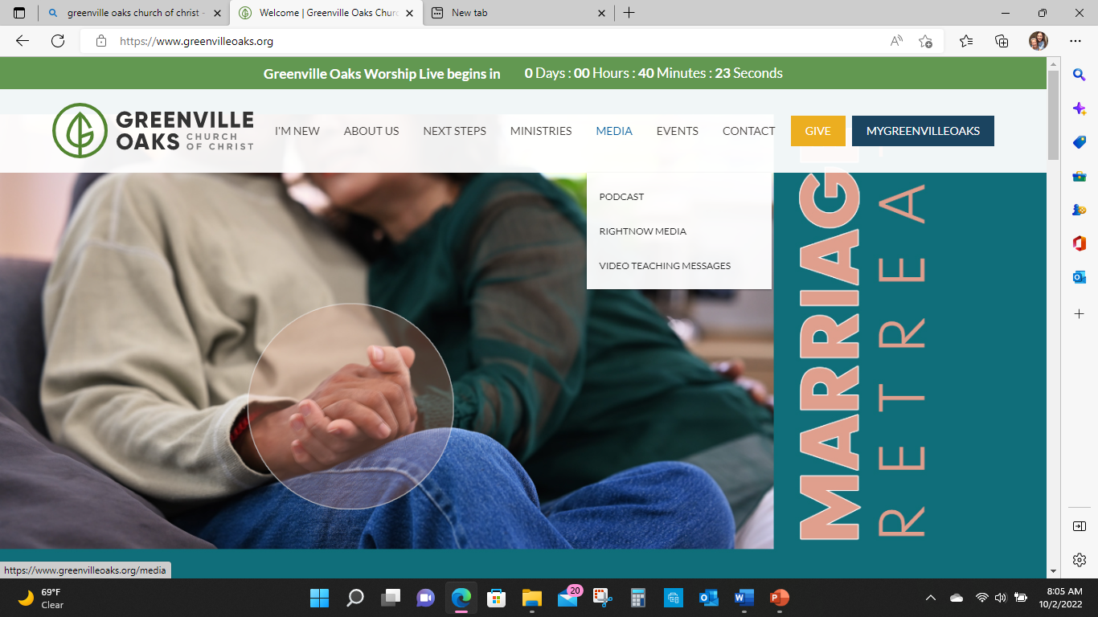

Slide 3
Jude 8
8 In the very same way,
These dreamers, Defile/corrupt human nature, reject (Yahweh's) authority,
and blaspheme (show no respect)
celestial beings.(glorious ones)

Slide 4
Jude 9
But when the archangel Michael, contending with the devil, was disputing about the body of Moses, he did not presume to pronounce a slanderous ^{judgment,}
but said, “The Lord rebuke you.“
¹⁰ However, these people slander whatever they do not understand, and the very things they do understand by instinct—as irrational animals do—will destroy them.

Slide 5
Michael Hierarchy of Angels
1 Thess 4 the Lord descends with a cry of command with the voice of an archangel
Revelation 12 Michael and his angels fight the dragon
Daniel 10, 13 Michael one of the chief princes
Daniel 8,9 Gabriel

Slide 6
Zechariah 1-2 ; 3
1Then the angel showed me Joshua the high priest standing before the (malak) angel Yahweh, with Satan standing at his right hand to accuse him.
2And then (angel) Yahweh said to Satan: “Yahweh rebukes you, Satan! Yahweh, who has chosen Jerusalem, rebukes you! Is not this man a firebrand snatched from the fire?”

Slide 7
Deuteronomy 34
Then Moses climbed Mount Nebo from the plains of Moab to the top of Pisgah, across from Jericho. There the LORD showed him the whole land—

Slide 8
Yahweh said to him, “This is the land that I swore to give Abraham, Isaac, and Jacob when I said, ‘I will give it to your descendants.’ I have let you see it with your own eyes, but you will not cross into it.”
5So Moses the servant of Yahweh died there in the land of Moab, as Yahweh had said. 6And He buried him in a valley in the land of Moab facing Beth-peor, and no one to this day knows the location of his grave.

Slide 9
Numbers 20 Moses
1In the first month, the whole congregation of Israel entered the Wilderness of Zin and stayed in Kadesh..
2Now there was no water for the congregation, so they gathered against Moses and Aaron. 3The people quarreled with Moses and said, “If only we had perished with our brothers before Yahweh!

Slide 10
Numbers 20
4Why have you brought Yahweh’s assembly into this wilderness for us and our livestock to die here? Why have you led us up out of Egypt to bring us to this wretched place? It is not a place of grain, figs, vines, or pomegranates—and there is no water to drink!”

Slide 11
Numbers 20
6Then Moses and Aaron went from the presence of the assembly to the entrance to the Tent of Meeting. They fell facedown, and the glory of Yahweh appeared to them.
And Yahweh said to Moses, “Take the staff and assemble the congregation. You and your brother Aaron are to speak to the rock while they watch, and it will pour out its water. You will bring out water from the rock and provide drink for the congregation and their livestock.”

Slide 12
Numbers 20
9 So Moses took the staff from Yahweh’s presence, just as he had been commanded. Then Moses and Aaron gathered the assembly in front of the rock, and Moses said to them, “Listen now, you rebels, must we bring you water out of this rock?”
Then Moses raised his hand and struck the rock twice with his staff, so that a great amount of water gushed out, and the congregation and their livestock were able to drink.

Slide 13
Numbers 20
12 Yahweh said to Moses and Aaron, “Because you did not honor Me, to show me as Holy (set apart) in the sight of the Israelites, you will not bring this assembly into the land that I have given them.”

Slide 14
Deuteronomy 32
49 Yahweh said to Moses “Go up into the Abarim Range to Mount Nebo in Moab, across from Jericho, and view Canaan, the land I am giving the Israelites as their own possession. There on the mountain that you have climbed you will die and be gathered to your people, just as your brother Aaron died on Mount Hor and was gathered to his people.

Slide 15
Deturonmy 32
51For both of you betrayed me with the Israelites at the waters of Meribah at Kadesh in the wilderness of Zin. You failed to demonstrate my holiness (set apart) to the people of Israel there.

Slide 16
Gensis 49
²⁹ Then Jacob gave them these instructions: “I am about to be gathered to my people. Bury me with my fathers in the cave in the field of Ephron the Hittite, ³⁰ the cave in the field of Machpelah, near Mamre in Canaan, which Abraham bought along with the field as a burial place from Ephron the Hittite. ³¹ There Abraham and his wife Sarah were buried, there Isaac and his wife Rebekah were buried, and there I buried Leah.

Slide 17
Genesis 50:22-26 Heb 11:22
²² So Joseph remained in Egypt, he and his father’s house. ²⁴ And Joseph said to his brothers, “I am about to die, but Yahweh will visit you and bring you up out of this land to the land that he swore to Abraham, to Isaac, and to Jacob.” ²⁵ Then Joseph made the sons of Israel swear, saying, “Yahweh will surely visit you, and you shall carry up my bones from here.” ²⁶ So Joseph died, being 110 years old. They embalmed him, and he was put in a coffin in Egypt.

Slide 18
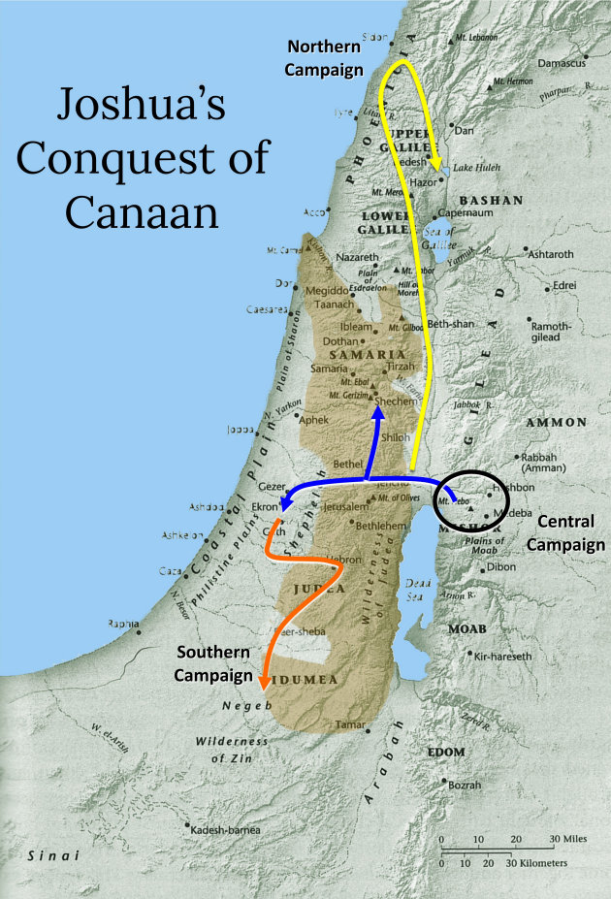

Slide 20
Trans Jordan Area
The geographical area that includes Oboth and Abarim in the Transjordan (Num 21; 33: Deut 32) was later associated with ancient cults of the dead and the netherworld.
Oboth means“spirits of the dead” Abarim means “those who have passed over [to the Netherworld].”

Slide 21
Trans Jordan Area
Ezekiel 38-39, Vision of Battle of Gog Magog “Valley of the Travelers [Oberim]” is “east of the sea”
Then those who dwell in the cities of Israel will go out, kindle fires, and burn up the weapons—the bucklers and shields, the bows and arrows, the clubs and spears.
For seven years they will use them for fuel. They will not gather wood from the countryside or cut it from the forests, for they will use the weapons for fuel. They will loot those who looted them and plunder those who plundered them, declares Yahweh.

Slide 22
Trans Jordan Area
11And on that day I will give Gog a burial, the Valley of the Travelers, east of the Sea
It will block those who travel through, because Gog and all his hordes will be buried there. So it will be called the Valley of Hamon-gog.
12For seven months the house of Israel will be burying them in order to cleanse the land. 13All the people of the land will bury them, and it will bring them renown on the day I display My glory, declares the Yahweh

Slide 24
Jude 9
But when the archangel Michael, contending with the devil, was disputing about the body of Moses, he did not presume to pronounce a blasphemous judgment,
but said, “The Lord rebuke you.“
¹⁰ Yet these people slander whatever they do not understand, and the very things they do understand by instinct—as irrational animals do—will destroy them.

