Slide 1
FULFILLING THE MISSION OF CHRIST

Slide 2
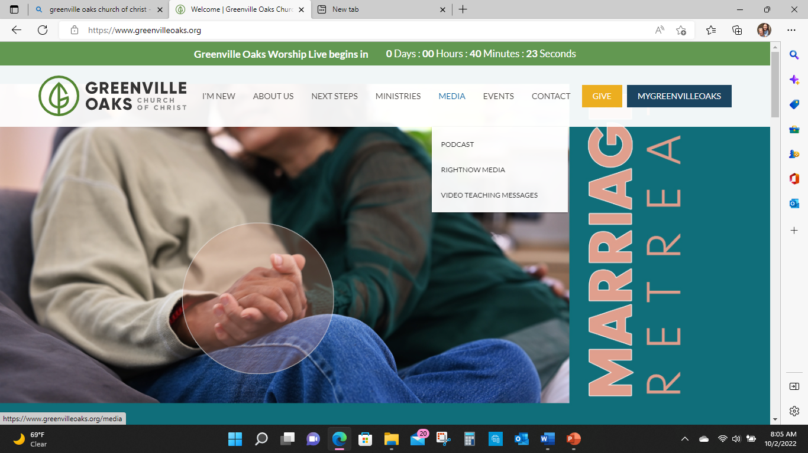

Slide 3
THE CHURCH
Community of Christ Followers
Fulfilling Christ’s Mission
Through Unity and Power of the Holy Spirit
To the Glory of God

Slide 4
Paul
The Fellowship of His Sufferings

Slide 5
Theological Motifs for Pauline Ethics
Eschatology (Parousia) / New Beginnings
The Cross
The New Community in Christ

Slide 6
Summary
Paul frames the church community within a divine cosmic paradigm shift in which suffering and joy will both be present until the Parousia (End Time).
The church community is the eschatological beachhead where the power of God has invaded the world.
The church community is to live faithfully between the times under Spirit’s control and moral discernment.

Slide 7
The Cross
“And when I came to you, brethren, I did not come with superiority of speech or of wisdom, proclaiming to you the testimony of God. For I determined to know nothing among you except Jesus Christ, and Him crucified. I was with you in weakness and in fear and in much trembling, and my message and my preaching were not in persuasive words of wisdom, but in demonstration of the Spirit and of power, so that your faith would not rest on the wisdom of men, but on the power of God.” (1 Corinthians 2:1-5)

Slide 8
The Cross
The cross had a variety of meanings for Paul:
The pivot point of the ages.
The place where Christ took upon himself “the curse of the law”.
The ultimate demonstration of God’s righteousness and God’s love.
The event in which God acted for the redemption of the world.
It is the mystery that confutes human wisdom and shames human power.

Slide 9
The Cross
“Grace to you and peace from God our Father and the Lord Jesus Christ, who gave Himself for our sins so that He might rescue us from this present evil age, according to the will of our God and Father, to whom be the glory forevermore. Amen” (Galatians 1:3-5)

Slide 10
Paradigm of Faith
The cross for Paul is a paradigm for the life of faith.
Believers incorporate the self-giving sacrifice of Christ into the community by serving one another.
“Bear one another’s burdens, and in this way you will fulfill the law of Christ.” (Galatians 6:2)

Slide 11
Paradigm of Faith
“But we who are strong ought to bear with the failings of the weak, and not just please ourselves. Let each of us please his neighbor for his good to build him up. For even Christ did not please himself, but just as it is written, “The insults of those who insult you have fallen on me.”” (Romans 15:1-3) (Psalm 69:9)

Slide 12
Paradigm of Faith
“Only conduct yourselves in a manner worthy of the gospel of Christ, so that whether I come and see you or remain absent, I will hear of you that you are standing firm in one spirit, with one mind striving together for the faith of the gospel; in no way alarmed by your opponents - which is a sign of destruction for them, but of salvation for you, and that too, from God. For to you it has been granted for Christ’s sake not only to believe in Him, but also to suffer for His sake, experiencing the same conflict which you saw in me, and now hear to be in me.” (Philippians 1:27-30)

Slide 13
A Life Of Fellowship
“Therefore, if there is any encouragement in Christ, any comfort provided by love, any fellowship in the Spirit, any affection or mercy, complete my joy and be of the same mind, by having the same love, being united in spirit, and having one purpose. Instead of being motivated by selfish ambition or vanity, each of you should, in humility, be moved to treat one another as more important than yourself. Each of you should be concerned not only about your own interests, but about the interests of others as well.” (Philippians 2:1-4)

Slide 14
Christian Hymn Pre-existence | Existence | Post-existence
“Let the same mind be in you that was in Christ Jesus, who, though he was in the form of God, did not regard equality with God as something to be exploited, but emptied himself, taking the form of a slave, being born in human likeness. And being found in human form, he humbled himself and became obedient to the point of death-even death on a cross. Therefore God also highly exalted him and gave him the name that is above every name, so that at the name of Jesus every knee should bend, in heaven and on earth and under the earth, and every tongue should confess that Jesus Christ is Lord, to the glory of God the Father.” (Philippians 2:5-11)

Slide 15
Christ’s Example
Christ’s obedience is offered to the Philippians as a pattern for their own obedience.
Just as Christ was obedient to death so should they stand firm in the gospel.
Just as He was humbled so should they humble themselves for the sake of others.
Christ becomes an example to illuminate the way of obedience.

Slide 16
Same Mind | Philippians 2:5
Let the same mind be in you that was in Christ Jesus (NRSV)
Have this mind among yourselves, which is yours in Christ Jesus (RSV)
Let this mind be in you, which was also in Christ Jesus (KJV)
Have this attitude in yourselves which was also in Christ Jesus (NASB)
In your relationships with one another, have the same mindset as Christ Jesus (NIV)

Slide 17
Paul’s Example
From head of the religious ranks to a disreputable traveling preacher writing to the Philippians from a prison cell.
“But whatever things were gain to me, those things I have counted as loss for the sake of Christ” (Philippians 3:7)
Paul’s hope is to share in Christ’s vindication at the Parousia.
“that I may know Him and the power of His resurrection and the fellowship of His sufferings, being conformed to His death; in order that I may attain to the resurrection from the dead.” (Philippians 3:10-11)

Slide 18
Paul’s Example
The koinonia of His sufferings is Paul’s picture of the life in Christ.
The community of believers are conformed to the death of Christ.
The cross becomes the ruling metaphor for obedience.
The resurrection is the sign of hope of a future vindication by God.
Paul’s message of suffering is incurred for ”the faith of the gospel” and through service to others.

Slide 19
Paul’s Example
Paul invites his readers to become fellow imitators of him and with him.
“You also became imitators of us and of the Lord, having received the word in much tribulation with the joy of the Holy Spirit, so that you became an example to all the believers in Macedonia and in Achaia.” (1 Thess 1:6-7)
Paul’s vision of a moral life are wrapped up in the themes of conformity of Christ’s death and the imitation of Christ.

Slide 20
Obedience of Faith
“Consequently, just as one trespass resulted in condemnation for all people, so also one righteous act resulted in justification and life for all people. For just as by the one man’s disobedience the many were made sinners, so by the one man’s obedience the many will be made righteous. For just as through the disobedience of the one man the many were made sinners, so also through the obedience of the one man the many will be made righteous” (Romans 5:18-19)

Slide 21
Obedience of Faith
The obedience of Jesus on the cross is the prototype for “the obedience of faith”.
The obedience of the one man (5:19) should be understood as a synonym for “the faith of Jesus Christ” (3:22) through which the righteousness of God is revealed.
God vindicated his own righteousness by putting forward Jesus, whose faithfulness in death atones for human sin/unfaithfulness and demonstrates God’s continuing faithfulness to his covenant promises.

Slide 22
Obedience of Faith
Jesus’ death is an act of faithfulness that simultaneously reconciles humanity to God and establishes a new reality in which we are set free from the power of sin, able to be conformed to the pattern of His life.
The faith of Jesus Christ becomes the animating force in our lives.
To be in Christ is to have one’s life conformed to the self-giving love enacted in the cross.

Slide 23
Obedience of Faith
“I have been crucified with Christ, and it is no longer I who live, but Christ lives in me. So the life I now live in the body, I live because of the faithfulness of the Son of God, who loved me and gave himself for me.” (Galatians 2:20)

Slide 24
Obedience of Faith
“But we have this treasure in clay jars, so that the extraordinary power belongs to God and does not come from us. We are experiencing trouble on every side, but are not crushed; we are perplexed, but not driven to despair; we are persecuted, but not abandoned; we are knocked down, but not destroyed, always carrying around in our body the death of Jesus, so that the life of Jesus may also be made visible in our body.” (2 Corinthians 4:7-10)

