Slide 1
Jude

Slide 2
REVERSING HERMON
Dr. Michael S Heiser

Slide 3
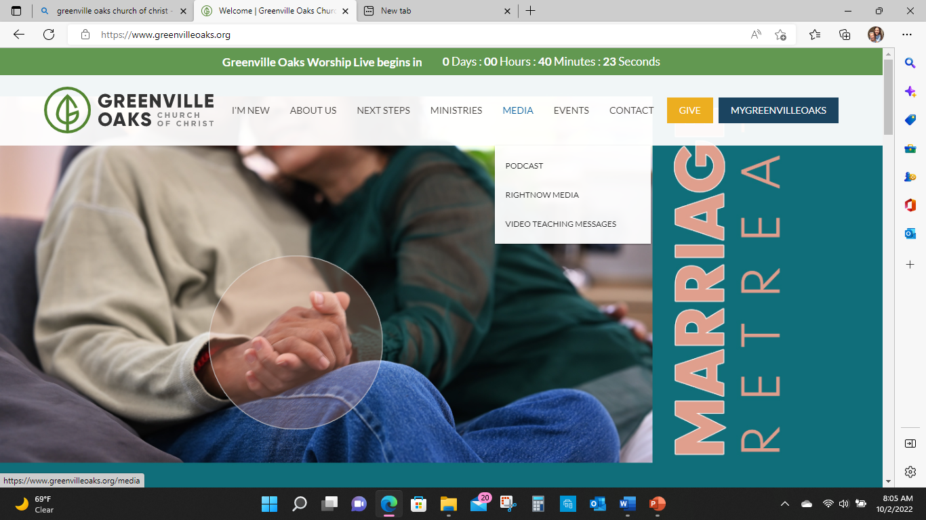

Slide 4
The Big Question
Why is the world in the situation we are in?!
Genesis 3: The Fall (Death)
Genesis 6: The Sin of The Watchers (Evil)
Genesis 11: The Tower of Babel (Chaos)

Slide 5
Jude 1-2
Jude, a servant of Jesus Christ and brother of James,
To those who are called, beloved in God the Father and kept for Jesus Christ:
May mercy, peace, and love be multiplied to you.

Slide 6
Jude 3
Beloved, although I was very eager to write to you about our common salvation, I found it necessary to write appealing to you to contend for the faith that was once for all delivered to the saints.

Slide 7
Jude 4
For certain people have crept in unnoticed who long ago were designated for this condemnation, ungodly people, who pervert the grace of our God into sensuality and deny our only Master and Lord, Jesus Christ.

Slide 8
Jude 5
Now I want to remind you, although you once fully knew it, that Jesus, who saved a people out of the land of Egypt, afterward destroyed those who did not believe.

Slide 9
Jude 6
And the angels who did not stay within their own position of authority, but left their proper dwelling, he (Jesus) has kept in eternal chains under gloomy darkness until the judgment of the great day-

Slide 10
Jude 7
-just as Sodom and Gomorrah and the surrounding cities, which likewise indulged in sexual immorality and pursued unnatural desire, serve as an example by undergoing a punishment of eternal fire.

Slide 11
Jude 8
Yet in like manner these people also, relying on their dreams, defile the flesh, reject authority, and blaspheme the glorious ones.

Slide 12
Non-Canonical Sources
Old Testament and New Testament authors used literature of the day as part of their inspirational writing.
Intertestamental non-canonical material was used by Second Temple Jews evidenced by findings of the Dead Sea Scrolls at Qumran.
The DSS were penned in the second century BC and used at least until the destruction of the second temple in 70AD.

Slide 13
Non-Canonical Sources
The Old Testament Apocrypha: Writings that make up part of the Old Testament Scripture of the Roman Catholic Church and Eastern Orthodox Church. During the Protestant Reformation, Martin Luther believed the Apocrypha “are not considered equal to the Holy Scriptures but are useful and good to read”. Most Protestant denominations agreed and followed Luther’s position.

Slide 14
Non-Canonical Sources
Pseudepigrapha: The practice of producing written works and then assigning their authorship to someone other than the real author. The practice was common in the ancient world. The biblical figure Enoch did not write 1 Enoch.
Canonical books named after biblical figures for which no evidence exists that their namesake did any of the writing include Job, 1 and 2 Samuel, and Joshua.

Slide 15
Non-Canonical Examples
1 Enoch (The Ethiopic Book of Enoch)
Assumption of Moses
The Wisdom of Solomon
Four Books of The Maccabees
The Book of Jubilees
Psalms of Solomon
The Book of Baruch
The Book of Tobit

Slide 16
Enoch | Genesis 5
The son of Jared (18)
The father of Methuselah (21)
”Walked with God” 300 years (22)
Lived 365 years and then was “not” (24)
The great grandfather of Noah (30)
The 7th from Adam (Genesis 4 tie to Jude 14)

Slide 17
Enoch |Hebrews 11:5
By faith Enoch was taken up so that he should not see death, and he was not found, because God had taken him. Now before he was taken he was commended as having pleased God.

Slide 18
Genesis 6:1-3
When man began to multiply on the face of the land and daughters were born to them, the sons of God saw that the daughters of man were attractive. And they took as their wives any they chose. Then God said, “My Spirit shall not abide in man forever, for he is flesh: his days shall be 120 years.”

Slide 19
Genesis 6:4
The Nephilim (giants) were on the earth in those days, and also afterward, when the sons of God came in to the daughters of man and they bore children to them. These were the mighty men who were of old, the men of renown.

Slide 20
Genesis 6:5-7
Yahweh saw that the wickedness of man was great in the earth, and that every intention of the thoughts of his heart was only evil continually. And Yahweh regretted that He had made man on the earth, and it grieved Him to His heart. So Yahweh said, “I will blot out man whom I have created from the face of the land, man and animals and creeping things and birds of the heavens, for I am sorry that I have made them.

Slide 21
Sethite Interpretation of Genesis 6:1-4
Refuses to take the passage at face value.
Predominant approach to explain the passage.
States the passage describes forbidden intermarriage between the godly men of Seth and the ungodly women of Cain.
The line of Seth was to remain pure and separate from the evil lineage of Cain.
Part of rational is Genesis 4:26 “Then men began to call upon the name of the Lord”.

Slide 22
Sethite Interpretation Flaws
Genesis 4:26 never states that the only people who “called on the name of the Lord” were men from Seth’s lineage.
The view fails to explain the Nephilim.
The text never calls the women in the episode “daughters of Cain” rather they are “daughters of humankind”.
There is no command in the text regarding marriages or prohibition against marrying certain persons.
Nothing in the passage or anywhere else in the Bible identifies people who come from Seth’s lineage with the descriptive phrase “sons of God”.
Did not show up until the late 200’s AD.

Slide 23
The Story of The Sin of The Watchers 1 Enoch 6-16
In the days of Jared, two hundred angels under the leadership of Šemiḥazah and ʿAśzazel, filled with lust for the beautiful daughters of men, descended on Mount Hermon and took human women as wives.
Their children, the Nephilim (giants), ravaged the earth, and the fallen angels taught men forbidden knowledge and all kinds of sin.

Slide 24
The Story of The Sin of The Watchers 1 Enoch 6-16
The fallen angels were therefore responsible for the total corruption of the world on account of which God sent the Flood.
The Watchers (sons of God) were punished by being bound under the earth until the Day of Judgment, when they will be cast into Gehenna.

Slide 25
1 Enoch 10:4-6
And again the Lord said to Raphael: ‘Bind Azazel hand and foot, and cast him into the darkness and split open the desert, which is the Dudael, and cast him in. And fill the hole by covering him with rough and jagged rocks, and cover him with darkness, and let him live there forever, and cover his face that he may not see the light. And on the day of the great judgment he shall be hurled into the fire.

Slide 26
1 Enoch 10:7-8
And heal the earth which the angels have ruined, and proclaim the healing of the earth, for I will restore the earth and heal the plague, that not all of the children of men may perish through all the secret things that the Watchers have disclosed and have taught their sons. The whole earth has been corrupted through the works that were taught by Azazel: to him ascribe ALL SIN.

Slide 27
1 Enoch 10:9-10
To Gabriel said the Lord: ‘Proceed against the bastards and the reprobates, and against the children of fornication and destroy the children of fornication and the children of the Watchers. Cause them to go against one another that they may destroy each other in battle. Shorten their days. No request that (the Watchers) their fathers make of you shall be granted them on their behalf; for they hope to live an eternal life, and that each one of them will live five hundred years.’

Slide 28
1 Enoch 10:11-12
And the Lord said to Michael: ‘Go, bind Semjaza and his team who have associated with women and have defiled themselves in all their uncleanness. When their sons have slain one another, and they have seen the destruction of their beloved ones, bind them fast for seventy generations under the hills of the earth, until the day of the consummation of their judgement and until the eternal judgments is accomplished.

Slide 29
1 Enoch 15:8-9
And now, the giants, who are produced from the spirits and the flesh, shall be called evil spirits on the earth, and shall live on the earth. Evil spirits have come out from their bodies because they are born from men and from the holy Watchers; their beginning is of primal origin;

Slide 30
1 Enoch 15:10-12
They shall be evil spirits on earth, and evil spirits shall they be called. And the spirits of the giants afflict, oppress, destroy, attack, do battle, and work destruction on the earth. They take no food, but nevertheless hunger and thirst and cause offences. And these Spirits shall rise up against the children of men and against the women, because they have proceeded from them.

Slide 31
Back to Jude
Jude used the judgment of the Watchers as a parallel type to the false teachers he is writing about.

Slide 32
The Sin of The Watchers / sons of God )
There is a direct relationship between the “sons of God” choosing to leave heaven and their vocation assigned by Yahweh to come to earth and corrupt humanity by turning the hearts of humans against God and His will for humankind.
This is why Jude thinks it’s a good analogy to compare the angels that sinned to the false teachers. Because the angels that sinned taught false teaching.

Slide 33
Jude 6 )
And the angels who did not stay within their own position of authority, but left their proper dwelling, he has kept in eternal chains under gloomy darkness until the judgment of the great day.
Leaving home and rejecting authority demonstrates a desire for autonomy.
The angels that sinned blaspheme God and diminished the loyalty of the rest of the heavenly host.

Slide 34
2 Peter 2:1 )
But false prophets also arose among the people, just as there will be false teachers among you, who will secretly bring in destructive heresies, even denying the Master who bought them, bringing upon themselves swift destruction.

Slide 35
2 Peter 2:2-3)
And many will follow their sensuality, and because of them the way of truth will be blasphemed. And in their greed they will exploit you with false words. Their condemnation from long ago is not idle, and their destruction is not asleep.

Slide 36
2 Peter 2:4-5 )
For if God did not spare angels when they sinned, but cast them into hell and committed them to chains of gloomy darkness to be kept until the judgment; if he did not spare the ancient world, but preserved Noah, a herald of righteousness, with seven others, when he brought a flood upon the world of the ungodly;

Slide 37
2 Peter 2:6-8)
if by turning the cities of Sodom and Gomorrah to ashes he condemned them to extinction, making them an example of what is going to happen to the ungodly; and if he rescued righteous Lot, greatly distressed by the sensual conduct of the wicked (for as that righteous man lived among them day after day; he was tormenting his righteous soul over their lawless deeds that he saw and heard);

Slide 38
2 Peter 2:9-10 )
then the Lord knows how to rescue the godly from trials, and to keep the unrighteous under punishment until the day of judgment, and especially those who indulge in the lust of defiling passion and despise authority.

Slide 39
1 Cor 11:4-6
Every man who prays or prophesies with his head covered dishonors his head. And every woman who prays or prophesies with her head uncovered dishonors her head, for it is just as if her head were shaved. If a woman does not cover her head, she should have her hair cut off. And if it is shameful for a woman to have her hair cut or shaved off, she should cover her head.

Slide 40
1 Cor 11:7-10
A man ought not to cover his head, since he is the image and glory of God; but the woman is the glory of man. For man did not come from woman, but woman from man. Neither was man created for woman, but woman for man. For this reason a woman ought to have a sign of authority on her head, because of the angels.

Slide 41
1 Peter 3:18-20
For Christ also suffered once for sins, the righteous for the unrighteous, that he might bring us to God, being put to death in the flesh but made alive in the spirit, in which he went and proclaimed to the spirits in prison, because they formerly did not obey, when God’s patience waited in the days of Noah, while the ark was being prepared, in which a few, that is, eight persons, were brought safely through water.

Slide 42
1 Peter 3:21-22
Baptism, which corresponds to this, now saves you, not as a removal of dirt from the body but as an appeal to God for a good conscience, through the resurrection of Jesus Christ, who has gone into heaven and is at the right hand of God, with angels, authorities, and powers having been subjected to him.
Baptism proclaims our believing loyalty allegiance to Yahweh for all heaven and earth to witness.

Slide 43
Jude 6-7
And the angels who did not stay within their own position of authority, but left their proper dwelling, he (Jesus) has kept in eternal chains under gloomy darkness until the judgment of the great day.
-just as Sodom and Gomorrah and the surrounding cities, which likewise indulged in sexual immorality and pursued unnatural desire (different/strange flesh), serve as an example by undergoing a punishment of eternal fire.

Slide 44
Sodom and Gomorrah
Genesis 18:1-15 | Yahweh appears to Abraham and promises a son and that all the nations will be blessed through Abraham.
Genesis 18:16-33 | Yahweh is heading down to Sodom and Gomorrah to check out the outcry due to ”exceedingly grave sin”. Abraham negotiates with Yahweh to save Lots family.

Slide 45
Sodom and Gomorrah
Genesis 19:1-29
Two angels appear to Lot at the Sodom gate.
Lot begs them to come to his house.
The men of the city surround the house calling for the two male visitors to have sex with them.
Lot offers his young daughters in lieu of his guests.
The men of the city refuse but the angels rescue Lot.

Slide 46
Sodom and Gomorrah
Genesis 19:1-29
The angels escort Lot, his wife and two daughters out of town.
Lot’s wife disobeys the angels, turns around to look while the town is being toasted, and turns to salt.
Sodom, Gomorrah and all surrounding towns in the valley are destroyed except for Zoar at Lot’s request.

Slide 47
Sodom and Gomorrah
Was homosexuality the “exceedingly grave sin”?
The reader knows the visitors are angels but none of the people in the plot do, including Lot.
There is the added element of threatened rape to Lot’s guests and violation of his hospitality?
The text also indicates the whole town is part of the violation.
No doubt the violation has a sexual element but is that all?

Slide 48
Back to Jude
Jude ties the sin of the angels in verse six to the sin of the inhabitants of Sodom in verse seven.
Both the angels and the Sodomites left their natural order of things.
The angels left their proper dwelling and engaged in sexual relations with humans.
The Sodomites did the opposite by leaving their proper place and tried to have sex with angels.
The sexual aspect of the sin is the vehicle by which both violated the order established by God.

Slide 49
Back to Jude
The inhabitants of Sodom did not know the visitors were angels but the readers of Jude know the whole backstory.
Jude then ties the sin of the angels and the sin of the Sodomites to the sin of the false teachers he is addressing in his letter.

Slide 50
Jude 8
Yet in like manner these people also, relying on their dreams, defile the flesh, reject authority, and blaspheme the glorious ones.
Jude’s audience got it!
Most modern day Christians have not!

