Slide 1
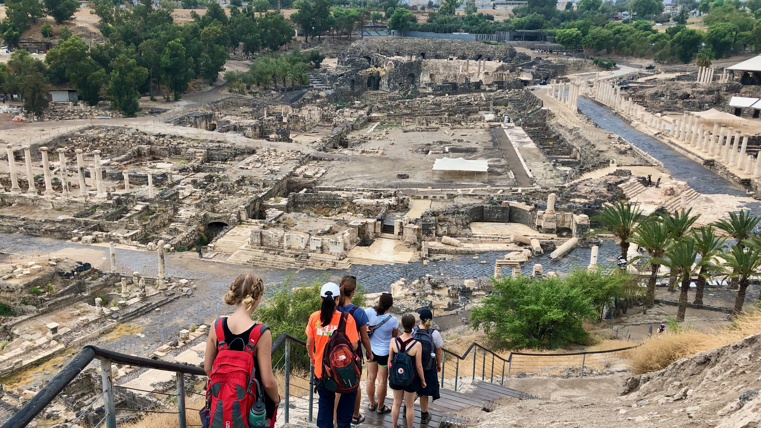
Ancient Insights
The Cultural Context of Jesus’s Teachings

Slide 2
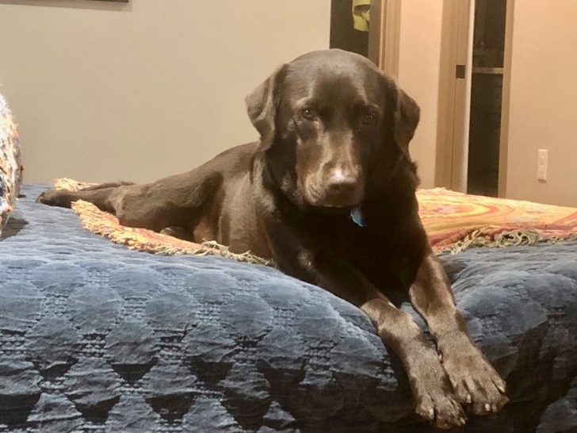
About Me

Slide 3
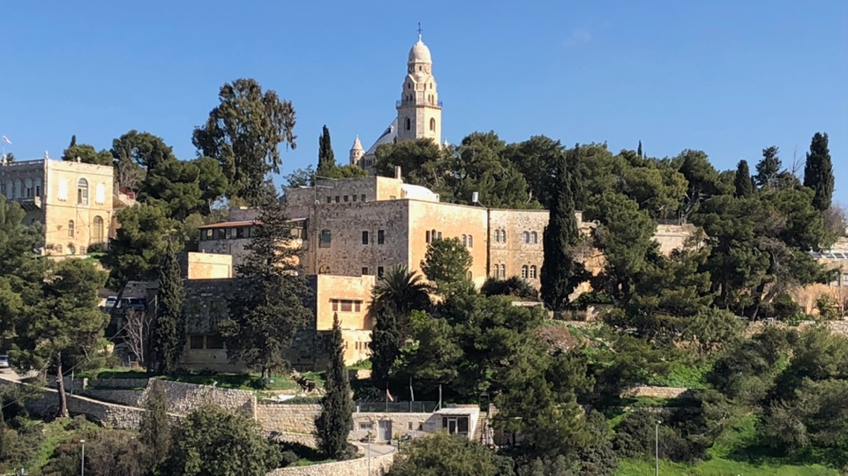
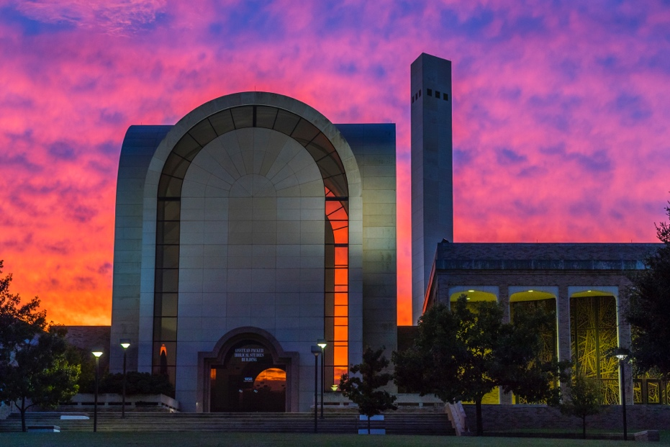
About Me
Jerusalem University College
ACU
Biblical History & Geography
MA, Old Testament
SMU
Master of Theology (ThM)
PhD Hebrew Bible/Old Testament (present)

Slide 4
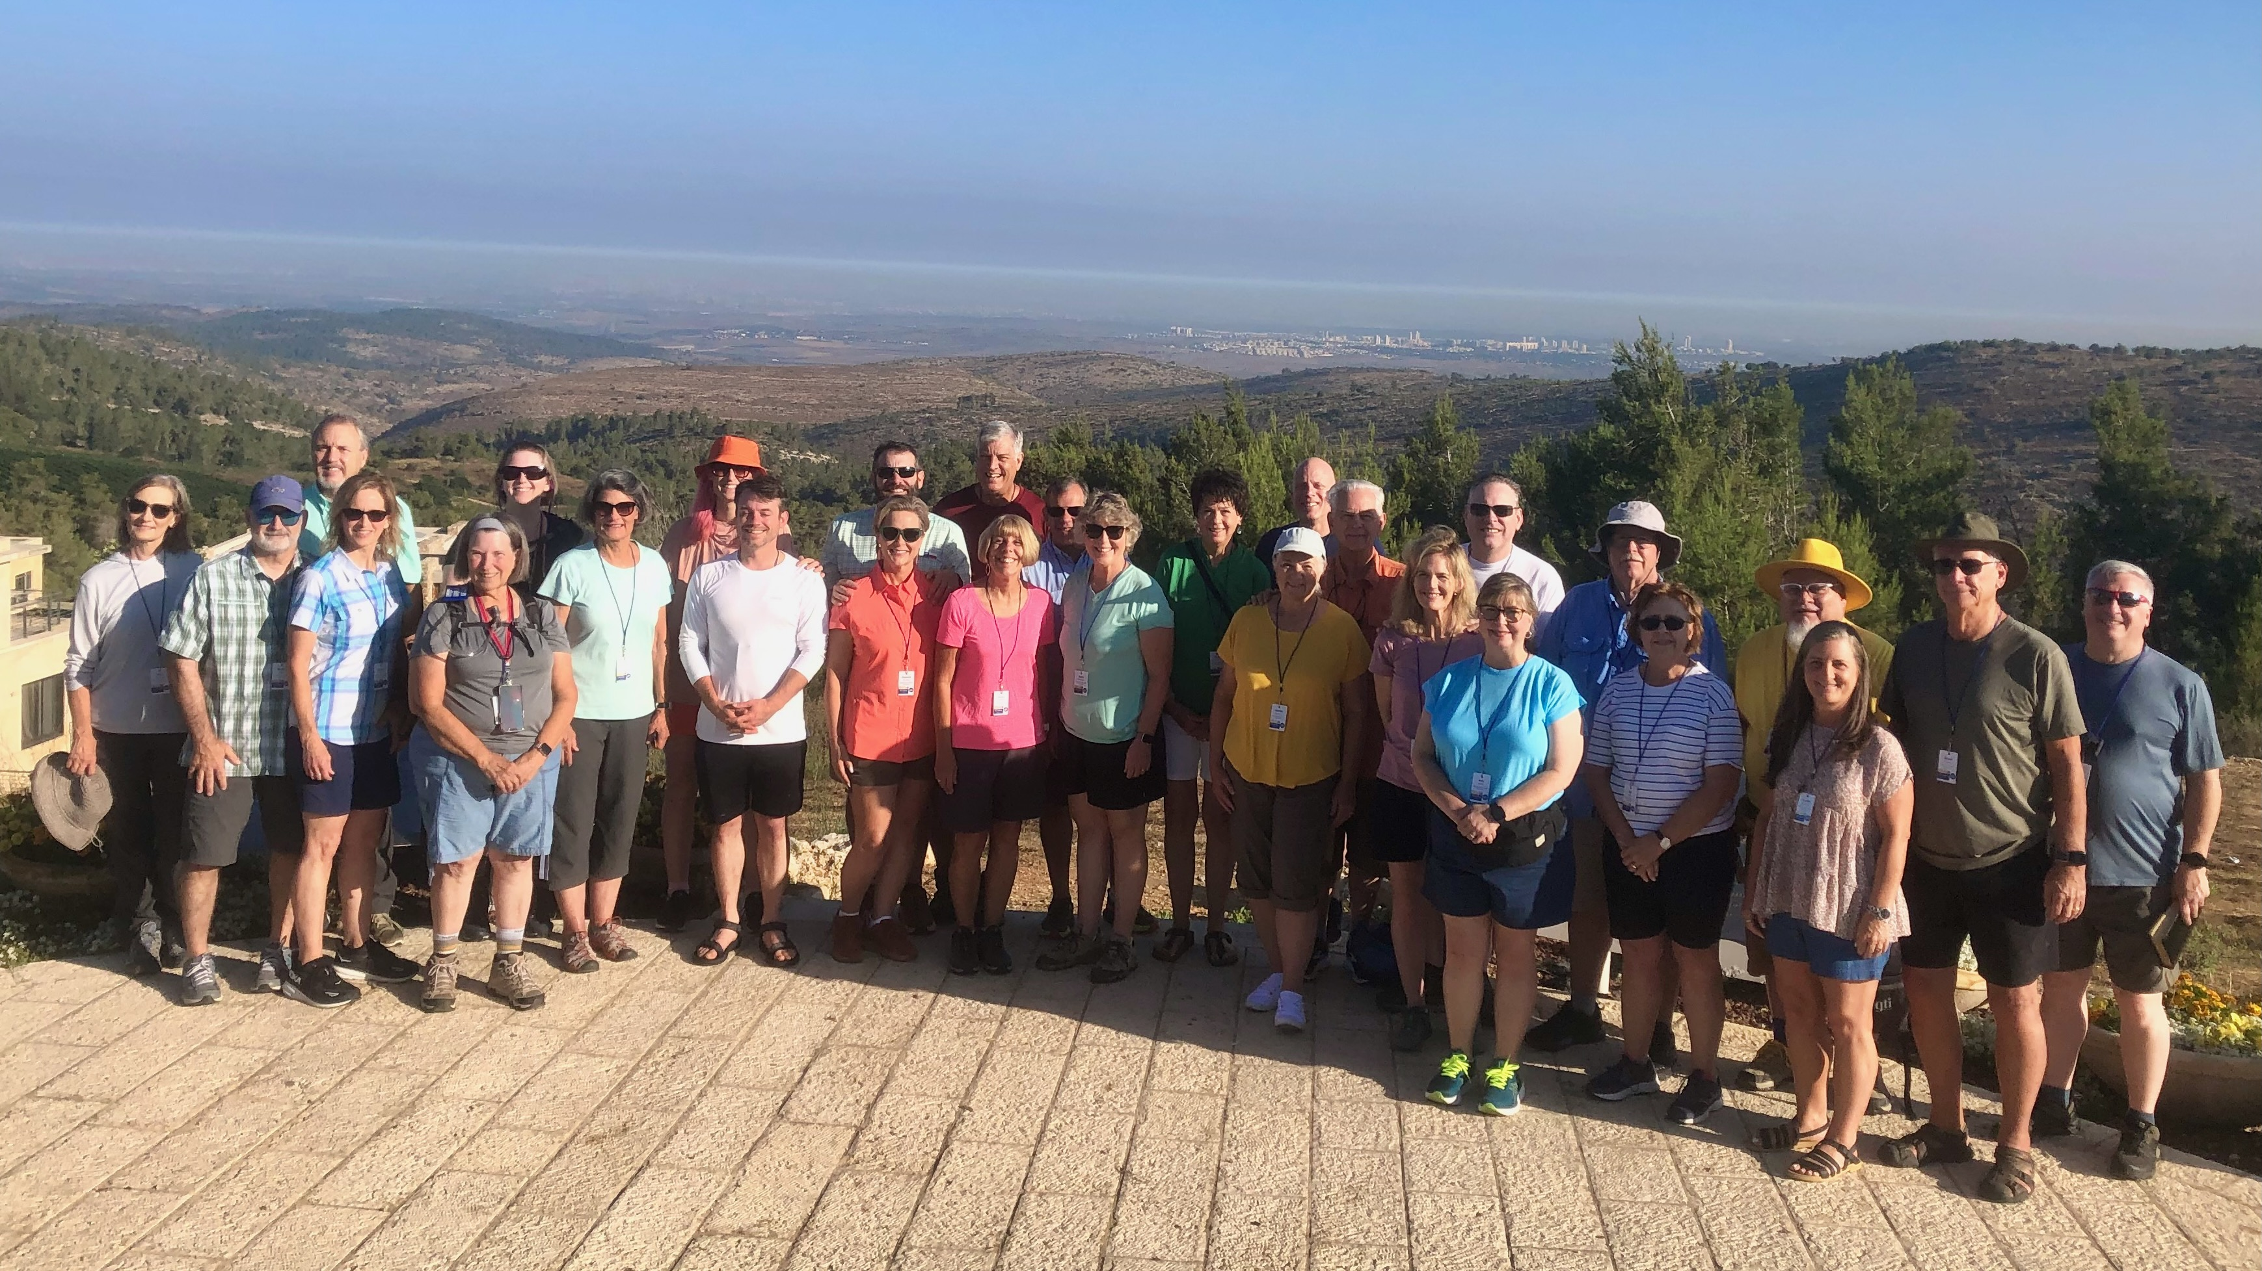
Israel Study Tour

Slide 5
Objective and Method
70 Faces of Scripture
Different lenses reveal different insights.
The teachings of Jesus in the Gospels reflect the “culture of the day.”
Our Lens: Examine the culture of the Second Temple Period to shed light on Jesus’s teachings.

Slide 6
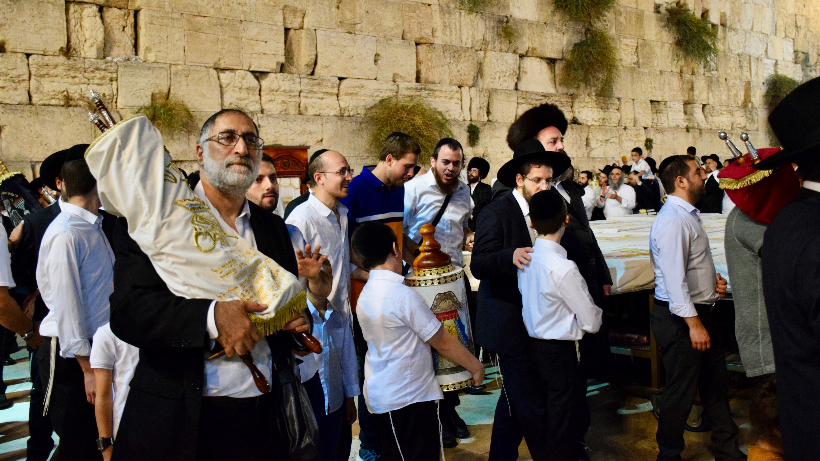
Jewish Groups and Sects

Slide 7
A Thought Experiment

Slide 8
What Would You Do?
Go Underground
Go Along
Peaceful Protest/Approval
Fight Back
Move Away

Slide 9
What Do You Believe?
What Determines the course of human history?
Free
Will
A Mix
God
Sadducees
Pharisees
Essenes

Slide 10
Where Does Jesus Fit?
Jesus’s Teachings align most closely with the Pharisees.

Slide 11
The Criticism of an Insider
Then Jesus said to the crowds and to his disciples, “The scribes and the Pharisees sit on Moses’ seat; therefore, do whatever they teach you and follow it; but do not do as they do, for they do not practice what they teach.
Matt 23:1–3 (NRSV)

Slide 12
A Possible Clue?
Now they had been sent from the Pharisees. They asked him, “Why then are you baptizing if you are neither the Messiah, nor Elijah, nor the prophet?” John answered them, “I baptize with water. Among you stands one whom you do not know, the one who is coming after me; I am not worthy to untie the thong of his sandal.” This took place in Bethany across the Jordan where John was baptizing.
John 1:24–28 (NRSV)

Slide 13
A “Fun” Example

Slide 14
Water from The Rock
Moses brings water from a rock twice
Exod. 17:6 and Num. 20:8-11
Early and Late in the Wilderness Wandering

Slide 15
Rabbis asked:
How did they get water the rest of the time?

Slide 16
Rabbinic Answer:
It was the same rock.
They took it with them.
Text says: “The Rock”, not “A Rock”
Known as “Miriam’s Well”

Slide 17
Sounds Crazy?
1 Cor. 10:1-4
Moreover, brethren, I do not want you to be unaware that all our fathers were under the cloud, all passed through the sea, all were baptized into Moses in the cloud and in the sea, all ate the same spiritual food, and all drank the same spiritual drink. For they drank of that spiritual Rock that followed them, and that Rock was Christ.

Slide 18
Summary
The lens(es) we use to examine Scripture helps us to gain new insights from the Bible.
While we cannot fully uncover the ancient cultural context(s), of the biblical writers, seeking out the ancient culture can help us better understand the text.

Slide 19
Next Week
What is the Greatest Commandment?
Read Mark 12:28–34; Matt 22:34–40

