Slide 1
Ancient Insights
The Cultural Context of Jesus’s Teachings

Slide 2
Objective and Method
70 Faces of Scripture
Different lenses reveal different insights.
The teachings of Jesus in the Gospels reflect the “culture of the day.”
Our Lens: Examine the culture of the Second Temple Period to shed light on Jesus’s teachings.

Slide 3
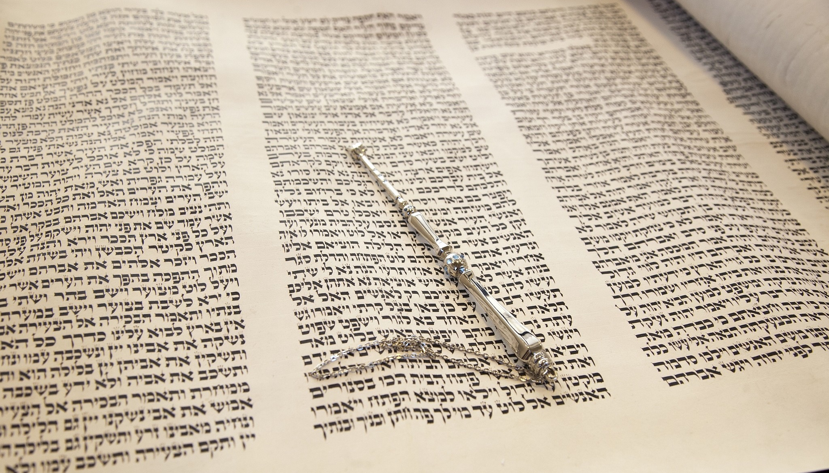
The Greatest Commandment

Slide 4
Our Roadmap
The Torah and its commandments
Jewish interpretive techniques
How do we interpret Scripture?
How did some Jews interpret Scripture?
How Jesus applies these principles.
What is the Greatest Commandment?

Slide 5
A Few Words About Torah
Torah = “Teaching” or “Instruction”
“Law” is an incomplete translation.
Genesis - Deuteronomy
NOT Israel’s legal code
Torah is a gift to Israel as part of the Covenant.

Slide 6
A Few Words About Torah
613 Commandments in the Torah.
How do you handle possible conflicts between commandments?

Slide 7
Possible Conflicts
Can you lie to save a life?
Can you bow to another god to save your life?
Can you heal on the Sabbath?

Slide 8
Ranked Order
Love the LORD Your God... (Deut 6:4–9).
Up For Debate
613. Don’t take a mother bird off her nest (Deut. 22:6).

Slide 9
Jewish Interpretive Methods
(Hermeneutics)

Slide 10
How Do We Interpret Scripture?
What rules do we use? What limits do we set?
Hermeneutics
The lenses we use to find (authoritative) meaning.
Philo: Scripture as 3 meanings
Literal
Typological
Allegorical

Slide 11
Do Churches of Christ have a Hermeneutic?

Slide 12
Church of Christ Hermeneutics
Direct Command
Specific Example
Necessary Inference
“Speak where the Bible speaks; be silent where the Bible is silent.”

Slide 13
One of my Classes this Fall
Hermeneutical Developments in Hebrew Bible Studies
Topics:
Feminist Hermeneutics
Disability Hermeneutics
Liberationist Hermeneutics
Post-Colonial Hermeneutics
Minoritizing Hermeneutics
Queer Hermeneutics
Womanist Hermeneutics
Visual Hermeneutics

Slide 14
How Did Jews in the 1st Century Interpret Scripture?

Slide 15
CAUTION!!
Our information comes from ~200 CE.
The information is from a single branch of Judaism: Rabbinic Judaism.
Successors to the Pharisees
No info from Sadducees, Zealots, or many other groups.
No information from the “common” people.
We must avoid generalizations!

Slide 16
Rabbinic Interpretive Methods
Middot = Interpretive Rules (Hermeneutics)
Midrash = “Seeking Out” (Interpretation)
Halakah = Commandments/Legal Matters
Aggadah = Non-legal, Narrative Material
Scripture may have many different meanings, but it can’t mean anything you want it to mean.
They set boundaries on how to interpret scripture.

Slide 17
Middot (Interpretive Rules)
Hillel’s 7 Middot
R. Ishmael’s 13 Middot
R. Eliezer ben Jose ha-Galili’s 37 Middot

Slide 18
Hillel’s 7 Interpretive Rules
Qal wa-homer = “Light to Heavy”
“If (x)...then how much more (y)...”
Is there anyone among you who, if your child asks for bread, will give a stone? Or if the child asks for a fish, will give a snake? If you then, who are evil, know how to give good gifts to your children, how much more will your Father in heaven give good things to those who ask him!
Matt 7:9–11 (NRSV)

Slide 19
Hillel’s 7 Interpretive Rules
Qal wa-homer = “Light to Heavy”
“If (x)...then how much more (y)...”
Gezerah Shawa ≈ “The Same Expression”

Slide 20
Gezerah Shawa
When two texts use identical phrases, they have identical meaning.
Applies only to Torah passages.
Applies only to legal matters (Halakah).

Slide 21
The Greatest Commandment

Slide 22
One of the scribes came near and heard them disputing with one another, and seeing that he answered them well, he asked him, “Which commandment is the first of all?” Jesus answered, “The first is, ‘Hear, O Israel: the Lord our God, the Lord is one; you shall love the Lord your God with all your heart, and with all your soul, and with all your mind, and with all your strength.’ The second is this, ‘You shall love your neighbor as yourself.’ There is no other commandment greater than these.” Then the scribe said to him, “You are right, Teacher; you have truly said that ‘he is one, and besides him there is no other’; and ‘to love him with all the heart, and with all the understanding, and with all the strength,’ and ‘to love one’s neighbor as oneself,’—this is much more important than all whole burnt offerings and sacrifices.” When Jesus saw that he answered wisely, he said to him, “You are not far from the kingdom of God.” After that no one dared to ask him any question.
Mark 12:28–34

Slide 23
What’s the Real Issue?
Did people disagree on #1?
The issue is probably how do you order the commandments?
Possibly: What’s #2?

Slide 24
One of the scribes came near and heard them disputing with one another, and seeing that he answered them well, he asked him, “Which commandment is the first of all?” Jesus answered, “The first is, ‘Hear, O Israel: the Lord our God, the Lord is one; you shall love the Lord your God with all your heart, and with all your soul, and with all your mind, and with all your strength.’ The second is this, ‘You shall love your neighbor as yourself.’ There is no other commandment greater than these.” Then the scribe said to him, “You are right, Teacher; you have truly said that ‘he is one, and besides him there is no other’; and ‘to love him with all the heart, and with all the understanding, and with all the strength,’ and ‘to love one’s neighbor as oneself,’—this is much more important than all whole burnt offerings and sacrifices.” When Jesus saw that he answered wisely, he said to him, “You are not far from the kingdom of God.” After that no one dared to ask him any question.
Mark 12:28–34

Slide 25
Jesus’s Interpretive Technique
“And you shall love” (ve-ahavta) appears in two contexts in the Torah.
“And you shall love the LORD your God...” (Deut 6:4).
“And you shall love your neighbor as yourself” (Lev 19:18).
Jesus uses the Gezerah Shawa intrepretive rule.

Slide 26
What does this mean?
Loving your neighbor = Loving God
You demonstrate your love for God by how you love your neighbor.
The second is this, ‘You shall love your neighbor as yourself.’ There is no other commandment greater than these.”

Slide 27
What’s the next logical question?
Who is my neighbor?
Luke 10:25–37

Slide 28
Another Interpretation
You shall love your neighbor as yourself.
You shall love your neighbor who is just like you.

Slide 29
Summary
We all use lenses/rules to interpret Scripture.
Often we don’t articulate the rules we apply.
Jesus makes use of the accepted interpretive practices of his day to teach and interpret Scripture.
How you show love to your neighbor is a practical demonstration of how you love God.
Remember, you are no different from your neighbor.

Slide 30
Next Week
Jesus uses current events.
Read Luke 19:11–27; Matt 17:14–20

