Slide 1
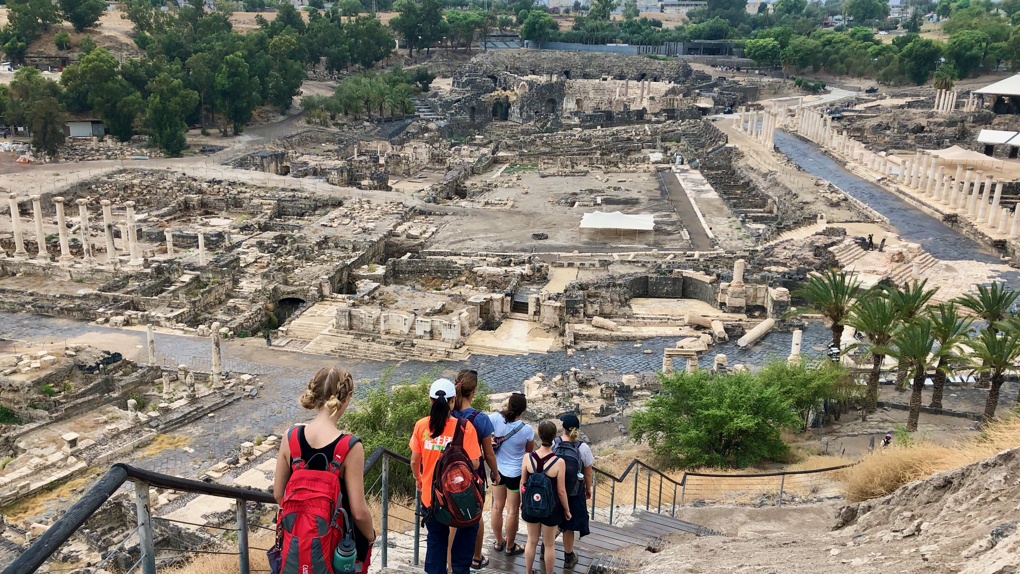
Ancient Insights
The Cultural Context of Jesus’s Teachings

Slide 2
Objective and Method
70 Faces of Scripture
Different lenses reveal different insights.
The teachings of Jesus in the Gospels reflect the “culture of the day.”
Our Lens: Examine the culture of the Second Temple Period to shed light on Jesus’s teachings.

Slide 3
Jesus and Current Events

Slide 4
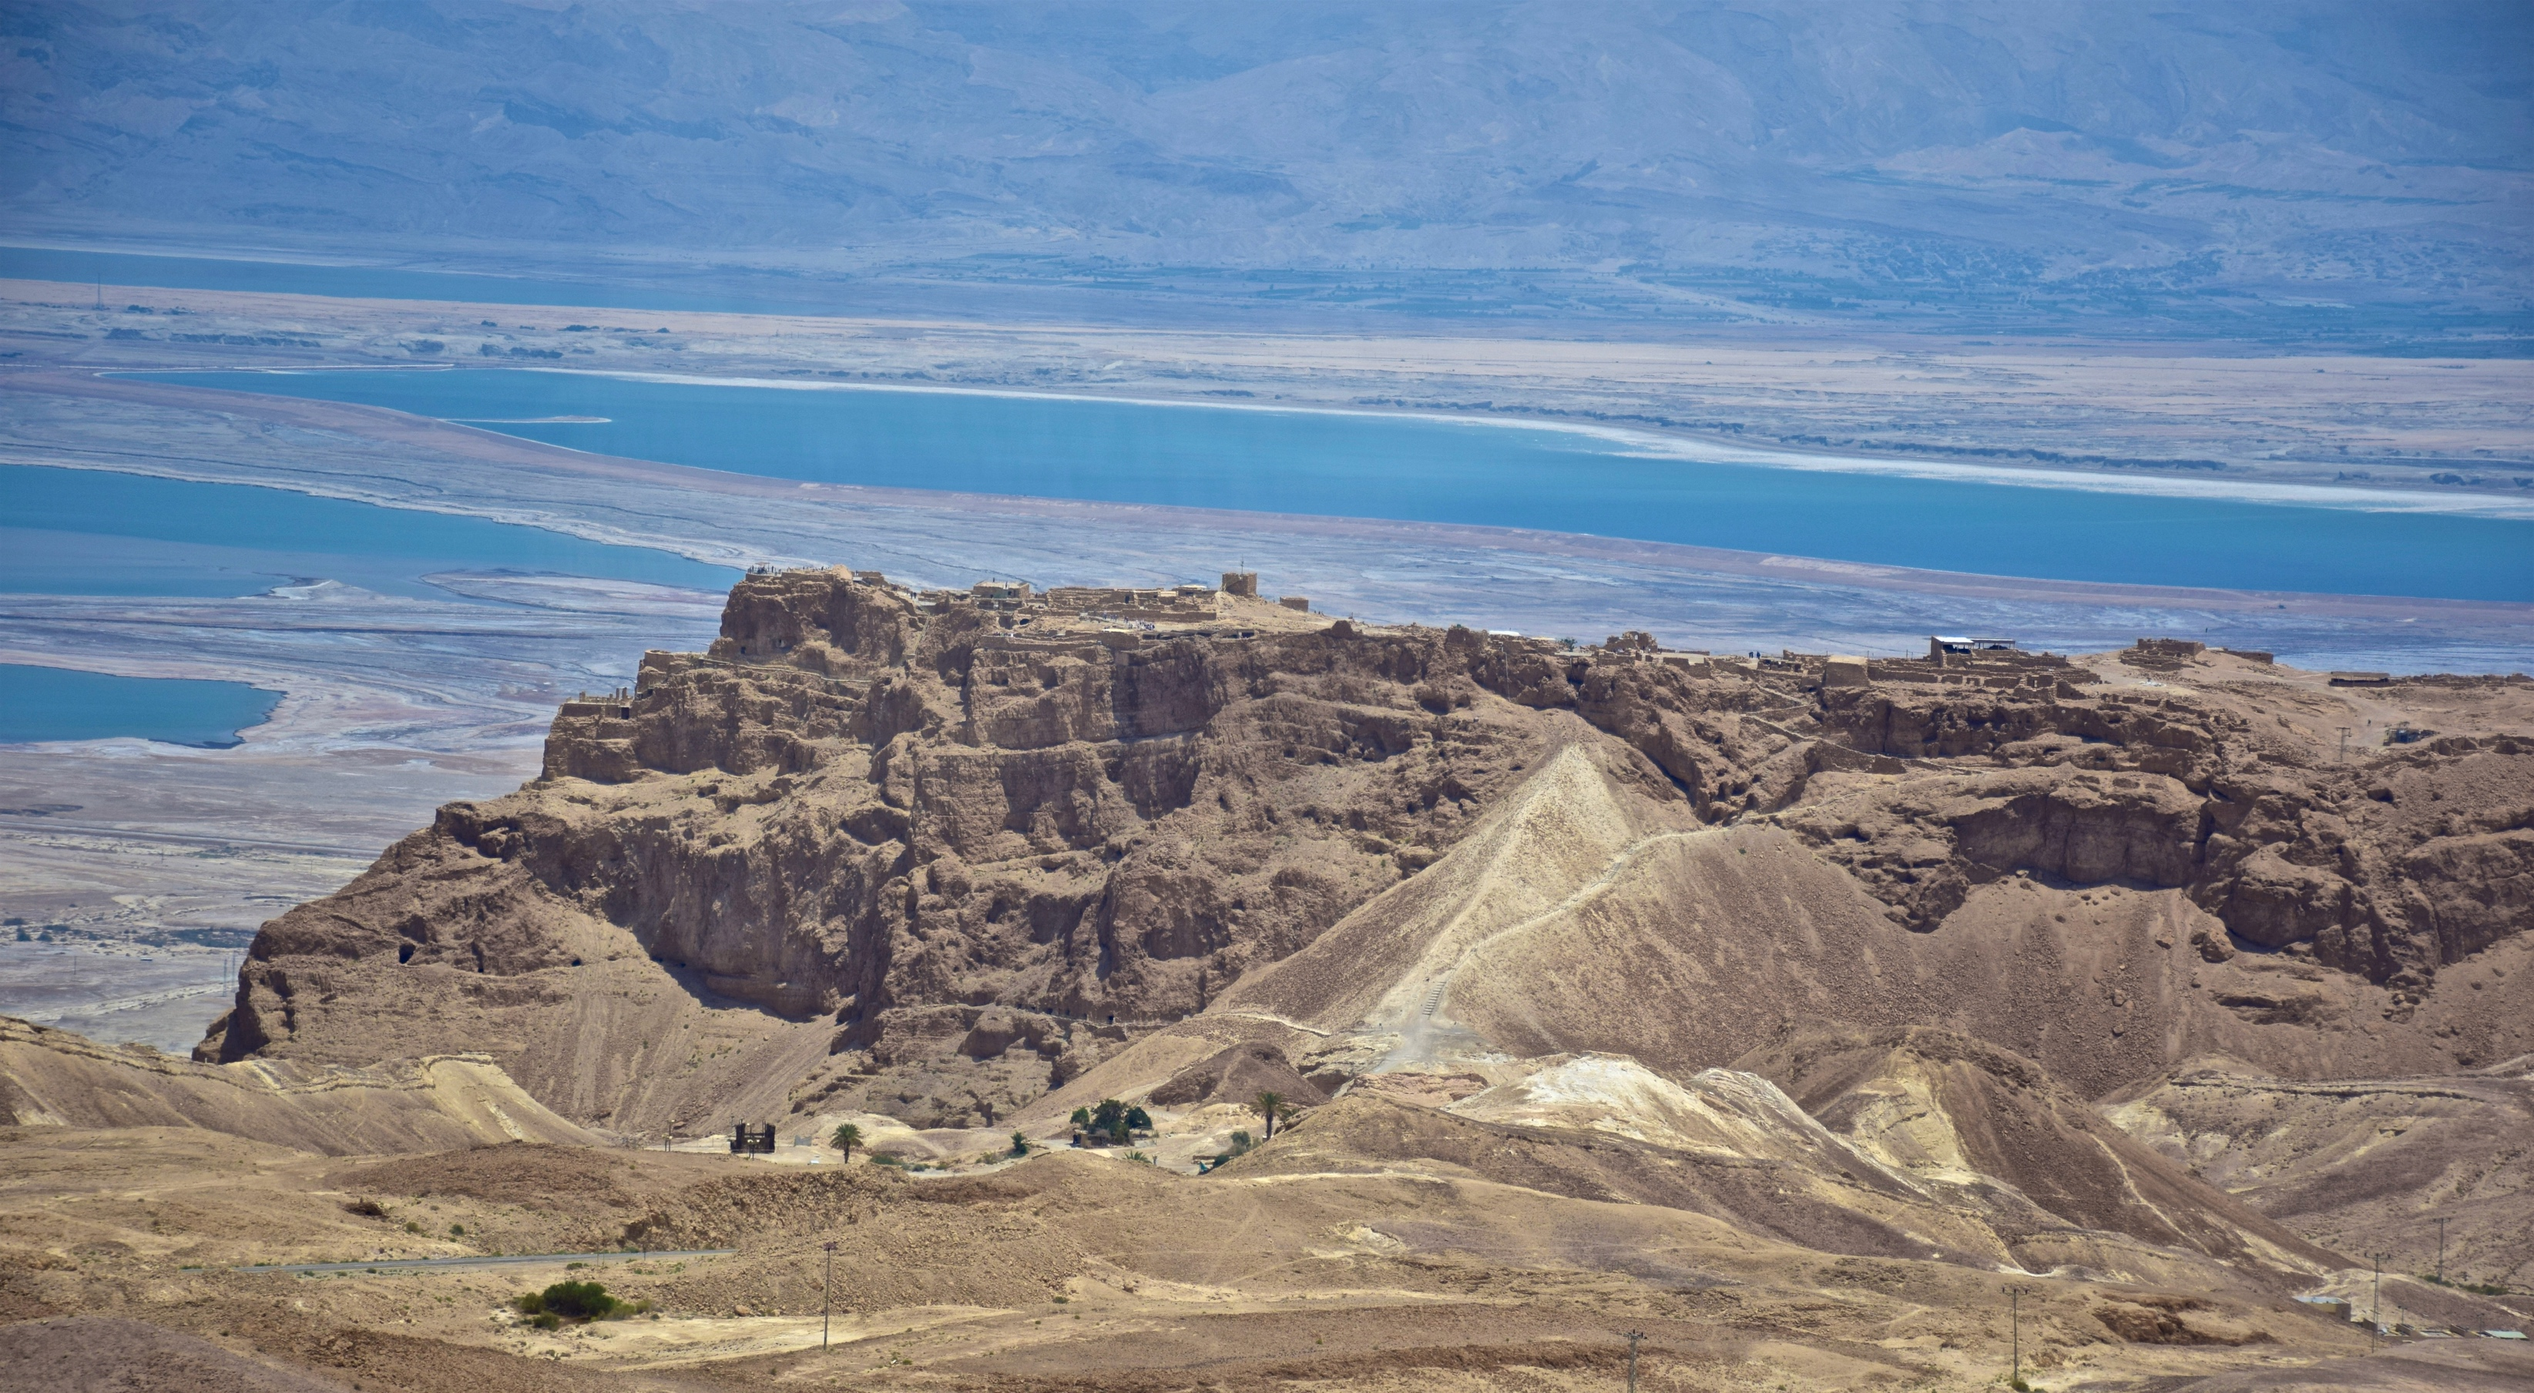
Herod the Great (and Family)

Slide 5
A Brief History...
1250 BCE(?) – Israel enters Promised Land
1060 BCE – Saul appointed King
1000 BCE – David becomes King
960 BCE – Solomon becomes King
920 BCE – Divided Kingdom (Israel & Judah)
722 BCE – Assyria conquers Israel
Exiles elite from Northern Kingdom
Judah becomes a vassal of Assyria
612 BCE – Babylon conquers Assyria

Slide 6
A Brief History...
587 BCE Babylonians Destroy Jerusalem and Temple. Babylonian exile.
539 BCE Persian conquest of Babylonia by Cyrus the Great
530s–520s BCE Waves of Jews return from Babylonia
516 BCE Temple rebuilt
458–432 BCE Ezra & Nehemiah
333/34 BCE Alexander the Great conquers Persia
301 BCE Macedonia Ptolemies rule Judea
200 BCE Seleucids rule Judea
168/7 BCE Antiochus Epiphanes (Seleucid) Persecution
164 BCE Maccabees reconquer and purify the temple
164–63 BCE Start of Maccabean/Hasmonean rule
63 BCE Start of the Roman period

Slide 7
Hasmoneans
Hasmoneans were not of the Davidic (nor Aaronic) line.
Held Monarchy and High Priesthood.
Later stages of Hasmoneans were no better than the Greeks.
Lots of infighting and intrigue.
Romans enter the fray to bring stability to the region.
Ultimately appoint Herod as tetrarch over Judea.

Slide 8
The Problem with Herod
Herod (72–4 BCE)
Father (Antipater) was an Idumean (Edomite).
Mother (Cypros) was Nabatean from Petra.
Idumeans were converts to Judaism.
Herod’s detractors did not consider him to be a “real” Jew.
Apparently this was a sore point for Herod.
Herod was not born to Jewish aristocracy.
He was of common birth.
Herod marries Miramme, a Hasmonean princess.
Gain Jewish credibility / ensure his sons are considered Hasmoneans.

Slide 9
Herod: A Complex Figure
Accomplished military leader
Master politician
Unparalleled builder
Paranoid ruler
Ruthless psychopath

Slide 10
Herod Becomes King
Named king (first) by Marc Antony.
Must conquer the kingdom.
Hasmoneans (and supporters) opposed Herod.
Rebel outposts in the Galilee.
Led Guerilla campaigns against Herod (and trade).

Slide 11
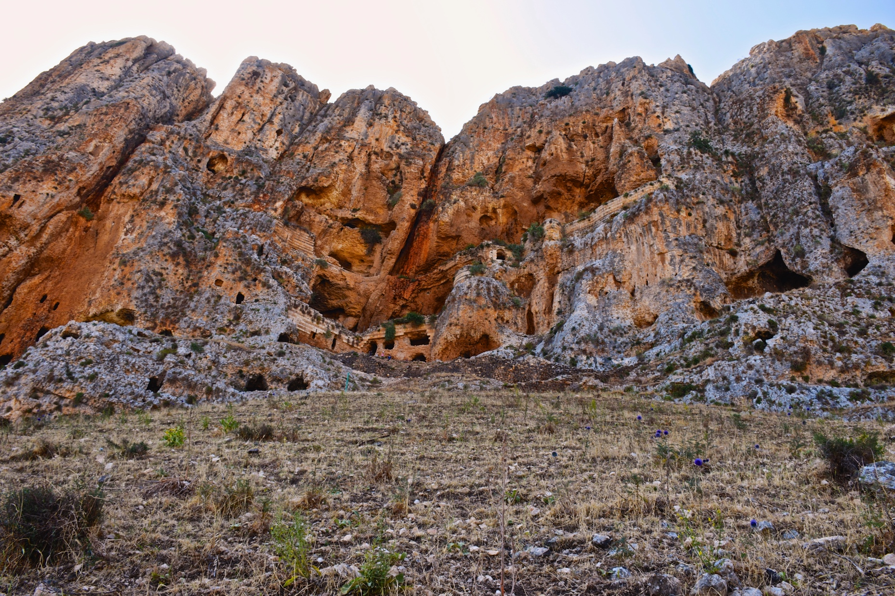
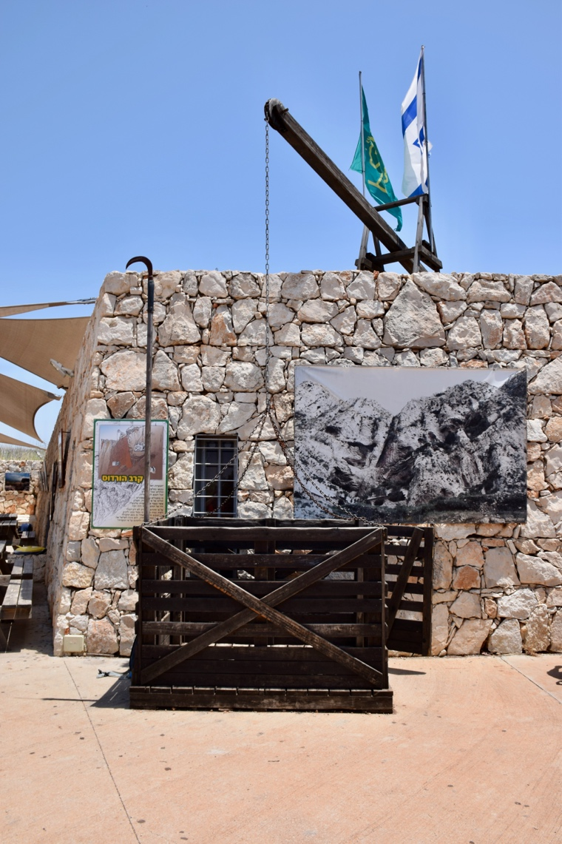
Herod’s Response

Slide 12
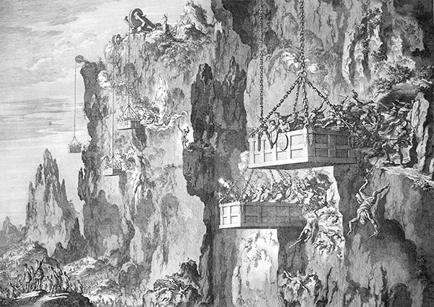

Slide 13
Like Father, Like Son
Herod’s succession was a mess.
Two wills naming two different sons.
Archelaus and Antipas claimed the throne.
The family goes to Rome for Caesar to sort it out.
Judea goes into rebellion.
Emissaries from Judea travel to Rome to oppose Herodian rule.
Ask to be annexed to Syria under Roman governor.

Slide 14
Like Father, Like Son
Caesar divides Herod’s kingdom
Names Archelaus as “ethnarch” (not king) of Judea, Idumea, and Samaria.
If he proved himself, kingship would follow.
Appoints Antipas head of Galilee and Perea.
Appoints Philip head of Batanea, Trachonitis, Aurantitis, and Panias.

Slide 15
Like Father, Like Son
Archaelaus is an inept ruler.
Jewish/Samaritan delegation ask for his removal.
Caesar removes Archelaus; appoints a Roman governor.
Banishes Archelaus to Vienne in Gaul (France).

Slide 16
Luke 19:11–27
As they were listening to this, he went on to tell a parable, because he was near Jerusalem, and because they supposed that the kingdom of God was to appear immediately. So he said, “A nobleman went to a distant country to get royal power for himself and then return. He summoned ten of his slaves, and gave them ten pounds, and said to them, ‘Do business with these until I come back.’ But the citizens of his country hated him and sent a delegation after him, saying, ‘We do not want this man to rule over us.’ When he returned, having received royal power, he ordered these slaves, to whom he had given the money, to be summoned so that he might find out what they had gained by trading.

Slide 17
Luke 19:11–27
The first came forward and said, ‘Lord, your pound has made ten more pounds.’ He said to him, ‘Well done, good slave! Because you have been trustworthy in a very small thing, take charge of ten cities.’ Then the second came, saying, ‘Lord, your pound has made five pounds.’ He said to him, ‘And you, rule over five cities.’ Then the other came, saying, ‘Lord, here is your pound. I wrapped it up in a piece of cloth, for I was afraid of you, because you are a harsh man; you take what you did not deposit, and reap what you did not sow.’ He said to him, ‘I will judge you by your own words, you wicked slave! You knew, did you, that I was a harsh man, taking what I did not deposit and reaping what I did not sow? Why then did you not put my money into the bank? Then when I returned, I could have collected it with interest.’ He said to the bystanders, ‘Take the pound from him and give it to the one who has ten pounds.’ (And they said to him, ‘Lord, he has ten pounds!’) ‘I tell you, to all those who have, more will be given; but from those who have nothing, even what they have will be taken away. But as for these enemies of mine who did not want me to be king over them—bring them here and slaughter them in my presence.’”

Slide 18
How does Jesus use
current events in this parable?

Slide 19
What is ridiculous in this parable?
Who is placed in charge?
10 Slaves
May or may not be ridiculous
May have been common practice

Slide 20
What is ridiculous in this parable?
What are the funds given to each?
A Mina = 100 denarii ≈ 4 months wages
$18,000–$20,000 (average US wage data)

Slide 21
What is ridiculous in this parable?
What do 2 of them receive as reward?
Control of multiple cities (10 or 5).
Do slaves ever get to rule cities?
Never!
Not even if they are incredible at their jobs.
There is an upending of social order in the rewards of this parable.
This is a common theme in Jewish apocalyptic literature.
Told against the backdrop of a ruthless puppet ruler
Much like Herod and Archelaus.

Slide 22
Summary
Jesus uses well-known, current events as the basis for (some of) his teachings.
These events add context to provide possible new meanings for the text.
The 10 servants upend the social order through their faithful service.

Slide 23
Next Week
Herod the Builder
Read Matt 17:14–20

