Slide 1
Being God’s Image
Women and Men in the Kingdom of God

Slide 2
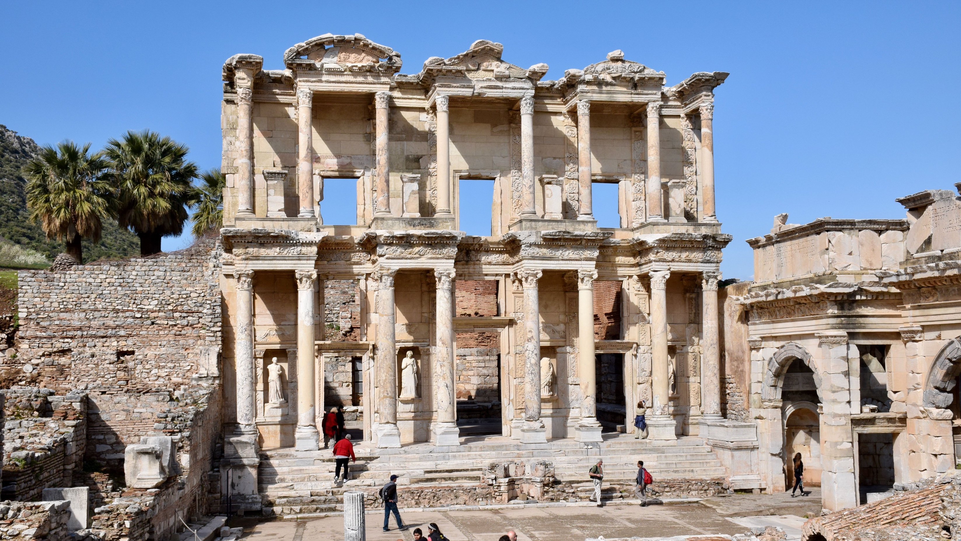
Biblical Study Tour: July 1–12, 2024

Slide 3
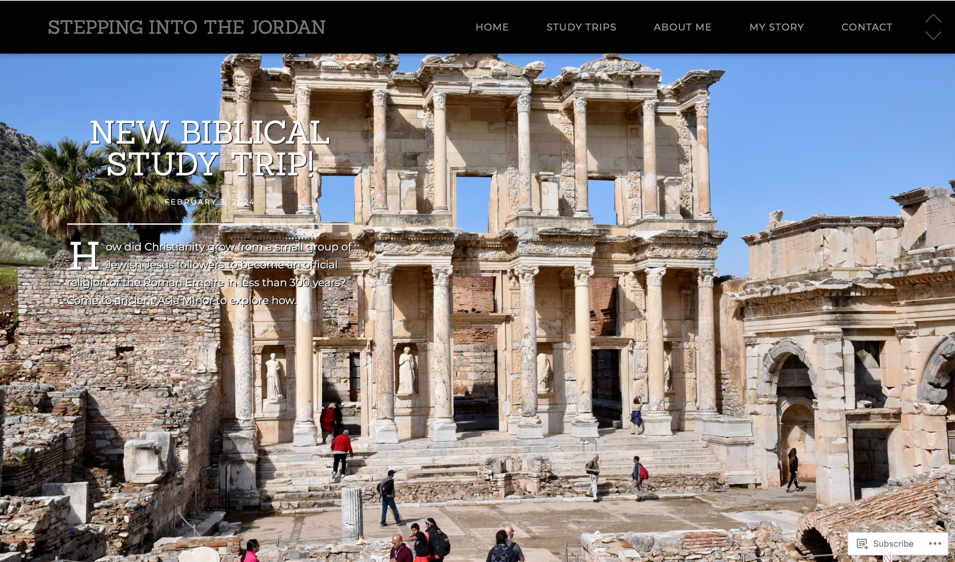
www.SteppingIntoTheJordan.com

Slide 4
Direct Link
https://steppingintothejordan.com/study-trips/

Slide 5
March 22–23, 2024 (Friday & Saturday)

Slide 6
Direct Link
https://www.smu.edu/perkins/publicprograms/summit-for-faith-and-learning

Slide 7
In the Image of God Gen 1:1–2:3

Slide 8
What does it mean to be made in the image of God?

Slide 9
The Feminist Movement
How do feminists respond to the Bible?

Slide 10
“It might be interesting to speculate upon the probable length of a ‘depatriarchalized Bible.’ Perhaps there would be enough salvageable material to comprise an interesting pamphlet.”
Mary Daly, Beyond God the Father: Toward a Philosophy of Women's Liberation, 103n5.

Slide 11
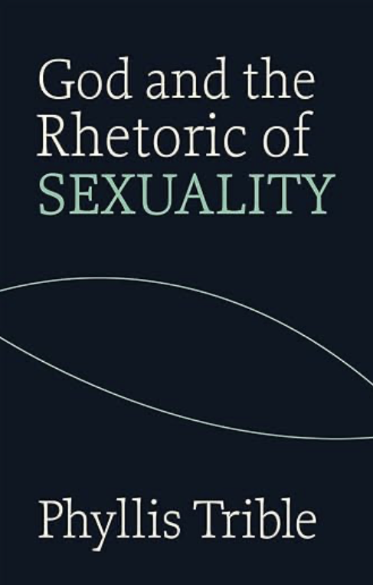
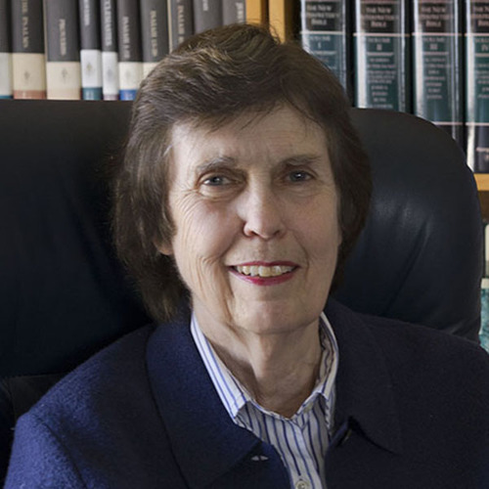
Dr. Phyllis Trible (PhD, Union Theological Seminary)
Professor Emeritus, Union Theological Seminary
Hebrew Bible Scholar
Literary/Rhetorical Critic Applies a Feminist Lens

Slide 12
Trible’s Method of Interpretation
Literary/Rhetorical Critic
Reads the Bible as a literary text.
Type of literature utilized.
Literary conventions applied.
She has no interest in the cultural context.
Close and careful reading of the text as literature.

Slide 13
Trible’s Question
Is patriarchy built into the biblical text
or is patriarchy a product of our interpretation of the Bible?
She examines certain texts using a close, literary reading of the text to reach some remarkable conclusions.

Slide 14
Two Genesis Creation Accounts:
Gen 1:1–2:3
Gen 2:4–3:24
What type of literature is Gen 1:1–2:3?
Poetry

Slide 15
“From Chaos to Cosmos”
7 Days (Episodes)
Days 1–6 follow the same formula.
Day 7 is different
Days 1–6 begin with “and God said...”
End with “and there was evening and morning...”

Slide 16
“From Chaos to Cosmos”
Symmetry organizes the days into two parts.
Days 1–3: Infrastructure
Days 4–6: Fills out the Cosmos

Slide 17
“From Chaos to Cosmos”
Infrastructure
Population
Day 1:
Light separated from darkness
(Gen 1:3–5)
Day 4:
Greater and Lesser Lights. Day/Night
(Gen 1:14–19)
Day 2:
Firmament separates waters
(Gen 1:6–8)
Day 5:
Aquatic and Aerial Animals
(Gen 1:20–23)
Day 3:
Earth appears. Puts forth vegetation
(Gen 1:9–13)
Day 6:
Land Animals and Humans
(Gen 1:24–30)

Slide 18
Gen 1:26
Then God said,
“Let us make humankind (ha-adam) in our image, according to our likeness;
and let them have dominion
over the fish of the sea,
over the birds of the air,
over the cattle,
over all the wild animals
over all of the earth
over every creeping thing that creeps upon the earth.”

Slide 19
Gen 1:27
So God created humankind (ha-adam) in his image,
in the image of God he created them;
male and female he created them.

Slide 20
Gen 1:28
And God blessed them,
and God said to them:
“Be fruitful and multiply,
and fill the earth;
and subdue it;
and have dominion
over the fish of the sea,
over the birds of the air,
over every living thing that moves upon the earth.”

Slide 21
Gen 1:29-30
Αnd God said,
“See, I have given you
every plant yielding seed that is upon the face of all the earth,
and every tree with seed in its fruit;
you shall have them for food.
And to every beast of the earth,
and to every bird of the air,
and to everything that creeps on the earth,
everything that has the breath of life,
I have given every green plant for food.”
And it was so.

Slide 22
How are Humans different in Gen 1?
The account is longer.
Made in the image of God.
There is a “divine deliberation.” “Let us make...”
Humans are made without reference to any natural context or substance.
“water brings forth;” “the earth brings forth”
No division of “according to their kinds”
Designates sexuality (male and female)
“Procreation shared with the animal world; sexuality is not.”
Granted dominion over creation.

Slide 23
The Poetry of Gen 1:27
7 Word Vocabulary / 3 Lines / 4 Words Each Line
Lines 1–2: Inverted Parallelism
Lines 2–3: Straight Parallelism
And-created God humankind in-his-image; in-the-image-of God created-he him;
male and-female created-he them.

Slide 24
Lines 1–2: Inverted Parallelism
A
B
C C’
B’
A’
And-created
God [humankind]
in-his-image; in-the-image-of
God
created-he [him];
“in God’s Image” is the focus of lines 1 & 2
But what does “God’s Image” mean?

Slide 25
Lines 2–3: Straight Parallelism
A
B
in-the-image-of God created-he him;
male and-female created-he them.
A’
B’
The shift from “him” to “them” reinforces sexual difference within the unity of humankind in line 1 (ha-adam).

Slide 26
Lines 2–3: Straight Parallelism
A
B
in-the-image-of God created-he him;
male and-female created-he them.
A’
B’
What can we learn from the relationship between A and A’?

Slide 27
Lines 2–3: Straight Parallelism
A
B
in-the-image-of God created-he him;
male and-female created-he them.
A’
B’
There is a “semantic correspondence” between image of God and male and-female

Slide 28
Lines 2–3: Straight Parallelism
A
B
in-the-image-of God created-he him;
male and-female created-he them.
A’
B’
The better understood term amplifies the lesser understood term.

Slide 29
Trible’s Conclusions
God is the subject.
Creation and Humankind are the objects.
Gen 1 seeks to explain “image of God” and God’s “otherness” through the metaphor of male and female.
From the beginning, humankind (ha-adam) exists as two sexes, not androgynous.

Slide 30
Trible’s Conclusions
These sexes are harmonious
Sexual differentiation does not mean hierarchy; it means equality.
Humankind receives 2 responsibilities:
procreation and dominion
Given to both sexes, without distinction
No mention of gender roles/sexual stereotypes

Slide 31
We’ve only discussed Days 1–6.
What happens on Day 7?
If the description of creation moves to climax, what is the ultimate climax of creation?
God stops creating.
Sabbath

Slide 32
Summary
Gen 1 is poetry. Trible helps us read it as such.
Humankind (male and female) are bearers of God’s image.
Both sexes are metaphors to understand God’s otherness.
Sexual differentiation means equality in Gen 1.
Both sexes are given the same responsibilities.
No gender roles or sexual stereotypes are implied.
The climax of Gen 1:1–2:3 is Sabbath.

Slide 33
Next Week
Read Gen 2:4–3:24
Compare Creation account with Gen 1:1–2:3.
Similarities?
Differences?

