Slide 1
Being God’s Image
Women and Men in the Kingdom of God

Slide 2
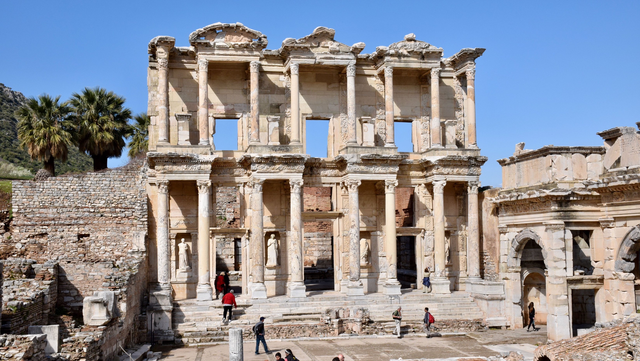
Biblical Study Tour: July 1–12, 2024

Slide 3
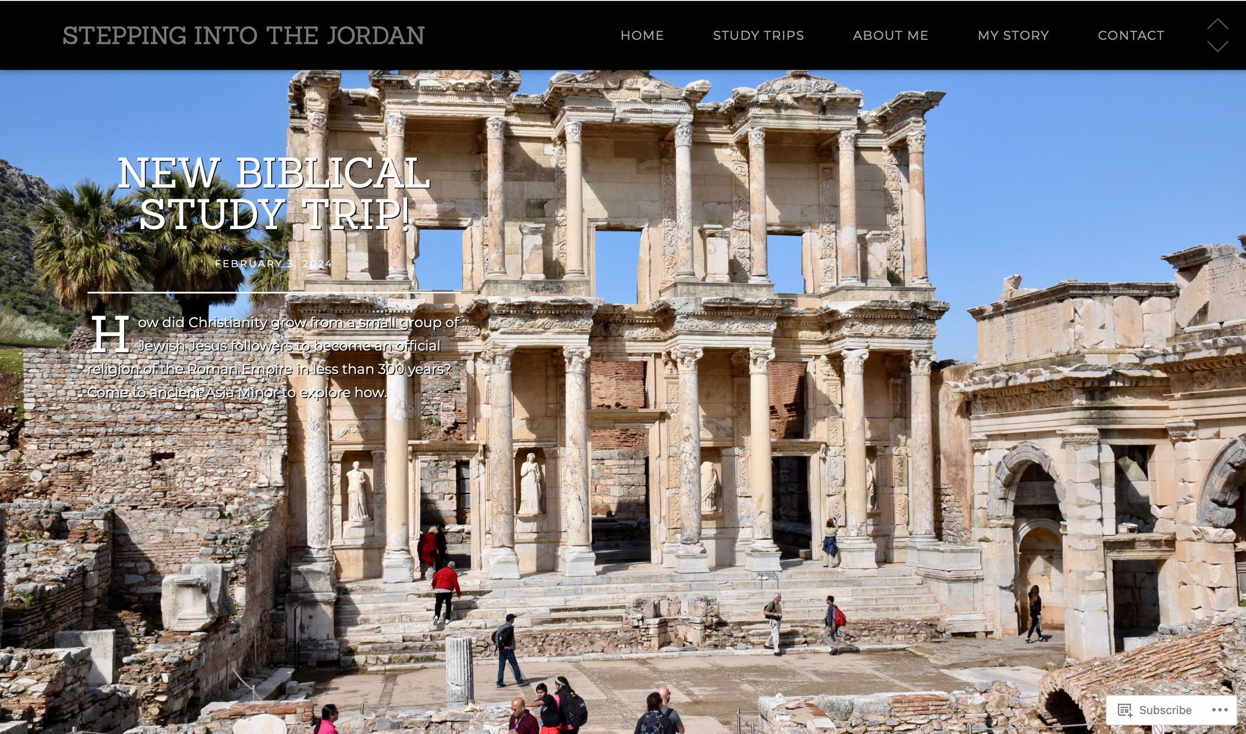
www.SteppingIntoTheJordan.com

Slide 4
Direct Link
https://steppingintothejordan.com/study-trips/

Slide 5
March 22–23, 2024 (Friday & Saturday)

Slide 6
Direct Link
https://www.smu.edu/perkins/publicprograms/summit-for-faith-and-learning

Slide 7
A Suitable Helper? Gen 2:4–3:24

Slide 8
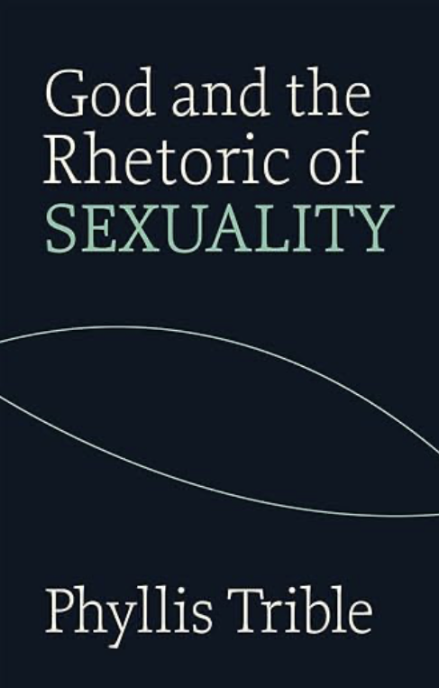
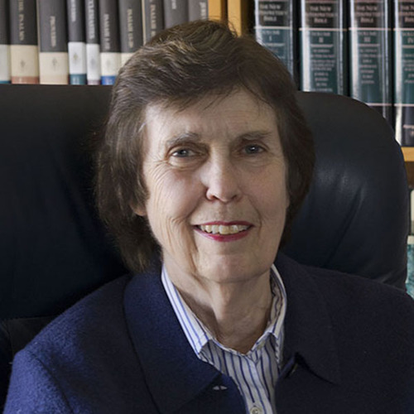
Dr. Phyllis Trible (PhD, Union Theological Seminary)
Professor Emeritus, Union Theological Seminary
Hebrew Bible Scholar
Literary/Rhetorical Critic Applies a Feminist Lens

Slide 9
Trible’s Method of Interpretation
Literary/Rhetorical Critic
Reads the Bible as a literary text.
Type of literature utilized.
Literary conventions applied.
She has no interest in the cultural context.
Close and careful reading of the text as literature.

Slide 10
Trible’s Question
Is patriarchy built into the biblical text
or is patriarchy a product of our interpretation of the Bible?
She examines certain texts using a close, literary reading of the text to reach some remarkable conclusions.

Slide 11
Our Father in heaven,
hallowed be your name.
Your kingdom come.
Your will be done,
on earth as it is in heaven.
Give us this day our daily bread.
And forgive us our debts,
as we also have forgiven our debtors.
And do not bring us to the time of trial,
but rescue us from the evil one.
Matt 6:9b–13 (NRSV)
What does Jesus mean by “your kingdom come?”

Slide 12
The Kingdom of God
God’s will prevails.
Justice for the oppressed.
Everything works like it's supposed to work.
The Restoration of all things
Hebrew term: Shalom

Slide 13
What is our role in the Kingdom of God?
Is it a future state or the “here and now?”

Slide 14
Two Genesis Creation Accounts:
Gen 1:1–2:3
Gen 2:4–3:24

Slide 15
When YHWH God made the earth and the heavens, before all the plants of the field were on the earth and before all the grass of the field sprouted up, since YHWH God had not caused it to rain upon the earth and there was no Adam to work the ground [adamah]. A stream would rise up from the earth and water all the face of the ground.
And YHWH God formed the groundling [ha-adam] from the dust of the ground and breathed into his nostrils the breath of life and the groundling became a living being.
Gen 2:4b–7 (my translation)
What is different from Gen 1?

Slide 16
And YHWH God took the groundling and rested him in the garden of Eden to work it and keep watch over it. YHWH God commanded the groundling,
“From all the trees of the garden “eating you will eat.”
But from the tree of knowledge of good and evil you may not eat from it.
Because on the day you eat from it “dying you will die.”
And YHWH God said,
“It is not good for the groundling to be alone.
I will make for him an ezer kenegddo.”
Gen 2:15–18 (my translation)

Slide 17
And YHWH God formed from the ground [ha-adamah] all the animals of the field, and all the flying things in the heavens and brought them to the groundling to see what he called them. Whatever the groundling called each living creature, that was its name. So the groundling named all the wild beasts and flying things in the heavens and all the beasts of the field.
But for the groundling he did not find an ezer kenegddo.
Gen 2:19–20 (my translation)
What is different from Gen 1?

Slide 18
So YHWH God caused a deep sleep to fall upon the groundling and he slept. And he took part of his side and covered the flesh over it. And YHWH God constructed the side which he took from the groundling to be a woman [ishah] and brought her to the groundling. And the groundling said,
“This one, this time, is bone from my bone
And flesh from my flesh.
This one will be called woman [ishah]
Because from man [ish] was this one taken.”
For this reason, a man shall leave/forsake his father and mother
And he shall cling to his woman
And they will be one flesh.
Gen 2:21–24 (my translation)
What does ezer kenegddo mean?

Slide 19
Genesis 2:18
Woman..."a helper suitable."​
​Ezer Kenegddo עֵזֶר כְּנֶגְדּוֹ​))
​Ezer: “helper”
Kenegddo: “suitable” or “meet”
Does not convey the Hebrew meaning well.

Slide 20
A Word about Translation
“The only way to get to know the meaning of a word is to see how it is used, and the more places it is used, the more often a word is attested, the more it becomes semantically familiar.”
William P. Brown, A Handbook to Old Testament Exegesis, 26.

Slide 21
Ezer (עֵזֶר​)
Used 22x in the Old Testament
2x in Genesis 2 in relation to woman
4x used in reference to Israel’s military partners
16x used to describe God aiding Israel
Not a word for servant or slave
The ezer does what the other party cannot do on their own.

Slide 22
Kenegddo (כְּנֶגְדּוֹ​)
A “compound word”
ke (כְּ) = “like” or “as”
neged (נֶגֶד) = “opposite of”, “in front of”, “before”
o (וֹ) = pronominal suffix 3ms (him)

Slide 23
Ezer Kenegdo (עֵזֶר כְּנֶגְדּוֹ​)
A strong and (more than) equal partner
Standing opposite him
Able to do what he is not able to do by himself.
They make each other stronger.
They hold each other accountable.

Slide 24
In Creation...
A strong partnership of Man and Woman
Equality
Joint dominion over creation
Everything working as intended.
Hebrew Term for this: Shalom

Slide 25
Now the snake was more cunning than all the beasts of the field which YHWH God made. And he said to the woman,
“Did God really say you may not eat from any tree of the garden?”
The woman said to the serpent,
“We may eat the fruit from the tree(s) of the garden,
But the fruit from the tree in the middle of the garden,
God said you may not eat from it, nor touch it, lest you will die.
Gen 3:1–3 (my translation)
Notice anything different here?

Slide 26
The serpent said to the woman,
“Dying you will not die.
Because God knows that on the day you all eat from it
Your (pl) eyes will be opened
And you all will be like God
Knowing good and evil.”
And the woman saw that
the tree was good for eating
and attractive to the eyes
and the tree was desirable for wisdom.
Gen 3:4–6a (my translation)

Slide 27
And the woman took from its fruit,
And she ate.
And she also gave to her man/husband who was with her,
And he ate.
And the eyes of the two of them were opened
And they knew that they were naked
And they sewed fig leaves
And made for themselves loincloths.
Gen 3:6b–7 (my translation)
Where is the man when all this happens?

Slide 28
And the groundling said,
“The woman who you (singular) gave me,
She gave to me from the tree
And I ate.”
And YHWH God said to the woman,
“What is this you have done?”
And the woman said,
“The snake snookered me!
And I ate.”
Gen 3:12–13 (my translation)

Slide 29
And YHWH God said to the snake,
“Because you did this,
cursed are you from all the beasts
and from all the animals of the field.
Upon your belly you will crawl.
And dust you will eat all the days of your life.
And I will place hostility between you and the woman,
And between your seed and her seed.
He will strike your head,
And you will strike his heel.”
Gen 3:14–15 (my translation)
What is cursed?

Slide 30
And to the woman he said,
“I will greatly increase your hardship and pregnancy.
In hardship you will bear children.
And to your husband you will desire
And he will rule you.”
Gen 3:16 (my translation)
What is cursed?
The woman is not cursed!

Slide 31
And to Adam he said,
“Because you listened to the voice of your woman,
And ate from the tree which I commanded you, ‘Do not eat from it,’
Cursed is the ground because of you (singular).
In hardship you will eat all the days of your life.
And thorns and thistles it will grow for you,
But you will eat the plants of the field.
By the sweat of your brow you will eat bread.
Until you return to the ground
Because from it you were taken.
Because you are dust
And to dust you will return.
Gen 3:17–19 (my translation)
What is cursed?

Slide 32
And the groundling called the name of his woman “Eve” [Hawwa] because she was the mother of all the living. And YHWH God made for Adam and for his wife robes of skin and clothed them.
Gen 3:20 (my translation)
“Called the name of...” Where have we seen this before?
Here is where the power dynamics shift.

Slide 33
What are the consequences
of their disobedience?

Slide 34
The Consequences
Hardship for women and men
Unequal relational dynamics
Snake and ground “cursed” (not people)
The shalom of creation is broken.
The consequences are not “God’s plan or design.”

Slide 35
As God’s people, which option best describes our mission?
A) Perpetuate the “consequences” of the broken shalom.
B) Help restore the shalom of God’s kingdom here on earth.

Slide 36
A Post-Script
I am my beloved’s,
and his desire is for me.
Song 7:10
Trible reads Song of Songs as a reversal
of the Garden’s consequences.
The consequences were never meant to be permanent.

Slide 37
Summary
In Gen 1, sexual differentiation means equality.
In Gen 2–3, the woman is an ezer kenegddo.
Someone who does for the man what he is unable to do for himself.
A more than capable partner, not a subservient helper.
Disobedience breaks the garden’s shalom.
The consequences bring about hardship
Relational inequality
The consequences were never meant to be the end goal.
Restoration of shalom is a central theme of Scripture.

Slide 38
Next Week
What is Patriarchy?
Read Gen 27

