Slide 1
Being God’s Image
Women and Men in the Kingdom of God

Slide 2
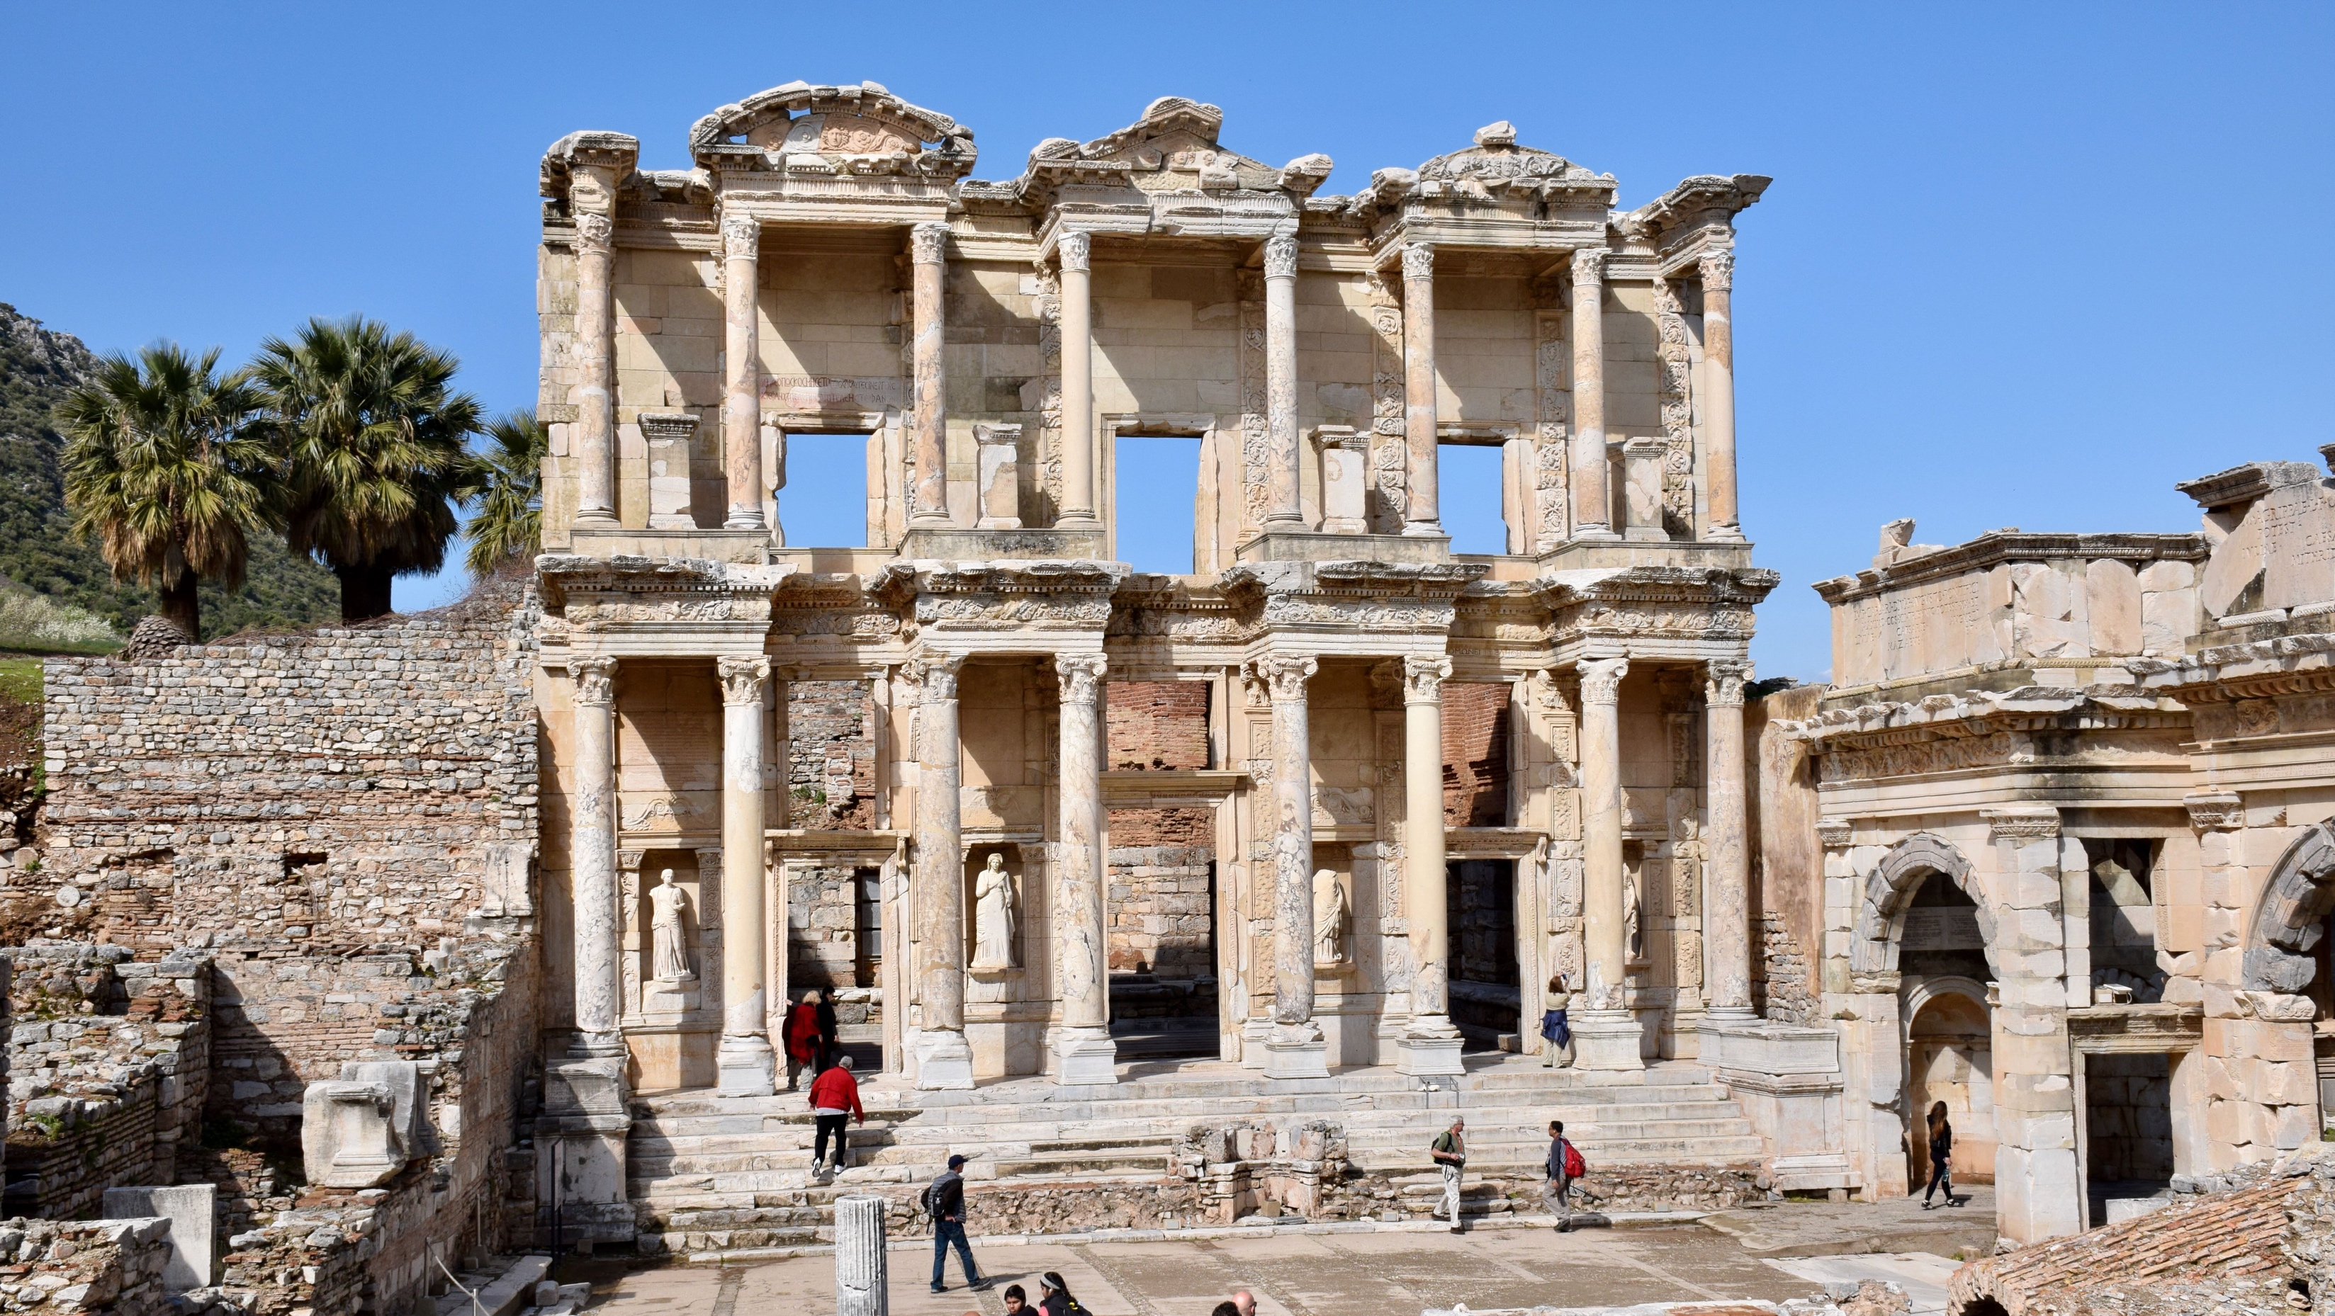
Biblical Study Tour: July 1–12, 2024

Slide 3
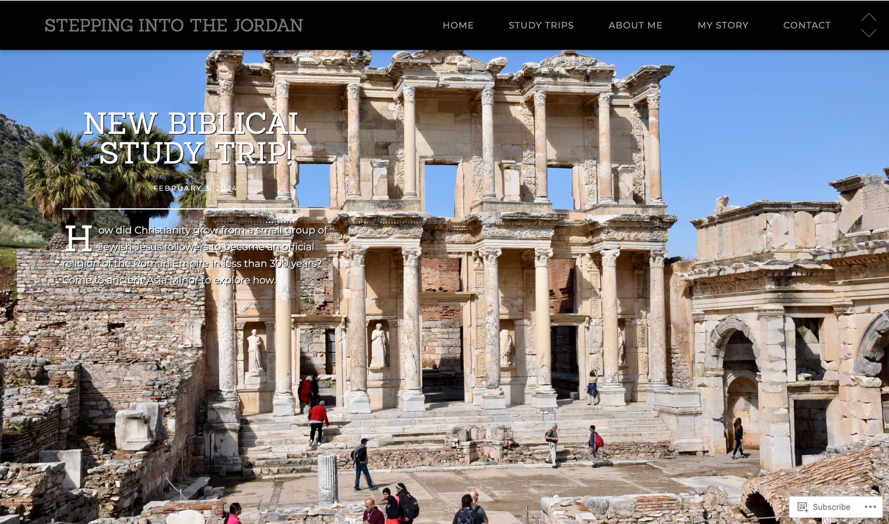
www.SteppingIntoTheJordan.com

Slide 4
Direct Link
https://steppingintothejordan.com/study-trips/

Slide 5
March 22–23, 2024 (Friday & Saturday)

Slide 6
Direct Link
https://www.smu.edu/perkins/publicprograms/summit-for-faith-and-learning

Slide 7
A Review

Slide 8
Where have we been?
The Traditional View
Neither complementarian nor egalitarian are the traditional view.
1 Tim 2:12
Grammar Analysis
Contextual Analysis
1 Cor 14
Culture-specific
Women were praying and prophesying

Slide 9
Where have we been?
Gen 1
Equality between male and female
Shared blessing and responsibility
Gen 2–3
The Garden reflects God’s dominion.
The Woman is created as an equal partner.
Disobedience breaks the garden’s shalom.
The “consequences” are contrary to God’s dominion.

Slide 10
Next Week
What is Patriarchy
Read Gen 27

