Slide 1
Paul’s Worldview
Paul’s misuse of the Old Testament in Romans

Slide 2
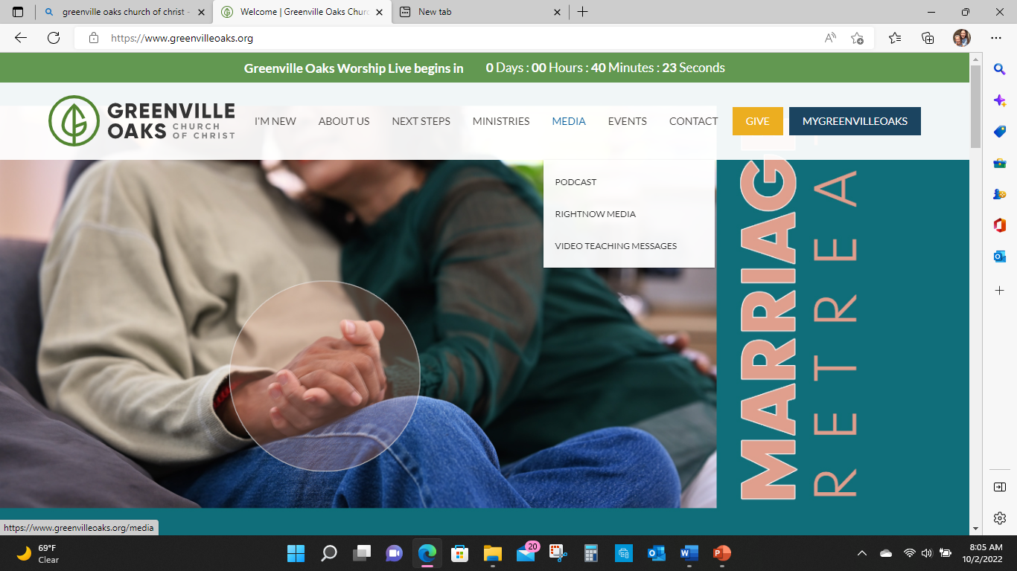

Slide 3
Paul’s tension in Romans
Faith/faithfulness
Torah keeping (as a merit-based salvation)

Slide 4
Romans 3:21 )
Yahweh has now shown us his saving power without the help of the Torah
But the Torah and the Prophets testify to us about this.
(Deuteronomy 19:15)

Slide 5
Romans 3:21 )
²² We are made right/ righteous with God by putting our faith in Jesus Christ. This happens to all who believe.
It is no different for the Jews than for the Gentiles. ²³ Everyone has sinned. No one measures up to Yahweh’s glory.

Slide 6
Romans 3 )
God did all this to prove that he does what is right.
He is a God of mercy so he did not punish the people for their sins who lived before Jesus lived.

Slide 7
Romans 3 )
²⁶ God did all this to prove in our time that he does what is right. He also makes right (relationship) with himself those who believe in Jesus.

Slide 8
Romans 3 )
²⁷ So who can brag? No one!
Are people saved by the law that requires them to obey? Not at all!
They are saved because of the specific law that requires faith.
²⁸ We believe that a person is made right with God because of their faith.
They are not saved by obeying the law.

Slide 9
Romans 3 )
When those who are baptized believe in Jesus, then Yahweh makes them right with himself.
Suppose those who are not baptized believe in Jesus.
Then God also will make them right with himself.
³¹ Does faith make the law useless?
Not at all! We agree with the law of baptism.

Slide 10
Romans 4
What should we say about these things? What did Abraham, the father our people, discover about being (righteous) right with God?
² Did he become right with God because of something he did?
If so, he could brag about it.
But he couldn’t brag to God.

Slide 11
Romans 4
³ What do we find in Scripture?
It says, “Abraham believed God.
God accepted Abraham’s faith,
and so his faith made him right with God.”
(Genesis 15:6).”

Slide 12
Romans 4
⁴ When a person works, the are paid because it is owed to them…their pay is not considered a gift.
⁵ But things are different with God.
God makes ungodly people right with himself.
If people trust in him, their faith is accepted even though they do not work.
Their faith makes them right with God.

Slide 13
Romans 4
King David says
“Blessed are those whose lawless acts are forgiven. Blessed are those whose sins are taken away. ⁸ Blessed is the person whose sin the Lord never counts against them.” (Psalm 32:1,2)

Slide 14
Romans 4
Is the blessing of having sins removed only for those who are baptized?
Or is it also for those who are not baptized?

Slide 15
Romans 4
We have been saying that God accepted Abraham’s faith.
So his faith made him right with God.
¹⁰ When did it happen?
Was it after Abraham was baptized, or before?

Slide 16
Romans 4
It was before he was baptized, not after!
¹¹ He was baptized as a SIGN of the covenant God had made with him.
It showed that his faith had made him right with God before he was baptized.

Slide 17
Romans 4
So Abraham is the father of all believers who have not been baptized.
God accepts their faith. So their faith makes them right with him.

Slide 18
Romans 4
¹² And Abraham is also the father of those who are baptized and believe.
So just being baptized is not enough.
Those who are baptized must also follow the steps of our father Abraham. He had faith before he was baptized.

Slide 19
BLASPHEMEY!!!!
Jewish Christians were saying that the only way to be “saved” is by believing in Jesus AND keeping the Torah laws (sabbath, dietary rules, circumcision)
In order to be marked out as a Christian you must keep the Torah.
Paul says…. Abraham did it

Slide 20
Romans 4:13
Abraham and his family received a promise.
God promised that Abraham would be the heir of the world.
It would not come to him because he obeyed the law. It would come because of his faith, which made him right with God.

Slide 21
Romans 4:14
¹⁴ Do those who depend on the Bible for salvation receive the promise ?
If they do, faith would mean nothing.
God’s promise would be worthless.
The Abrahamic, Mosaic and “new” covenant has it’s place but its not intended to supersede the PURPOSE of the covenant.

Slide 22
Romans 4:14
¹⁵ The law brings God’s anger. Where there is no law, the law can’t be broken.
¹⁶ The promise is based on God’s grace. The promise comes by faith.

Slide 23
Romans 4:16
All of Abraham’s children will certainly receive the promise. And it is not only for those who are ruled by the law.
Those who have the same faith that Abraham had are also included.
Abraham is the father of everyone.

Slide 24
Why is this important to us?
Torah separates
Torah points out sinfulness
Torah can’t save
Abraham plan of salvation
Faith in the faithfulness of Yahweh.

Slide 25
Why is this important to us?
Bible points out sinfulness
Bible can’t save
Bible is a series of books showing a plan of salvation
Faith in the faithfulness of Yahweh.

Slide 26
Why is this important to us?
As we are encountering people (nations), we are not using the Bible to point out sinfulness
We are looking for ways that Yahweh is being faithful to the long term plan.
Bible is used to show “Israel” is the rescue plan

Slide 27
Why is this important to us?
How do I know that I am righteous?
What do I do with the guilt?

