Slide 1
ATONEMENT

Slide 2
SAY YOU HAVE A $100

Slide 3
FINANCIAL BALANCE SHEET
ASSETS – LIABILITIES = EQUITY
RESOURCES – OBLIGATIONS = OWNERSHIP

Slide 4
PERSONAL BALANCE SHEET
STRENGTHS – WEAKNESSES = POTENTIAL

Slide 5
EMOTIONAL BALANCE SHEET
GOOD VIBES – BAD VIBES = POSITIVE VIBES

Slide 6
SPIRITUAL BALANCE SHEET
HOPE – FEAR = PEACE
“May the God of hope fill you with all joy and peace as you trust in Him so that you may overflow with hope by the power of the Holy Spirit.” Romans 15:13 (NIV)

Slide 7
I LIKE BALANCE
I like things that are simple to understand.
I like things that reconcile easily.
I like things that make sense.
I like things that bring people together.
I like things that bring peace and joy.

Slide 8
QUESTION
WHY DID JESUS HAVE TO DIE?

Slide 9
REDEMPTION PERSPECTIVES
Webster Definitions
Redemption:
The act of saving or being saved from sin, error, or evil.
The action of regaining or gaining possession of something in exchange for payment, or clearing a debt.
Atonement: The reconciliation of God and humankind through Jesus Christ.

Slide 10
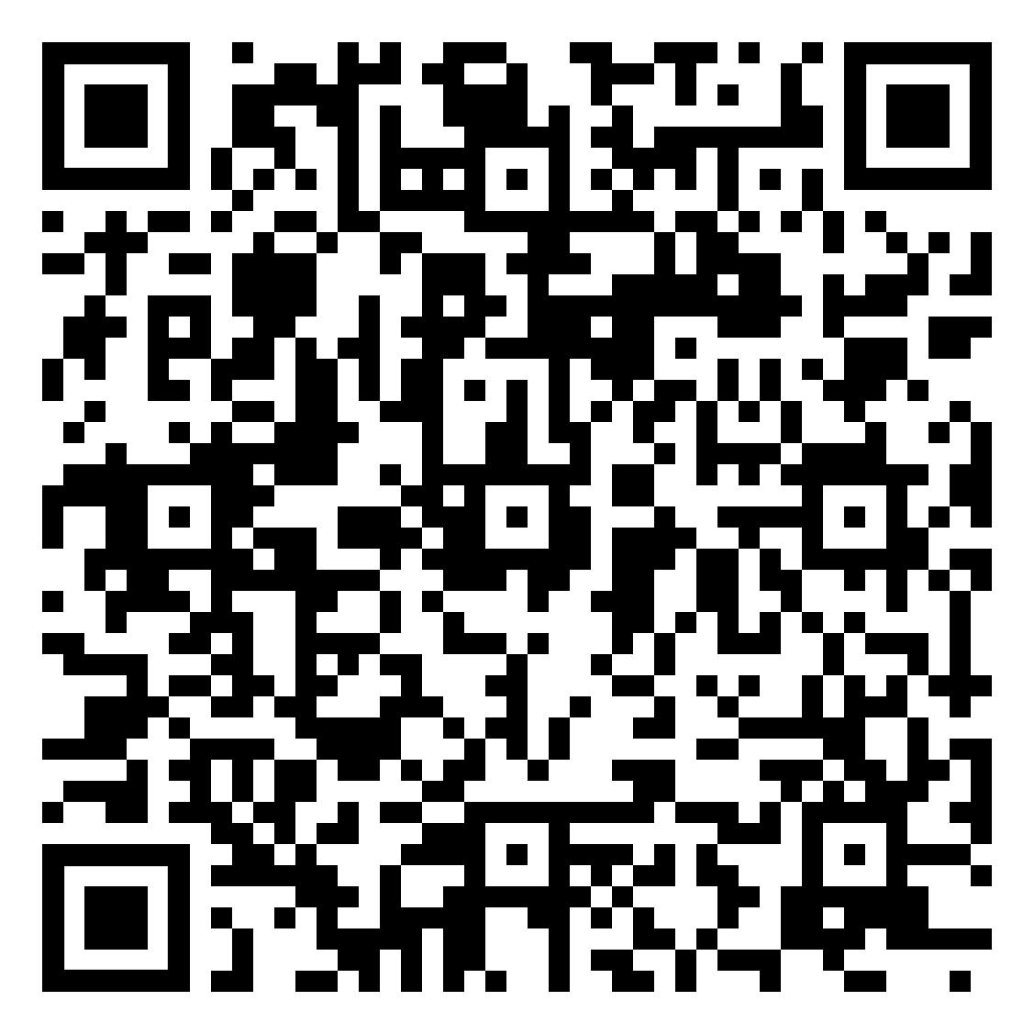
“GO OUT in joy” by Ladye Rachel Howell

Slide 11
Atonement Theory
Legal Satisfaction Atonement Theory
Anselm of Canterbury (11th Century)
Human sin requires a legal debt to be paid to God.
God’s honor is offended by human sin.
No human could pay the honor debt.
Jesus vicariously pays the debt humans owe to God’s honor.

Slide 12
Atonement Theory
Moral Influence Atonement Theory
Peter Abelard (11th Century)
Sharply disagreed with Anselm.
The work accomplished by Jesus on the cross was to demonstrate the love of a God who was willing to suffer.
That demonstration of crucified love then became the moral influence that can work transformation in humans.

Slide 13
Atonement Theory
Penal Substitutionary Atonement Theory (PSAT)
John Calvin (16th Century)
A spin on the Legal Satisfaction Atonement Theory.
Penal meaning punishment.
Substitutionary meaning taking our place.
Human sin is more like a crime that must be punished by God to maintain justice.
Jesus vicariously receives the punishment that sinful humans deserve.

Slide 14
Atonement Theory
Christus Victor Model of Atonement
Christus Victor, Latin for “Christ is the conqueror”
Gustaf Aulen (20th Century)
The ”classic” model because it was how the early church understood Jesus’s work on the cross.
The model is much older than Anselm’s or Abelard’s theories.
Jesus’s work on the cross is actually a cosmic victory where God is conquering evil and all demonic forces.

Slide 15
Atonement Theory
Objective Model:
Christus Victor, Legal Satisfaction and Penal Substitution
Jesus’s work on the cross accomplished something “outside” of humans.
Subjective Model:
Moral Influence
Jesus’ work on the cross accomplished something “inside” humans.

Slide 16
The New Community In Christ Summary
These overlapping themes (motifs) frame Paul’s ethical thought:
New creation in collision with the present age.
The cross as a paradigm for action.
The community as the locus of God’s saving power.

Slide 17
TRANSFORMATION
Through union with Christ, we undergo transformation that should cause us to “walk in newness of life.”
Because God has liberated us from the power of sin, we should transfer our allegiance to the one who has set us free.
Because the Holy Spirit is at work in the community of faith, the fruit of the Spirit should be manifest in the community’s life.

Slide 18
TRANSFORMATION
“What shall we say then? Are we to remain in sin so that grace may increase? Absolutely not! How can we who died to sin still live in it? Or do you not know that as many as were baptized into Christ Jesus were baptized into his death? Therefore we have been buried with him through baptism into death, in order that just as Christ was raised from the dead through the glory of the Father, so we too may live a new life.” (Romans 6:1-4)

Slide 19
TRANSFORMATION
“For if we have become united with him in the likeness of his death, we will certainly also be united in the likeness of his resurrection. We know that our old man was crucified with him so that the body of sin would no longer dominate us, so that we would no longer be enslaved to sin. For someone who has died has been freed from sin.” (Romans 6:5-7)

Slide 20
TRANSFORMATION
“There is therefore now no condemnation for those who are in Christ Jesus. For the law of the life-giving Spirit in Christ Jesus has set you free from the law of sin and death.” (Romans 8:1-2)

Slide 21
TRANSFORMATION
”And although you were dead in your transgressions and sins, in which you formerly lived according to this world’s present path, according to the ruler of the kingdom of the air, the ruler of the spirit that is now energizing the sons of disobedience, among whom all of us also formerly lived out our lives in the cravings of our flesh, indulging the desires of the flesh and the mind, and were by nature children of wrath even as the rest... But God, being rich in mercy, because of his great love with which he loved us, even though we were dead in transgressions, made us alive together with Christ – by grace you are saved!” (Ephesians 2: 1-5)

Slide 22
Next Week
RESURRECTION

