Slide 1
FULFILLING THE MISSION OF CHRIST

Slide 3
THE CHURCH
Community of Christ Followers
Fulfilling Christ’s Mission
Through Unity and Power of the Holy Spirit
To the Glory of God

Slide 4
Paul
The Fellowship of His Sufferings

Slide 5
Theological Motifs for Pauline Ethics
New Creation
The Cross
The New Community in Christ

Slide 6
The New Community In Christ
“Ekklesia” | The Called Out Ones
“But you are a chosen race, a royal priesthood, a holy nation, a people for his own possession, that you may proclaim the excellencies of him who called you out of darkness into his marvelous light.” (1 Peter 2:9)

Slide 7
The New Community In Christ
What was the primary purpose of Paul’s letters?
To strengthen, support, and encourage struggling mission communities.
Was community formation just a matter of practical necessity?
It was a fundamental theological theme in Paul’s proclamation of the gospel.

Slide 8
The New Community In Christ
“Now may the God of endurance and comfort give you unity with one another in accordance with Christ Jesus, so that together you may with one voice glorify the God and Father of our Lord Jesus Christ.” (Romans 15:5-6)
“Now may the God of hope fill you with all joy and peace as you believe in him, so that you may abound in hope by the power of the Holy Spirit.” (Romans 15:13)

Slide 9
The New Community In Christ
But families have issues.
Offenses against the unity of the community:
“Now the works of the flesh are obvious: sexual immorality, impurity, depravity, idolatry, sorcery, hostilities, strife, jealousy, outbursts of anger, selfish rivalries, dissensions, fractions, envying, murder, drunkenness, carousing, and similar things. I am warning you, as I had warned you before: Those who practice such things will not inherit the kingdom of God!” (Galatians 5:19-21)

Slide 10
The New Community In Christ
The Galatians are called to express sacrificial love and mutual service for each other in their communal conformity to Christ.
“For you were called to freedom, brothers and sisters; only do not use your freedom as an opportunity to indulge your flesh, but through love serve one another.” (Galatians 5:13)
”Carry one another’s burdens, and in this way you will fulfill the law of Christ”. (Galatians 6:2)

Slide 11
The New Community In Christ
Communal unity in Corinth.
“God is faithful, by whom you were called into fellowship with his son, Jesus Christ our Lord. I urge you, brothers and sisters, by the name of our Lord Jesus Christ, to agree together, to end your divisions, and to be united by the same mind and purpose.” (1 Corinthians 1:9-10)

Slide 12
The New Community In Christ
Communal Spiritual Gifts | 1 Corinthians 12-14
Purpose: Communal edification.
Problem: Some claiming spiritual superiority.
Paul’s response:
“Now there are different gifts, but the same Spirit. And there are different ministries, but the same Lord. And there are different results, but the same God who produces all of them in everyone. To each person the manifestation of the Spirit is given for the benefit of all.” (1 Corinthians 12:4-7)

Slide 13
The New Community In Christ
The diversity of God’s gifts is necessary for the common good.
“If one member suffers, everyone suffers with it. If a member is honored, all rejoice with it” (12:26-27)
Common participation in the body of Christ is Paul’s expectation for community worship.
“What should you do then, brothers and sisters? When you come together, each one has a song, has a lesson, has a revelation, has a tongue, has an interpretation. Let all these things be done for the strengthening of the church.” (14:26)

Slide 14
The New Community In Christ
The “Love” chapter (13) is sandwiched between the “Spiritual Gift” chapters (12 & 14).
Love should constrain the super spiritual Corinthians.
Love binds the body of Christ together in mutual suffering and rejoicing.
Love seeks to build up the whole community rather than individual advantage.

Slide 15
The New Community In Christ
“Therefore I exhort you, brothers and sisters, by the mercies of God, to present your bodies as a sacrifice – alive, holy, and pleasing to God - which is your reasonable service (spiritual worship). Do not be conformed to this present world, but be transformed by the renewing of your mind, so that you may test and approve what is the will of God – what is good and well-pleasing and perfect.” (Romans 12:1-2)

Slide 16
The New Community In Christ
The community is called to be a ”living sacrifice”.
A single collective sacrifice of obedience to God.
This act of worship must be performed together by the community as a whole.
This act of communal worship is fundamental to Paul’s understanding of his mission.

Slide 17
The New Community In Christ
“For just as in one body we have many members, and not all the members serve the same function, so we who are many are one body in Christ, and individually we are members who belong to one another.” (Romans 12:4-5)

Slide 18
The New Community In Christ
In Romans 12:2, Paul moves from the community’s sacrificial self-surrender to the community’s transformation.
Having offered themselves to God they are to be transformed.
Set free from the confining power of this age.
Their mind (singular) is to be made new by God so they can discern the will of God.
Paul imagines God’s eschatological salvation in corporate terms.
The faithful find their identity and vocation as the body of Christ.

Slide 19
The New Community In Christ Summary
These overlapping themes (motifs) frame Paul’s ethical thought:
New creation in collision with the present age.
The cross as a paradigm for action.
The community as the locus of God’s saving power.

Slide 20
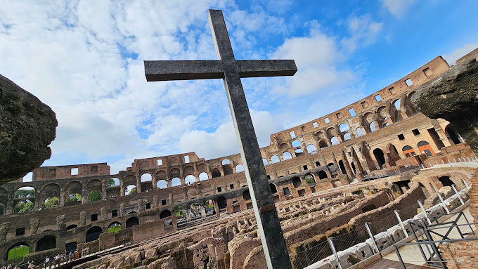
The Fellowship of His Sufferings

Slide 21
The Fellowship of His Sufferings
“But the Lord said to him (Ananias), “Go, because this man (Saul) is my chosen instrument to carry my name before Gentiles and kings and the people of Israel. For I will show him how much he must suffer for the sake of my name.”” (Acts 9:15-16)

Slide 22
Up Next
Bearing God’s Image:
Women and Men in the Kingdom of God
Rob Kranz

