Slide 1
Being God’s Image
Women and Men in the Kingdom of God

Slide 2
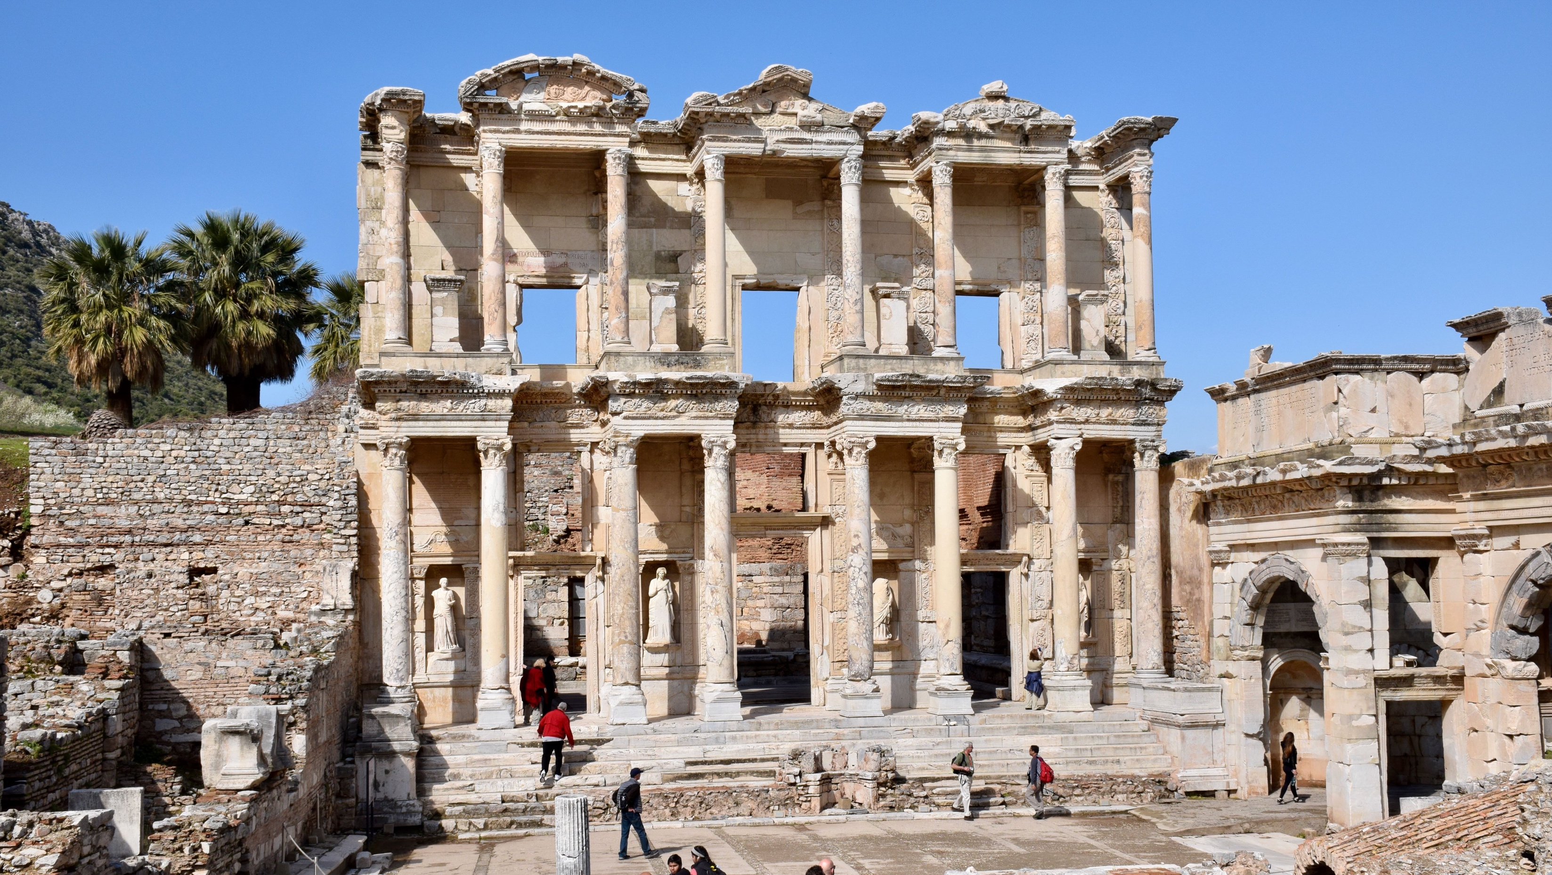
Price Subject to Change after March 28th
Biblical Study Tour: July 1–12, 2024

Slide 3
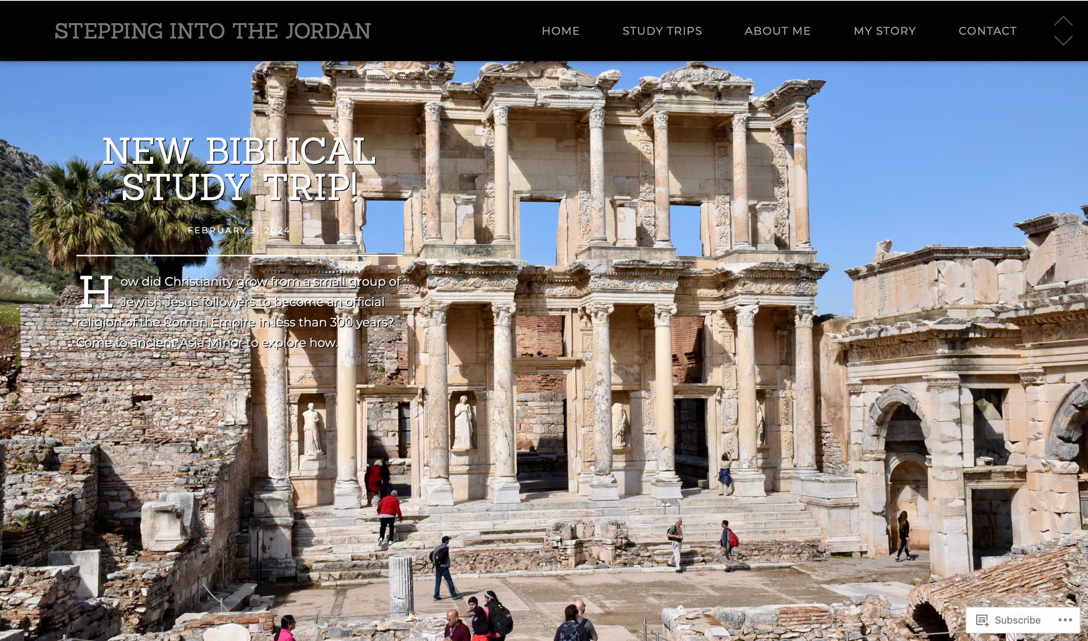
www.SteppingIntoTheJordan.com

Slide 4
Direct Link
https://steppingintothejordan.com/study-trips/

Slide 5
A Brief Review
Biblical Patriarchy

Slide 6
Individual Rights in Ancient World
The social world of the Bible is communal.
Self-identity is secondary to family identity
Identity comes from the Father’s Household (Beit Av)
Life begins at adoption, not birth.
Survival of the family on their land was everyone’s primary concern.
This was “eternal life.”

Slide 7
Protocol for Fathers of a Household
To protect and provide for his land and children, the father of a household is authorized to:
Adopt or excommunicate sons and daughters
Recruit workers and warriors
Negotiate marriages and covenants
Host strangers
Designate heirs

Slide 8
Protocol for Mothers of a Household
To protect and provide for their land and children, mothers of households:
Bear children and arrange for other wives to bear children
Manage the household by supervising domestic production, rationing, and food production.
Teach clan traditions
Mediate domestic conflicts
Designate heirs

Slide 9
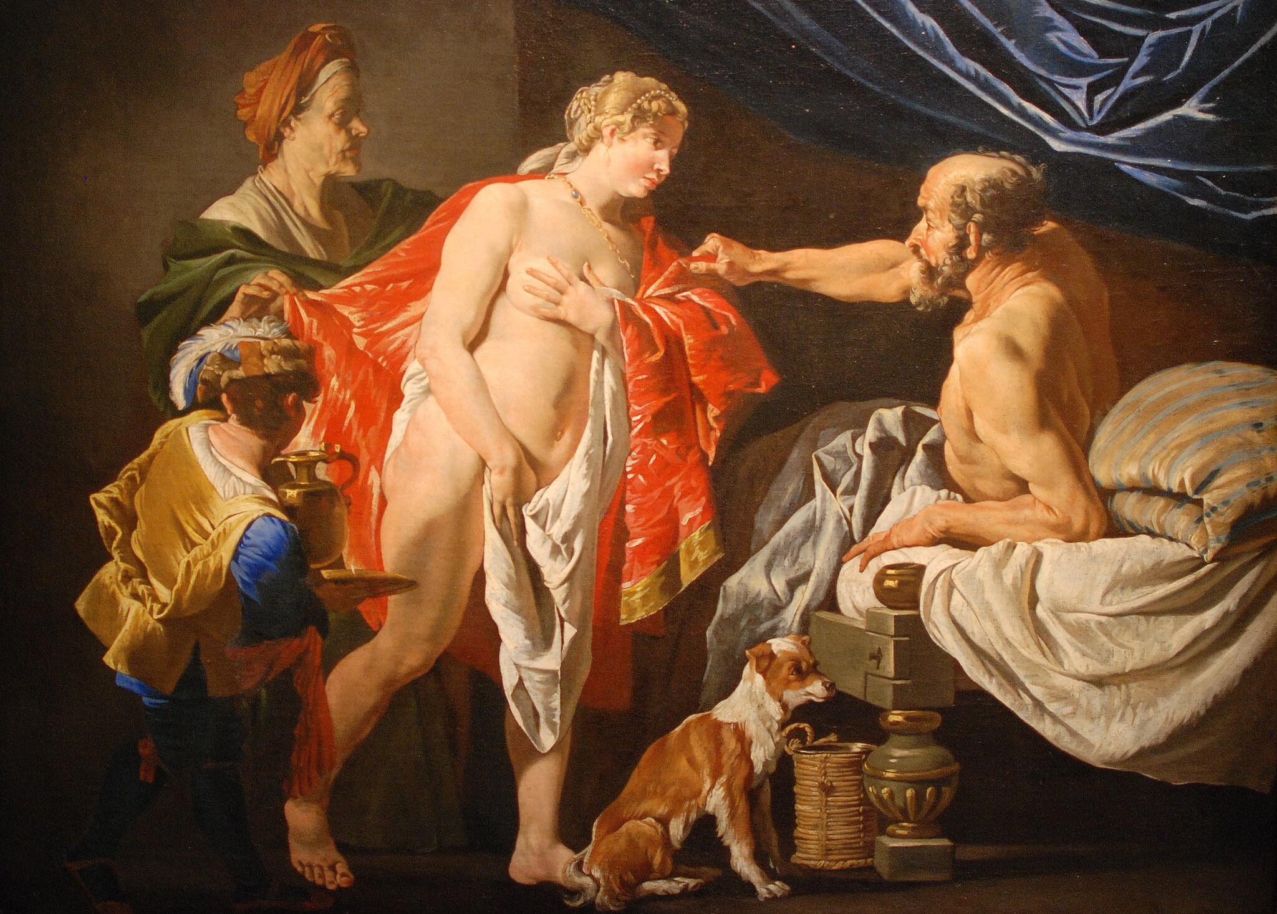
Sarah and Hagar

Slide 10
Setting the Stage
After these things the word of the LORD came to Abram in a vision, “Do not be afraid, Abram, I am your shield; your reward shall be very great.” But Abram said, “O Lord GOD, what will you give me, for I continue childless, and the heir of my house is Eliezer of Damascus?” And Abram said, “You have given me no offspring, and so a slave born in my house is to be my heir.” But the word of the LORD came to him, “This man shall not be your heir; no one but your very own issue shall be your heir.” He brought him outside and said, “Look toward heaven and count the stars, if you are able to count them.” Then he said to him, “So shall your descendants be.” And he believed the LORD; and the LORD reckoned it to him as righteousness.
Gen 15:1–6 (NRSV)

Slide 11
How long has it been since God made the original promise to Abram?
Around 10 years

Slide 12
Now Sarai, Abram’s wife, bore him no children. She had an Egyptian slave-girl whose name was Hagar, and Sarai said to Abram, “You see that the LORD has prevented me from bearing children; go in to my slave-girl; it may be that I shall obtain children by her.” And Abram listened to the voice of Sarai. So, after Abram had lived ten years in the land of Canaan, Sarai, Abram’s wife, took Hagar the Egyptian, her slave-girl, and gave her to her husband Abram as a wife. He went in to Hagar, and she conceived; and when she saw that she had conceived, she looked with contempt on her mistress.
Gen 16:1–4

Slide 13
How do you see patriarchal roles in this narrative?
Is Sarai within her rights to do this?

Slide 14
Now Sarai, Abram’s wife, bore him no children. She had an Egyptian slave-girl whose name was Hagar, and Sarai said to Abram, “You see that the LORD has prevented me from bearing children; go in to my slave-girl; it may be that I shall obtain children by her.” And Abram listened to the voice of Sarai. So, after Abram had lived ten years in the land of Canaan, Sarai, Abram’s wife, took Hagar the Egyptian, her slave-girl, and gave her to her husband Abram as a wife. He went in to Hagar, and she conceived; and when she saw that she had conceived, she looked with contempt on her mistress.
Gen 16:1–4

Slide 15
Then Sarai said to Abram, “May the wrong done to me be on you! I gave my slave-girl to your embrace, and when she saw that she had conceived, she looked on me with contempt. May the LORD judge between you and me!” But Abram said to Sarai, “Your slave-girl is in your power; do to her as you please.” Then Sarai dealt harshly with her, and she ran away from her.
Gen 16:5–6
Does anything strike you as odd here?
Is Hagar a wife or slave?

Slide 16
According to Matthews & Benjamin
A Trial by Ordeal in the Desert.
YHWH will decide who should be the primary woman of the household.
If Hagar survives, then YHWH sides with her.
If Hagar dies, the YHWH sides with Sarai.
(Personally, I’m skeptical of this view.)

Slide 17
The angel of the LORD found her by a spring of water in the wilderness, the spring on the way to Shur. And he said, “Hagar, slave-girl of Sarai, where have you come from and where are you going?” She said, “I am running away from my mistress Sarai.” The angel of the LORD said to her, “Return to your mistress, and submit to her.”
Gen 16:7–9
If this is a “Trial by Ordeal,” who wins?
But wait...there’s more!

Slide 18
The angel of the LORD also said to her, “I will so greatly multiply your offspring that they cannot be counted for multitude.” And the angel of the LORD said to her,
“Now you have conceived and shall bear a son;
you shall call him Ishmael,
for the LORD has given heed to your affliction.
He shall be a wild ass of a man,
with his hand against everyone,
and everyone’s hand against him;
and he shall live at odds with all his kin.”
So she named the LORD who spoke to her, “You are El-roi”; for she said, “Have I really seen God and remained alive after seeing him?” Therefore the well was called Beer-lahai-roi; it lies between Kadesh and Bered.
Gen 16:10–14
What does God give to Hagar?

Slide 19
The angel of the LORD also said to her, “I will so greatly multiply your offspring that they cannot be counted for multitude.” And the angel of the LORD said to her,
“Now you have conceived and shall bear a son;
you shall call him Ishmael,
for the LORD has given heed to your affliction.
He shall be a wild ass of a man,
with his hand against everyone,
and everyone’s hand against him;
and he shall live at odds with all his kin.”
So she named the LORD who spoke to her, “You are El-roi”; for she said, “Have I really seen God and remained alive after seeing him?” Therefore the well was called Beer-lahai-roi; it lies between Kadesh and Bered.
Gen 16:10–14
Hagar gives God a name.

Slide 20
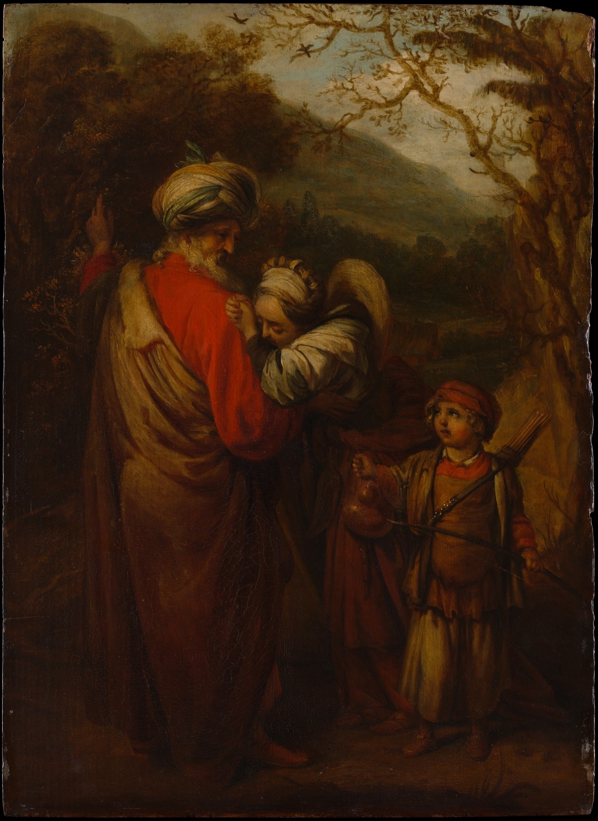
Hagar and Ishmael Sent Away

Slide 21
The child grew, and was weaned; and Abraham made a great feast on the day that Isaac was weaned. But Sarah saw the son of Hagar the Egyptian, whom she had borne to Abraham, playing with her son Isaac. So she said to Abraham, “Cast out this slave woman with her son; for the son of this slave woman shall not inherit along with my son Isaac.” The matter was very distressing to Abraham on account of his son. But God said to Abraham, “Do not be distressed because of the boy and because of your slave woman; whatever Sarah says to you, do as she tells you, for it is through Isaac that offspring shall be named for you. As for the son of the slave woman, I will make a nation of him also, because he is your offspring.” So Abraham rose early in the morning, and took bread and a skin of water, and gave it to Hagar, putting it on her shoulder, along with the child, and sent her away. And she departed, and wandered about in the wilderness of Beer-sheba.
Gen 21:8–14

Slide 22
When the water in the skin was gone, she cast the child under one of the bushes. Then she went and sat down opposite him a good way off, about the distance of a bowshot; for she said, “Do not let me look on the death of the child.” And as she sat opposite him, she lifted up her voice and wept. And God heard the voice of the boy; and the angel of God called to Hagar from heaven, and said to her, “What troubles you, Hagar? Do not be afraid; for God has heard the voice of the boy where he is. Come, lift up the boy and hold him fast with your hand, for I will make a great nation of him.” Then God opened her eyes and she saw a well of water. She went, and filled the skin with water, and gave the boy a drink.
Gen 21:15–19

Slide 23
God was with the boy, and he grew up; he lived in the wilderness, and became an expert with the bow. He lived in the wilderness of Paran; and his mother got a wife for him from the land of Egypt.
Gen 21:20–21
Sarah lived one hundred twenty-seven years; this was the length of Sarah’s life. And Sarah died at Kiriath-arba (that is, Hebron) in the land of Canaan; and Abraham went in to mourn for Sarah and to weep for her.
Gen 23:1–2

Slide 24
Now Isaac had come from Beer-lahai-roi, and was settled in the Negeb. Isaac went out in the evening to walk in the field; and looking up, he saw camels coming. And Rebekah looked up, and when she saw Isaac, she slipped quickly from the camel, and said to the servant, “Who is the man over there, walking in the field to meet us?” The servant said, “It is my master.” So she took her veil and covered herself.
Gen 24:62–65
His sons Isaac and Ishmael buried him in the cave of Machpelah, in the field of Ephron son of Zohar the Hittite, east of Mamre, the field that Abraham purchased from the Hittites. There Abraham was buried, with his wife Sarah. After the death of Abraham God blessed his son Isaac. And Isaac settled at Beer-lahai-roi.
Gen 25:9–11

Slide 25
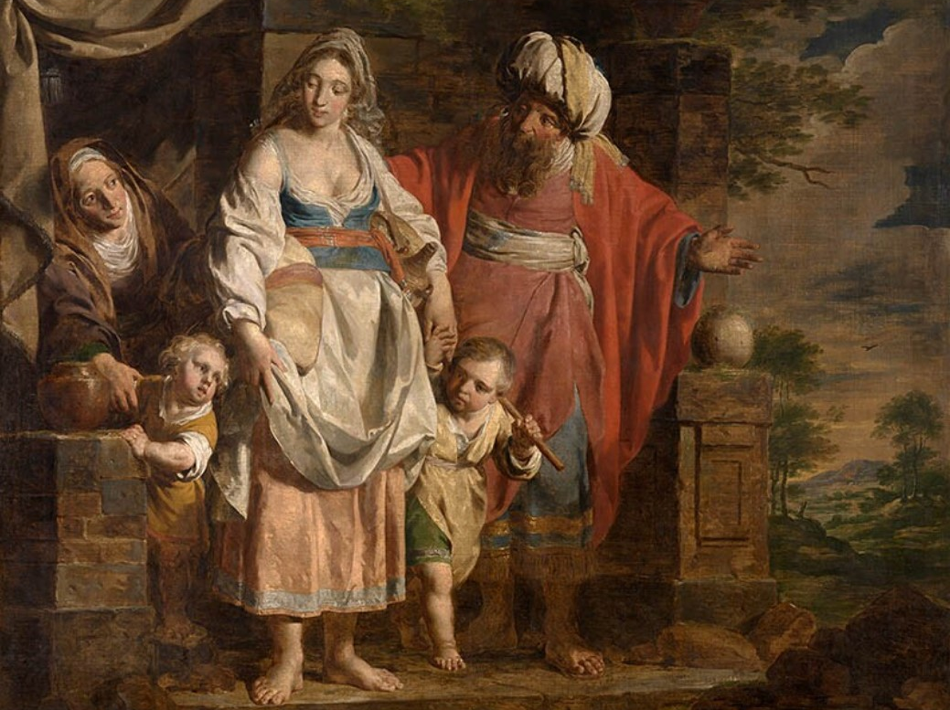
What does Hagar’s story
teach us about female agency?

Slide 26
Hagar
Receives a covenant (like the Patriarchs)
Only person to give God a name
Arranges marriage for Ishmael
Hagar’s oppression is a Type of Israel’s oppression in Egypt.

Slide 27
Summary
Sarah and Hagar function within patriarchy.
Sarah exercises authority as the matriarch.
Hagar functions as both patriarch and matriarch.
Hagar receives a covenant with God.
Names God
Arranges marriage for Ishmael
Does Hagar become “mother” for Isaac?

Slide 28
Next Week
We move to the NT
Jesus and Women
Thought Question: How did the Romans maintain control over such a vast empire?

