Slide 1
Being God’s Image
Women and Men in the Kingdom of God

Slide 2
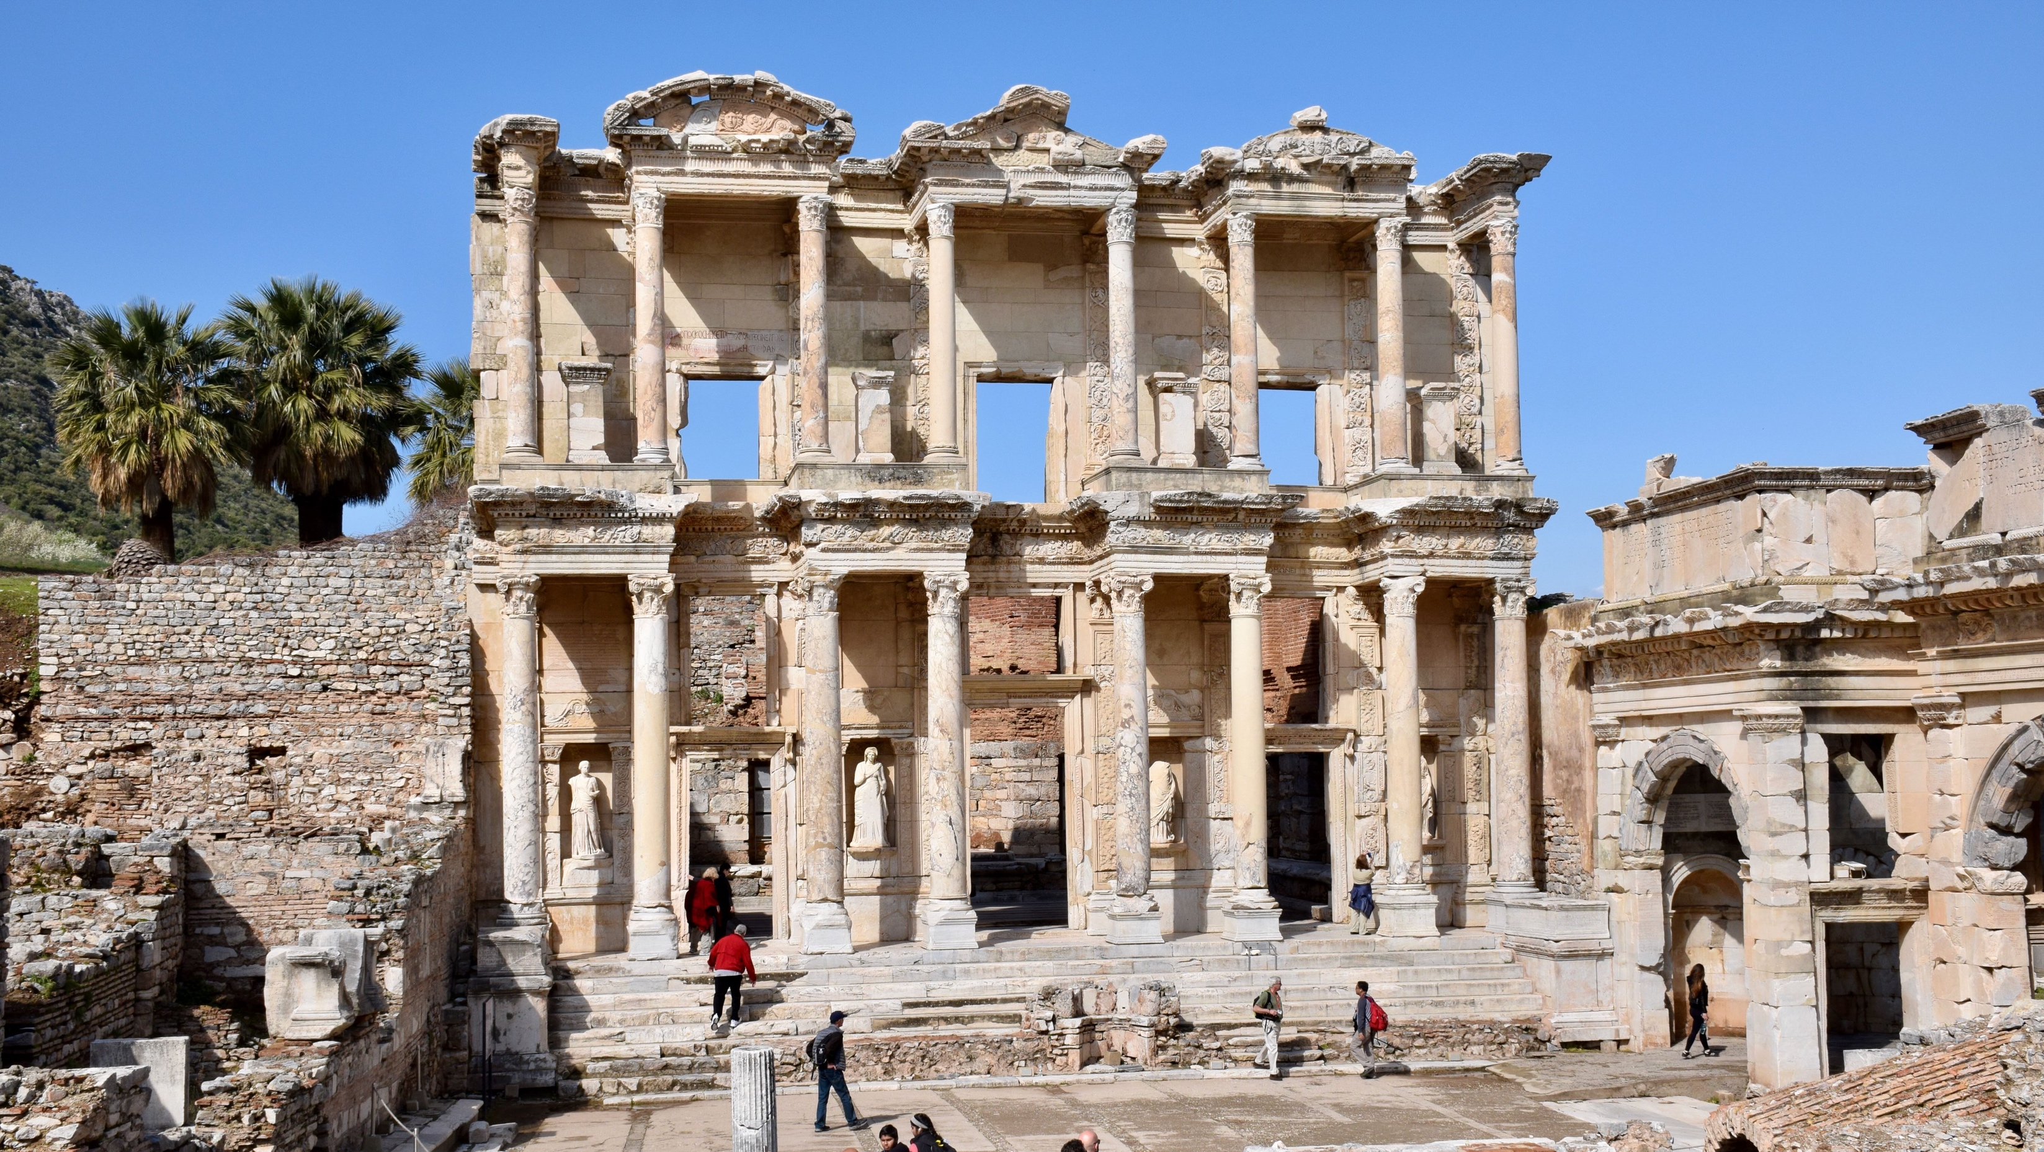
Biblical Study Tour: July 1–12, 2024

Slide 3
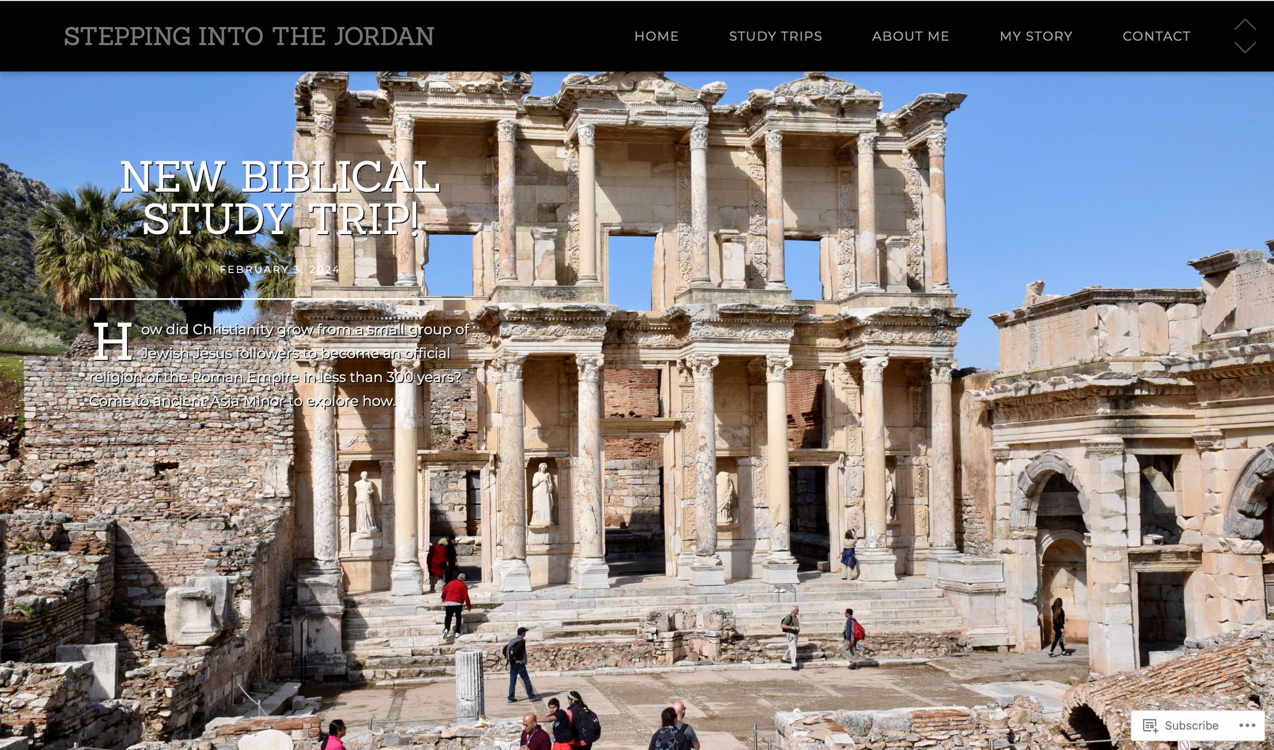
www.SteppingIntoTheJordan.com

Slide 4
Direct Link
https://steppingintothejordan.com/study-trips/

Slide 5
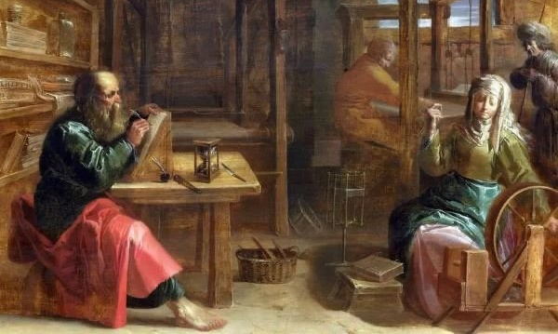
Paul and Women

Slide 6
Some Background
News of this came to the ears of the church in Jerusalem, and they sent Barnabas to Antioch. When he came and saw the grace of God, he rejoiced, and he exhorted them all to remain faithful to the Lord with steadfast devotion; for he was a good man, full of the Holy Spirit and of faith. And a great many people were brought to the Lord. Then Barnabas went to Tarsus to look for Saul, and when he had found him, he brought him to Antioch. So it was that for an entire year they met with the church and taught a great many people, and it was in Antioch that the disciples were first called “Christians.”
Acts 11:22–26 (NRSV)
Who is the “leader” between these two?

Slide 7
The disciples determined that according to their ability, each would send relief to the believers living in Judea; this they did, sending it to the elders by Barnabas and Saul.
Acts 11:29–30
Then after completing their mission Barnabas and Saul returned to Jerusalem and brought with them John, whose other name was Mark.
Acts 12:25
While they were worshiping the Lord and fasting, the Holy Spirit said, “Set apart for me Barnabas and Saul for the work to which I have called them.”
Acts 13:2
He was with the proconsul, Sergius Paulus, an intelligent man, who summoned Barnabas and Saul and wanted to hear the word of God.
Acts 13:7
As Paul and Barnabas were going out, the people urged them to speak about these things again the next sabbath.
Acts 13:42
What do you notice about their names?

Slide 8
Name Order
The “senior” person is listed first.
Something happens on Cyprus that changes the dynamics between Barnabas and Saul.
Saul’s name shifts to Paul.
Name order shifts with it.
After Acts 13, Paul is always listed first, with the exception of Acts 14 in Lystra.

Slide 9
The Lystra Incident
Barnabas they called Zeus, and Paul they called Hermes, because he was the chief speaker. The priest of Zeus, whose temple was just outside the city, brought oxen and garlands to the gates; he and the crowds wanted to offer sacrifice. When the apostles Barnabas and Paul heard of it, they tore their clothes and rushed out into the crowd, shouting, “Friends, why are you doing this? We are mortals just like you, and we bring you good news, that you should turn from these worthless things to the living God, who made the heaven and the earth and the sea and all that is in them.
Acts 14:12–15
What changed in the dynamics of this team?

Slide 10
What does this have to do
with Paul and Women?!?

Slide 11
After this Paul left Athens and went to Corinth. There he found a Jew named Aquila, a native of Pontus, who had recently come from Italy with his wife Priscilla, because Claudius had ordered all Jews to leave Rome. Paul went to see them, and, because he was of the same trade, he stayed with them, and they worked together—by trade they were tentmakers.
Acts 18:1–3
After staying there for a considerable time, Paul said farewell to the believers and sailed for Syria, accompanied by Priscilla and Aquila. At Cenchreae he had his hair cut, for he was under a vow. When they reached Ephesus, he left them there, but first he himself went into the synagogue and had a discussion with the Jews.
Acts 18:18–19
What shift do you notice?

Slide 12
Now there came to Ephesus a Jew named Apollos, a native of Alexandria. He was an eloquent man, well-versed in the scriptures. He had been instructed in the Way of the Lord; and he spoke with burning enthusiasm and taught accurately the things concerning Jesus, though he knew only the baptism of John. He began to speak boldly in the synagogue; but when Priscilla and Aquila heard him, they took him aside and explained the Way of God to him more accurately.
Acts 18:24–26
Who does Luke list first?
What do they do?

Slide 13
Greet Prisca and Aquila, who work with me in Christ Jesus, and who risked their necks for my life, to whom not only I give thanks, but also all the churches of the Gentiles. Greet also the church in their house.
Rom 16:3–5a
They are the first people Paul greets in Romans

Slide 14
What can we say about Priscilla?
After her initial introduction, she is always listed first.
She is a teacher of Apollos.
She is a church leader.
She is Paul’s co-worker.

Slide 15
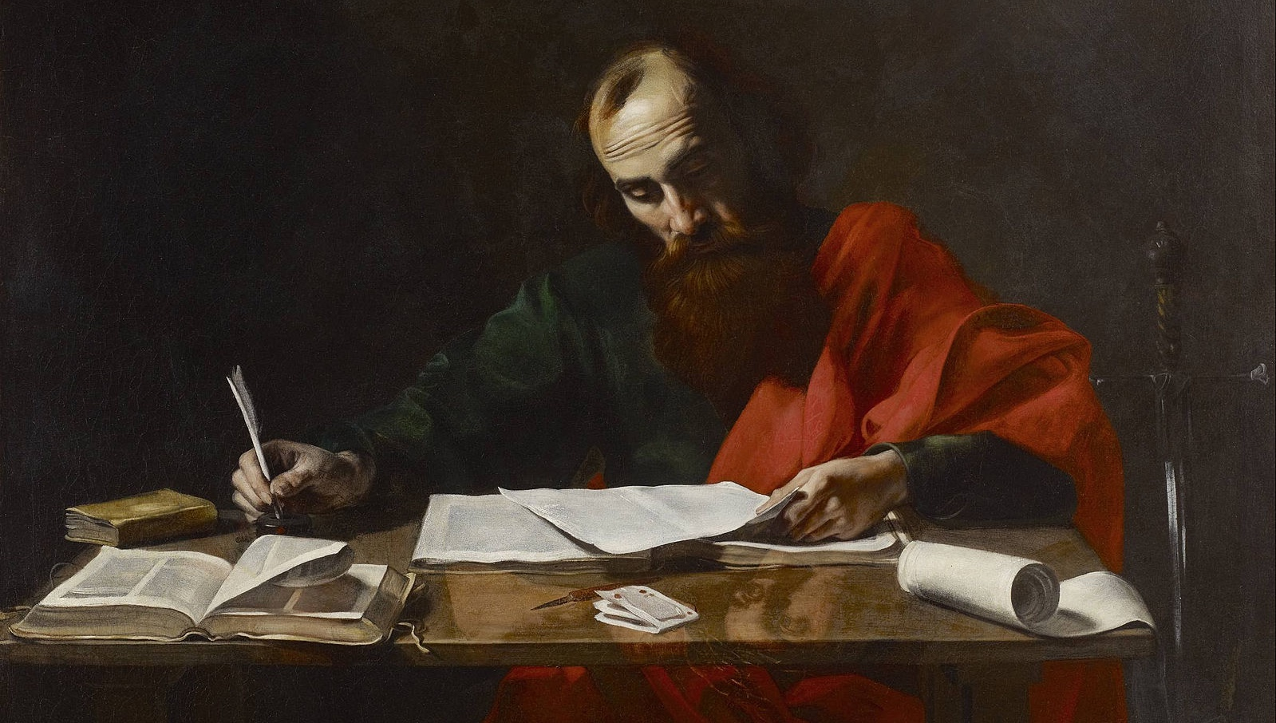
Romans 16

Slide 16
I commend to you our sister Phoebe, a deacon of the church at Cenchreae, so that you may welcome her in the Lord as is fitting for the saints, and help her in whatever she may require from you, for she has been a benefactor of many and of myself as well.
Greet Prisca and Aquila, who work with me in Christ Jesus, and who risked their necks for my life, to whom not only I give thanks, but also all the churches of the Gentiles. Greet also the church in their house. Greet my beloved Epaenetus, who was the first convert in Asia for Christ. Greet Mary, who has worked very hard among you. Greet Andronicus and Junia, my relatives who were in prison with me; they are prominent among the apostles, and they were in Christ before I was. Greet Ampliatus, my beloved in the Lord. Greet Urbanus, our co-worker in Christ, and my beloved Stachys. Greet Apelles, who is approved in Christ. Greet those who belong to the family of Aristobulus. Greet my relative Herodion. Greet those in the Lord who belong to the family of Narcissus. Greet those workers in the Lord, Tryphaena and Tryphosa. Greet the beloved Persis, who has worked hard in the Lord. Greet Rufus, chosen in the Lord; and greet his mother—a mother to me also. Greet Asyncritus, Phlegon, Hermes, Patrobas, Hermas, and the brothers and sisters who are with them. Greet Philologus, Julia, Nereus and his sister, and Olympas, and all the saints who are with them. Greet one another with a holy kiss. All the churches of Christ greet you.

Slide 17
I commend to you our sister Phoebe, a deacon of the church at Cenchreae, so that you may welcome her in the Lord as is fitting for the saints, and help her in whatever she may require from you, for she has been a benefactor of many and of myself as well.
Greet Prisca and Aquila, who work with me in Christ Jesus, and who risked their necks for my life, to whom not only I give thanks, but also all the churches of the Gentiles. Greet also the church in their house. Greet my beloved Epaenetus, who was the first convert in Asia for Christ. Greet Mary, who has worked very hard among you. Greet Andronicus and Junia, my relatives who were in prison with me; they are prominent among the apostles, and they were in Christ before I was. Greet Ampliatus, my beloved in the Lord. Greet Urbanus, our co-worker in Christ, and my beloved Stachys. Greet Apelles, who is approved in Christ. Greet those who belong to the family of Aristobulus. Greet my relative Herodion. Greet those in the Lord who belong to the family of Narcissus. Greet those workers in the Lord, Tryphaena and Tryphosa. Greet the beloved Persis, who has worked hard in the Lord. Greet Rufus, chosen in the Lord; and greet his mother—a mother to me also. Greet Asyncritus, Phlegon, Hermes, Patrobas, Hermas, and the brothers and sisters who are with them. Greet Philologus, Julia, Nereus and his sister, and Olympas, and all the saints who are with them. Greet one another with a holy kiss. All the churches of Christ greet you.

Slide 18
10 of the 29 named persons are women
Some have some interesting descriptions.

Slide 19
Phoebe (Romans 16:1-2)
I commend to you our sister Phoebe, a deacon of the church at Cenchreae, so that you may welcome her in the Lord as is fitting for the saints, and help her in whatever she may require from you, for she has been a benefactor of many and of myself as well.
Phoebe is recognized as the letter carrier.
Travel was dangerous.
She would have read and interpreted the letter, perhaps multiple times in different house churches.

Slide 20
Phoebe (Romans 16:1-2)
I commend to you our sister Phoebe, a deacon of the church at Cenchreae, so that you may welcome her in the Lord as is fitting for the saints, and help her in whatever she may require from you, for she has been a benefactor of many and of myself as well.
διάκονον can be translated servant, minister, or deacon
“of the church at Cenchreae” leads to deacon
Phoebe is the only named deacon of a church in Scripture
Recognized by Clement of Alexandria and John Chrysostom
Examples of female deacons in early church history

Slide 21
Phoebe (Romans 16:1-2)
I commend to you our sister Phoebe, a deacon of the church at Cenchreae, so that you may welcome her in the Lord as is fitting for the saints, and help her in whatever she may require from you, for she has been a benefactor of many and of myself as well.
προστάτις can also be translated patron, ruler, or leader.
Phoebe was probably wealthy.
In a culture focused on honor, patronage was integral to the social structure.

Slide 22
Junia
Greet Andronicus and Junia, my relatives who were in prison with me; they are prominent among the apostles, and they were in Christ before I was.
Junia is attested as female by the church fathers.
Female Junia is supported by the text.
In late 1800s, some decided Junia was Junias.
“prominent among” versus “well known by”
What is an apostle in this context?

Slide 23
What can we say about Paul and Women?
Women are integral to Paul’s ministry.
Paul has women co-workers.
Paul has a woman patron (as do others).
Paul attests to women holding important leadership roles in the early church.
House church leaders, deacons, apostles, benefactors
These women work against our “traditional” readings of the “problematic” passages in 1 Cor and 1 Tim.

Slide 24
Next Week
Elders and Deacons
Read
1 Tim 3
Titus 1
Rom 16:1

