Slide 1
Being God’s Image
Women and Men in the Kingdom of God

Slide 2
Next Week
A final summary/wrap-up
Plenty of time for Q&A and discussions.
If you want to e-mail questions to me:
rob.kranz@steppingintothejordan.com

Slide 3
Does this Study Matter?
Is this a theoretical discussion or does it have Kingdom-consequences?

Slide 4
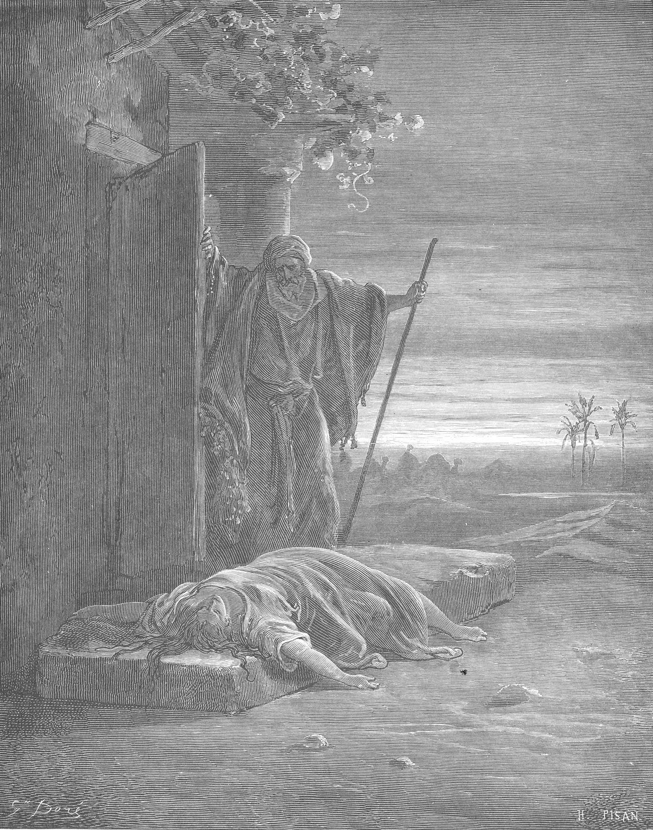
Judges 19–21
The Levite,
his Concubine,
and the aftermath

Slide 5
WARNING
This lesson contains graphic descriptions of sexual violence.

Slide 6
In those days, when there was no king in Israel, a certain Levite, residing in the remote parts of the hill country of Ephraim, took to himself a concubine from Bethlehem in Judah. But his concubine became angry with him, and she went away from him to her father’s house at Bethlehem in Judah, and was there some four months. Then her husband set out after her, to speak tenderly to her and bring her back. He had with him his servant and a couple of donkeys. When he reached her father’s house, the girl’s father saw him and came with joy to meet him. His father-in-law, the girl’s father, made him stay, and he remained with him three days; so they ate and drank, and he stayed there.
Judg 19:1–4 (NRSV)
Who is doing the eating and drinking?

Slide 7
On the fourth day they got up early in the morning, and he prepared to go; but the girl’s father said to his son-in-law, “Fortify yourself with a bit of food, and after that you may go.” So the two men sat and ate and drank together; and the girl’s father said to the man, “Why not spend the night and enjoy yourself?” When the man got up to go, his father-in-law kept urging him until he spent the night there again. On the fifth day he got up early in the morning to leave; and the girl’s father said, “Fortify yourself.” So they lingered until the day declined, and the two of them ate and drank. When the man with his concubine and his servant got up to leave, his father-in-law, the girl’s father, said to him, “Look, the day has worn on until it is almost evening. Spend the night. See, the day has drawn to a close. Spend the night here and enjoy yourself. Tomorrow you can get up early in the morning for your journey, and go home.”
Judg 19:5–9

Slide 8
But the man would not spend the night; he got up and departed, and arrived opposite Jebus (that is, Jerusalem). He had with him a couple of saddled donkeys, and his concubine was with him. When they were near Jebus, the day was far spent, and the servant said to his master, “Come now, let us turn aside to this city of the Jebusites, and spend the night in it.” But his master said to him, “We will not turn aside into a city of foreigners, who do not belong to the people of Israel; but we will continue on to Gibeah.” Then he said to his servant, “Come, let us try to reach one of these places, and spend the night at Gibeah or at Ramah.” So they passed on and went their way; and the sun went down on them near Gibeah, which belongs to Benjamin. They turned aside there, to go in and spend the night at Gibeah. He went in and sat down in the open square of the city, but no one took them in to spend the night.
Judg 19:10–15

Slide 9
Then at evening there was an old man coming from his work in the field. The man was from the hill country of Ephraim, and he was residing in Gibeah. (The people of the place were Benjaminites.) When the old man looked up and saw the wayfarer in the open square of the city, he said, “Where are you going and where do you come from?” He answered him, “We are passing from Bethlehem in Judah to the remote parts of the hill country of Ephraim, from which I come. I went to Bethlehem in Judah; and I am going to my home. Nobody has offered to take me in. We your servants have straw and fodder for our donkeys, with bread and wine for me and the woman and the young man along with us. We need nothing more.” The old man said, “Peace be to you. I will care for all your wants; only do not spend the night in the square.” So he brought him into his house, and fed the donkeys; they washed their feet, and ate and drank.
Judg 19:16–21

Slide 10
While they were enjoying themselves, the men of the city, a perverse lot, surrounded the house, and started pounding on the door. They said to the old man, the master of the house, “Bring out the man who came into your house, so that we may have intercourse with him.” And the man, the master of the house, went out to them and said to them, “No, my brothers, do not act so wickedly. Since this man is my guest, do not do this vile thing. Here are my virgin daughter and his concubine; let me bring them out now. Ravish them and do whatever you want to them; but against this man do not do such a vile thing.” But the men would not listen to him. So the man seized his concubine, and put her out to them. They wantonly raped her, and abused her all through the night until the morning. And as the dawn began to break, they let her go. As morning appeared, the woman came and fell down at the door of the man’s house where her master was, until it was light.
Judg 19:22–26

Slide 11
In the morning her master got up, opened the doors of the house, and when he went out to go on his way, there was his concubine lying at the door of the house, with her hands on the threshold. “Get up,” he said to her, “we are going.” But there was no answer. Then he put her on the donkey; and the man set out for his home. When he had entered his house, he took a knife, and grasping his concubine he cut her into twelve pieces, limb by limb, and sent her throughout all the territory of Israel. Then he commanded the men whom he sent, saying, “Thus shall you say to all the Israelites, ‘Has such a thing ever happened since the day that the Israelites came up from the land of Egypt until this day? Consider it, take counsel, and speak out.’”
Judg 19:27–30
Is the woman dead or alive when they leave Gibeah?

Slide 12
A Close Reading of the Text
What is this woman’s name?
How is she described?
Who carries out all the action?
The Levite and the Ephraimite have a problem. How do they solve it?
This story is meant to horrify us.
It is not designed to be a model to follow.

Slide 13
The tribes of Israel sent men through all the tribe of Benjamin, saying, “What crime is this that has been committed among you? Now then, hand over those scoundrels in Gibeah, so that we may put them to death, and purge the evil from Israel.” But the Benjaminites would not listen to their kinsfolk, the Israelites. The Benjaminites came together out of the towns to Gibeah, to go out to battle against the Israelites.
Judg 20:12–14
3 days of battle inflict losses on both sides before Israel defeats Benjamin

Slide 14
Meanwhile, the Israelites turned back against the Benjaminites, and put them to the sword—the city, the people, the animals, and all that remained. Also the remaining towns they set on fire.
Judg 20:48
Now the Israelites had sworn at Mizpah, “No one of us shall give his daughter in marriage to Benjamin.” And the people came to Bethel, and sat there until evening before God, and they lifted up their voices and wept bitterly. They said, “O LORD, the God of Israel, why has it come to pass that today there should be one tribe lacking in Israel?”
Judg 21:1–3
Why is the tribe of Benjamin lost?

Slide 15
Then they said, “Is there anyone from the tribes of Israel who did not come up to the LORD to Mizpah?” It turned out that no one from Jabesh-gilead had come to the camp, to the assembly. For when the roll was called among the people, not one of the inhabitants of Jabesh-gilead was there. So the congregation sent twelve thousand soldiers there and commanded them, “Go, put the inhabitants of Jabesh-gilead to the sword, including the women and the little ones. This is what you shall do; every male and every woman that has lain with a male you shall devote to destruction.” And they found among the inhabitants of Jabesh-gilead four hundred young virgins who had never slept with a man and brought them to the camp at Shiloh, which is in the land of Canaan.
Judg 21:8–12
The “solution” to the rape of 1 woman leads to the rape of 400 more.

Slide 16
So the elders of the congregation said, “What shall we do for wives for those who are left, since there are no women left in Benjamin?” And they said, “There must be heirs for the survivors of Benjamin, in order that a tribe may not be blotted out from Israel. Yet we cannot give any of our daughters to them as wives.” For the Israelites had sworn, “Cursed be anyone who gives a wife to Benjamin.” So they said, “Look, the yearly festival of the LORD is taking place at Shiloh, which is north of Bethel, on the east of the highway that goes up from Bethel to Shechem, and south of Lebonah.”
Judg 21:16–19

Slide 17
And they instructed the Benjaminites, saying, “Go and lie in wait in the vineyards, and watch; when the young women of Shiloh come out to dance in the dances, then come out of the vineyards and each of you carry off a wife for himself from the young women of Shiloh, and go to the land of Benjamin. Then if their fathers or their brothers come to complain to us, we will say to them, ‘Be generous and allow us to have them; because we did not capture in battle a wife for each man. But neither did you incur guilt by giving your daughters to them.’” The Benjaminites did so; they took wives for each of them from the dancers whom they abducted. Then they went and returned to their territory, and rebuilt the towns, and lived in them. So the Israelites departed from there at that time by tribes and families, and they went out from there to their own territories.
Judg 21:20–24

Slide 18
Let’s Recap
The threat of violence against the Levite leads to the rape and murder of his concubine and civil war.
The “solution” to the concubine’s death and a foolish vow by the men results in the rape of 400 more women plus countless others, as well as the execution of many more.
No women have any voice in this narrative.
The final verse of the chapter (and the Book of Judges) summarizes how the author of Judges feels about the situation.

Slide 19
In those days there was no king in Israel;
all the people did what was right in their own eyes.
Judg 21:25
This is not a positive evaluation.

Slide 20
Does this Study Matter?
Is this a theoretical discussion or does it have Kingdom-consequences?

Slide 21
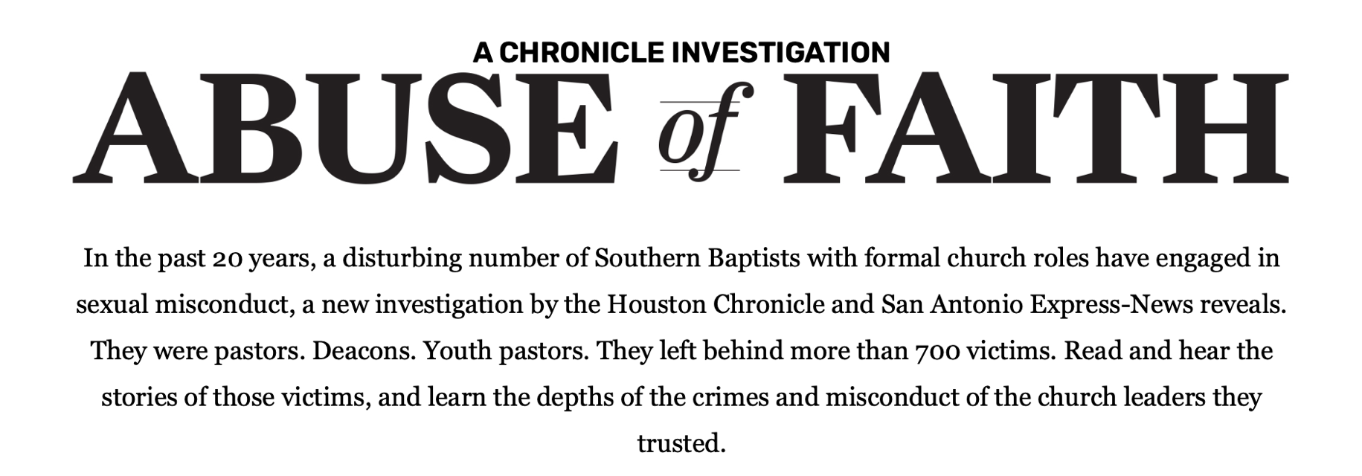
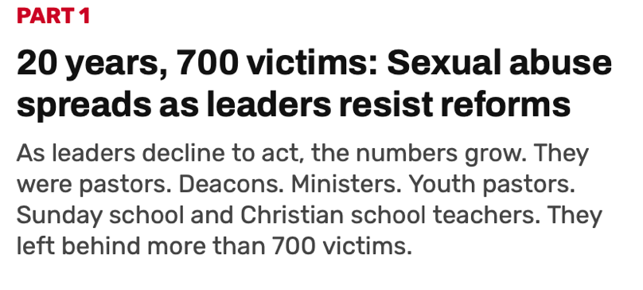
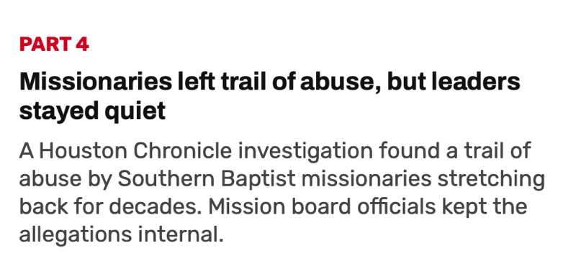

Slide 22
Name the Publication
The Christian Chronicle

Slide 23
#ChurchToo
“Quite simply, millions of abuse survivors are fed up with the church protecting abusers while shaming the victims...
from survivors who were either not believed by their church leaders or, worse, were humiliated, shamed and blamed for the abuse...
These survivors are desperate to know that not all church leaders protect abusers.”
Jimmy Hinton, Minister Sommerset Church of Christ
Bobby Ross, Jr. “#ChurchToo: Sexual abuse victims ‘fed up’ with silence,” The Christian Chronicle, March 1, 2018.

Slide 24
#ChurchToo
“I’ve heard story after countless story as the victims sit on my couch seeking hope for healing. Often, it’s been years, even decades, since the assaults. If they told anyone at the time, they often weren’t believed. If they were believed, they likely were told to forgive at best. At worst, they were blamed and shamed.”
Christine Parker, Therapist
Grand Central Church of Christ
Vienna, WV
Bobby Ross, Jr. “#ChurchToo: Sexual abuse victims ‘fed up’ with silence,” The Christian Chronicle, March 1, 2018.

Slide 25
My Opinion
Silencing women perpetuates abuse.
On the whole, men (and male-only leadership) have failed to properly confront sexual abuse within the church.
Often favoring the abuser over the victims.
The best way to ensure accountability is to give women a seat at the table.

Slide 26
Summary
Our view of women and their roles in the church have real-world implications.
The holistic witness of Scripture emphasizes the protection (and elevation) of the powerless.
To fail in this duty harms our witness to the world.
My opinion: Women need a seat at the table to ensure our churches protect and uplift victims of sexual violence and abuse and demand accountability from the abusers.

Slide 27
Next Week
Summary/Wrap-up
Q&A and Discussion
Feel free to e-mail questions to me.

