Slide 1
Being God’s Image
Women and Men in the Kingdom of God

Slide 2
Being God’s Image
Review and Wrap Up

Slide 3
What does the Bible say about gender roles?

Slide 4
As a tradition, we take the Bible very seriously. In this study, we carefully examined the complete witness of Scripture.
I have not asked you to ignore the Bible. I have asked you to examine it closely and consider how we read it. Hopefully, I have challenged you to read it differently.

Slide 5
Two Views
Complementarianism is the teaching that masculinity and femininity are ordained by God and that men and women are created to complement or complete each other. Complementarianism considers the gender roles found in the Bible to be purposeful and meaningful distinctions that, when applied in the home and church, promote the spiritual health of both men and women. Embracing the divinely ordained roles of men and women furthers the ministry of God’s people and allows men and women to reach their God-given potential.
Egalitarianism is the view that all people are inherently equal and ought to be treated as such. Within Christianity, egalitarianism views that God does not intend any distinctions between men and women in matters of spiritual leadership...All people are morally and spiritually equal, with identical value, and ought to be offered the same opportunities. In other words, God gifts men and women without distinction for service in the kingdom of God. As such, everyone should be allowed to achieve their God-given potential.

Slide 6
Traditionalism
The “traditional” view held by Judaism and Christianity was that women were inferior to men in their very nature.
The complementarian view is NOT the traditional view. That’s why its adherents call it “complementarian” and not “traditional.”

Slide 7
Genesis 1
Both sexes created in the image of God
Sexual differentiation does not mean hierarchy; it means equality.
Humankind receives 2 responsibilities:
procreation and dominion
Given to both sexes, without distinction
No mention of gender roles/sexual stereotypes

Slide 8
Gen 1–3
In Gen 1, sexual differentiation means equality.
In Gen 2–3, the woman is an ezer kenegddo.
Someone who does for the man what he is unable to do for himself.
A more than capable partner, not a subservient helper.
Disobedience breaks the garden’s shalom.
The consequences bring about hardship
Relational inequality
The consequences were never meant to be the end goal.
Restoration of shalom is a central theme of Scripture.

Slide 9
“Biblical” Patriarchy
Patriarchy in the Bible is different than our modern definition.
The social world of the Bible is communal
Individual concerns are of little importance.
Women (mothers) played a vital role in the leadership of the household.
Rebekah is one example of a woman who steps in to protect the survival of her household.
Her actions are not condemned.

Slide 10
Powerful Women in Old Testament
Sarah
Hagar
Rebekah
Deborah
Jael
Huldah
and many, many more....

Slide 11
Women in the New Testament
Women (especially in Asia Minor) played an important role as Patrons/Benefactors.
Jewish women played important leadership roles in the synagogue.
Synagogue Leader
Elder
Jesus had women patrons.
They weren’t (necessarily) doing the cooking and laundry.
Provided financial support
These women model a new form of patronage in the Kingdom of God.

Slide 12
Paul and Women
Women are integral to Paul’s ministry.
Paul has women co-workers.
Paul has a woman patron (as do others).
Paul attests to women holding important leadership roles in the early church.
House church leaders, deacons, apostles, benefactors
These women work against our “traditional” readings of the “problematic” passages in 1 Cor 14 and 1 Tim 2.

Slide 13
The Big “But”
Women should be silent in the churches. For they are not permitted to speak, but should be subordinate, as the law also says. If there is anything they desire to know, let them ask their husbands at home. For it is shameful for a woman to speak in church.
1 Cor 14:34–35 (NRSV)

Slide 14
1 Cor 14
Paul is referencing civic or household codes, not the Torah, in this passage.
His view is in line with the social structure of the Roman world of the 1st century (as we should expect it to be).
Note that it is “shameful,” not sinful. Likewise, our practice should not be “shameful” in accordance with our cultural norms.
His argument is part of a larger discussion on order and edification of the body.

Slide 15
The Bigger “But...”
I permit no woman to teach or to have authority over a man; she is to keep silent.
1 Tim 2:12

Slide 16
A Better Translation...
Option 1: I do not permit a woman to teach a man in a domineering way but to have a quiet demeanor.
Option 2: I do not permit a wife to teach a husband in a domineering way but to have a quiet demeanor.
Better fits the importance of women in Paul’s ministry

Slide 17
Elders and Deacons
Paul’s focus for church leadership in 1 Tim and Titus is outward-focused.
Paul’s qualifications for leadership are rooted in societal expectations of honor within the community, according to society’s standards.
We adapt these qualifications today to suit our specific needs (and interpretation).
Nevertheless, we know there were women elders, deacons, prophets, teachers, and bishops in the early church.

Slide 18
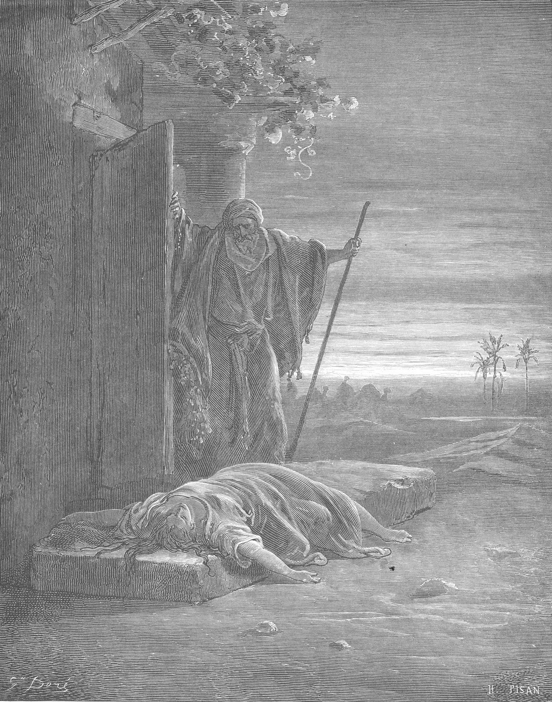
Judges 19–21
The Levite,
his Concubine,
and the aftermath

Slide 19
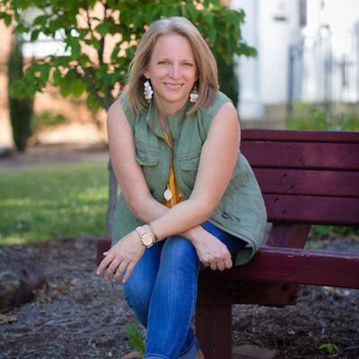
#ChurchToo
“I’ve heard story after countless story as the victims sit on my couch seeking hope for healing. Often, it’s been years, even decades, since the assaults. If they told anyone at the time, they often weren’t believed. If they were believed, they likely were told to forgive at best. At worst, they were blamed and shamed.”
Christine Parker, Therapist
Grand Central Church of Christ
Vienna, WV
Bobby Ross, Jr. “#ChurchToo: Sexual abuse victims ‘fed up’ with silence,” The Christian Chronicle, March 1, 2018.

Slide 20
Why this study matters
Our view of women and their roles in the church have real-world implications.
The holistic witness of Scripture emphasizes the protection (and elevation) of the powerless.
To fail in this duty harms our witness to the world.
My opinion: Women need a seat at the table to ensure our churches protect and uplift victims of sexual violence and abuse and demand accountability from the abusers.

Slide 21
Summary
I will pour out my spirit on all flesh;
your sons and your daughters shall prophesy,
your old men shall dream dreams,
and your young men shall see visions.
Even on the male and female slaves,
in those days, I will pour out my spirit.
Joel 2:28–29 (MT 3:1–2)
As many of you as were baptized into Christ have clothed yourselves with Christ. There is no longer Jew or Greek, there is no longer slave or free, there is no longer male and female; for all of you are one in Christ Jesus.
Gal 3:27–28

Slide 22
Questions?

Slide 23
Thank You!

