Slide 1
Being God’s Image
Women and Men in the Kingdom of God

Slide 2
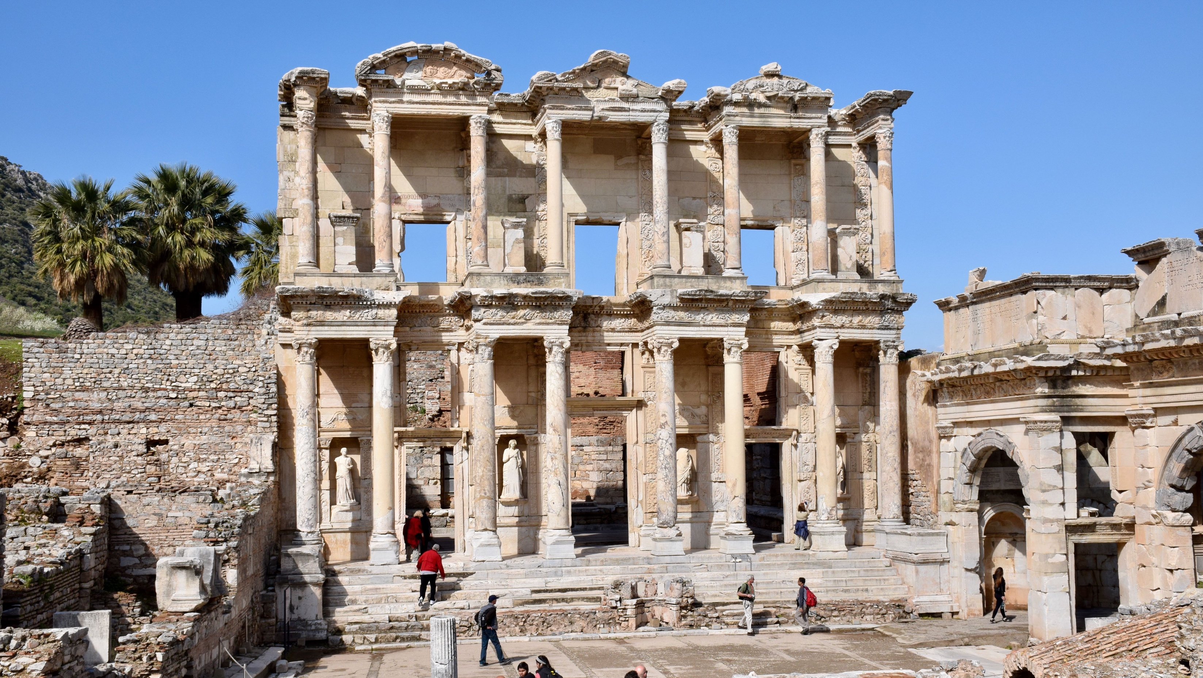
Price Subject to Change after March 28th
Biblical Study Tour: July 1–12, 2024

Slide 3
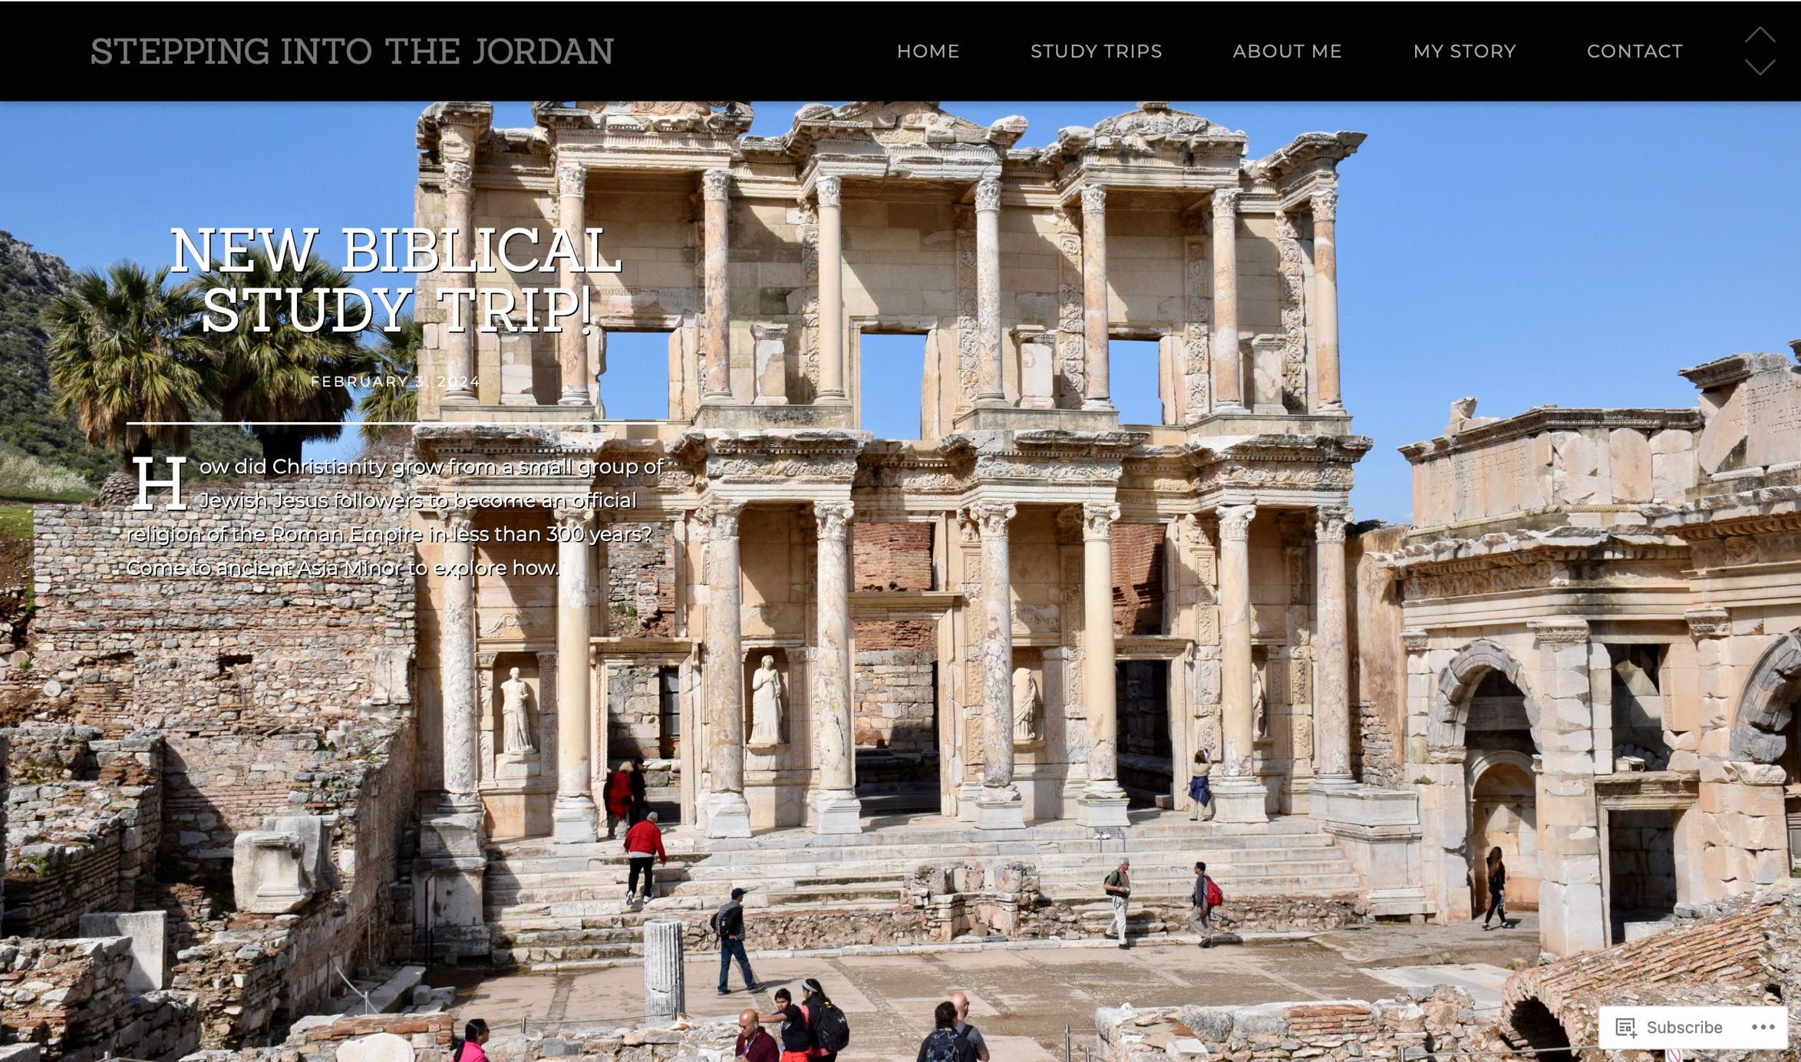
www.SteppingIntoTheJordan.com

Slide 4
Direct Link
https://steppingintothejordan.com/study-trips/

Slide 5
Huldah the Prophet
2 Kings 22
2 Chronicles 34–35

Slide 6
In the eighteenth year of King Josiah, the king sent Shaphan son of Azaliah, son of Meshullam, the secretary, to the house of the LORD, saying, “Go up to the high priest Hilkiah, and have him count the entire sum of the money that has been brought into the house of the LORD, which the keepers of the threshold have collected from the people; let it be given into the hand of the workers who have the oversight of the house of the LORD; let them give it to the workers who are at the house of the LORD, repairing the house, that is, to the carpenters, to the builders, to the masons; and let them use it to buy timber and quarried stone to repair the house. But no accounting shall be asked from them for the money that is delivered into their hand, for they deal honestly.”
2 Kings 22:3–7 (NRSV)

Slide 7
The high priest Hilkiah said to Shaphan the secretary, “I have found the book of the law in the house of the LORD.” When Hilkiah gave the book to Shaphan, he read it. Then Shaphan the secretary came to the king, and reported to the king, “Your servants have emptied out the money that was found in the house, and have delivered it into the hand of the workers who have oversight of the house of the LORD.” Shaphan the secretary informed the king, “The priest Hilkiah has given me a book.” Shaphan then read it aloud to the king.
2 Kings 22:8–10
Does anything strike you as odd here?

Slide 8
When the king heard the words of the book of the law, he tore his clothes. Then the king commanded the priest Hilkiah, Ahikam son of Shaphan, Achbor son of Micaiah, Shaphan the secretary, and the king’s servant Asaiah, saying, “Go, inquire of the LORD for me, for the people, and for all Judah, concerning the words of this book that has been found; for great is the wrath of the LORD that is kindled against us, because our ancestors did not obey the words of this book, to do according to all that is written concerning us.”
2 Kings 22:11–13
What is this “Book of the Law” they found?
What had they been doing without it?

Slide 9
When the king heard the words of the book of the law, he tore his clothes. Then the king commanded the priest Hilkiah, Ahikam son of Shaphan, Achbor son of Micaiah, Shaphan the secretary, and the king’s servant Asaiah, saying, “Go, inquire of the LORD for me, for the people, and for all Judah, concerning the words of this book that has been found; for great is the wrath of the LORD that is kindled against us, because our ancestors did not obey the words of this book, to do according to all that is written concerning us.”
2 Kings 22:11–13
Where would you expect a high priest to go to “inquire of the LORD?”

Slide 10
So the priest Hilkiah, Ahikam, Achbor, Shaphan, and Asaiah went to the prophetess Huldah the wife of Shallum son of Tikvah, son of Harhas, keeper of the wardrobe; she resided in Jerusalem in the Second Quarter, where they consulted her. She declared to them, “Thus says the LORD, the God of Israel: Tell the man who sent you to me, Thus says the LORD, I will indeed bring disaster on this place and on its inhabitants—all the words of the book that the king of Judah has read. Because they have abandoned me and have made offerings to other gods, so that they have provoked me to anger with all the work of their hands, therefore my wrath will be kindled against this place, and it will not be quenched.
2 Kings 22:14–17

Slide 11
“But as to the king of Judah, who sent you to inquire of the LORD, thus shall you say to him, Thus says the LORD, the God of Israel: Regarding the words that you have heard, because your heart was penitent, and you humbled yourself before the LORD, when you heard how I spoke against this place, and against its inhabitants, that they should become a desolation and a curse, and because you have torn your clothes and wept before me, I also have heard you, says the LORD. Therefore, I will gather you to your ancestors, and you shall be gathered to your grave in peace; your eyes shall not see all the disaster that I will bring on this place.” They took the message back to the king.
2 Kings 22:18–20

Slide 12
Who is Huldah?
Prophet
Wife of wife of Shallum son of Tikvah, son of Harhas
Husband was “keeper of the wardrobe.”
She lived in Jerusalem’s “2nd Quarter” (Mishneh).
Possible meanings of her name:
Eternity, world, lifespan
Mole

Slide 13
Who is Huldah?
She is the only female OT prophet designated as a Naviah (prophetess) who also delivers a classic formula oracle.
Is she the royal/court prophet?
The text is unclear.
Notice that Huldah has access to knowledge not available to the king or the High Priest.

Slide 14
Does the text make a big deal about the fact that this prophet is a woman?
No. It is stated as if it were a normal thing.
Do they question her authority as a woman?
Not for a second.

Slide 15
Did Josiah have other prophetic options?
Were there other prophets available to him?
Zephaniah
Nahum
Jeremiah
Huldah is not a prophet of “last resort.” She is the recognized voice of YHWH.

Slide 16
Do you see any similarities between Deborah and Huldah?
How would you compare and contrast them?

Slide 17
“But as to the king of Judah, who sent you to inquire of the LORD, thus shall you say to him, Thus says the LORD, the God of Israel: Regarding the words that you have heard, because your heart was penitent, and you humbled yourself before the LORD, when you heard how I spoke against this place, and against its inhabitants, that they should become a desolation and a curse, and because you have torn your clothes and wept before me, I also have heard you, says the LORD. Therefore, I will gather you to your ancestors, and you shall be gathered to your grave in peace; your eyes shall not see all the disaster that I will bring on this place.” They took the message back to the king.
2 Kings 22:18–20
Does Huldah’s prophecy come true?

Slide 18
Summary
Huldah is the go-to Prophet for Josiah’s court and the High Priest.
There were other (male) prophetic options.
Huldah’s status as a female prophet is never questioned.
Huldah authoritatively conveys the words of YHWH.
In Kings, she is responsible for instigating Josiah’s reforms.

Slide 19
Next Week
Sarah and Hagar
Read Gen 16 and 21

