Slide 1
Being God’s Image
Women and Men in the Kingdom of God

Slide 2
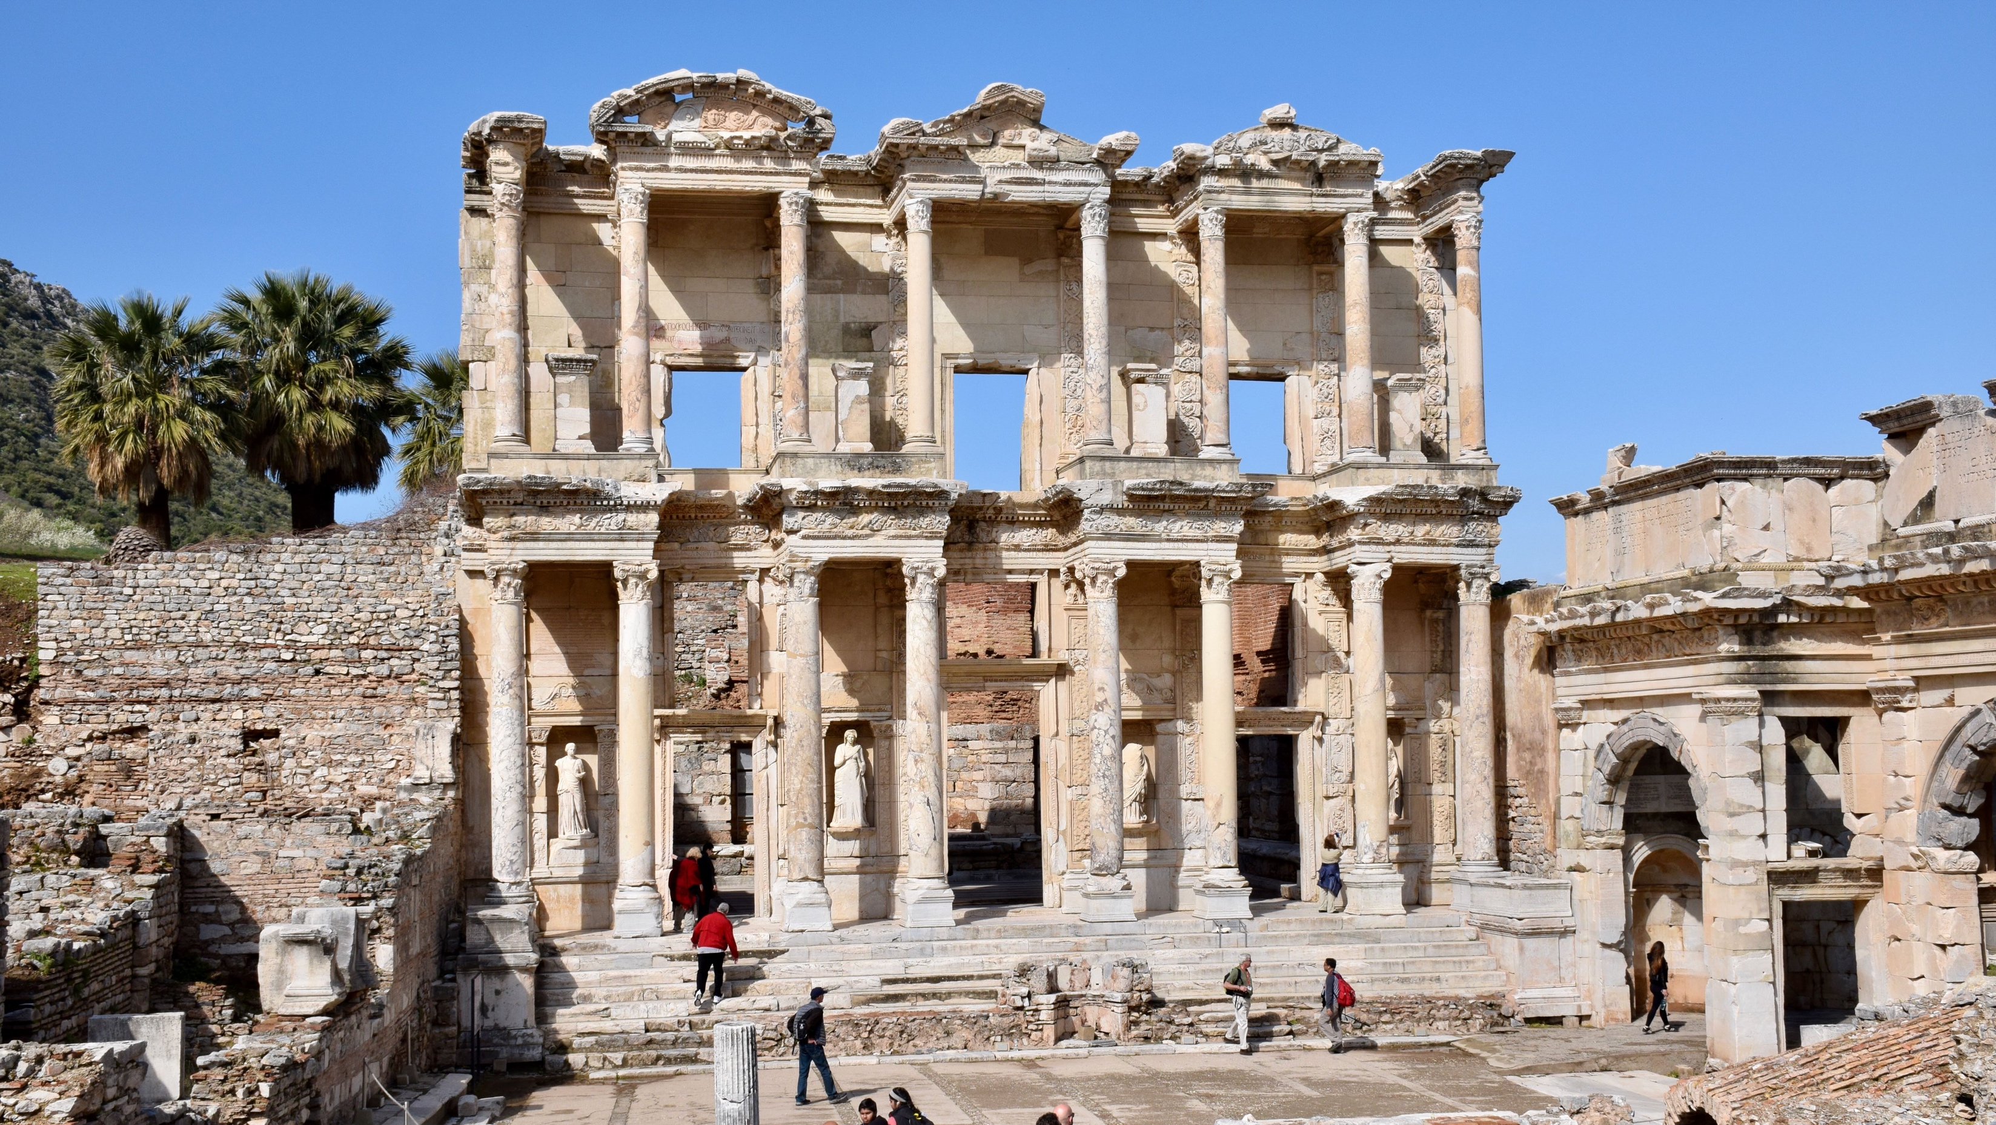
Price Subject to Change after March 28th
Biblical Study Tour: July 1–12, 2024

Slide 3
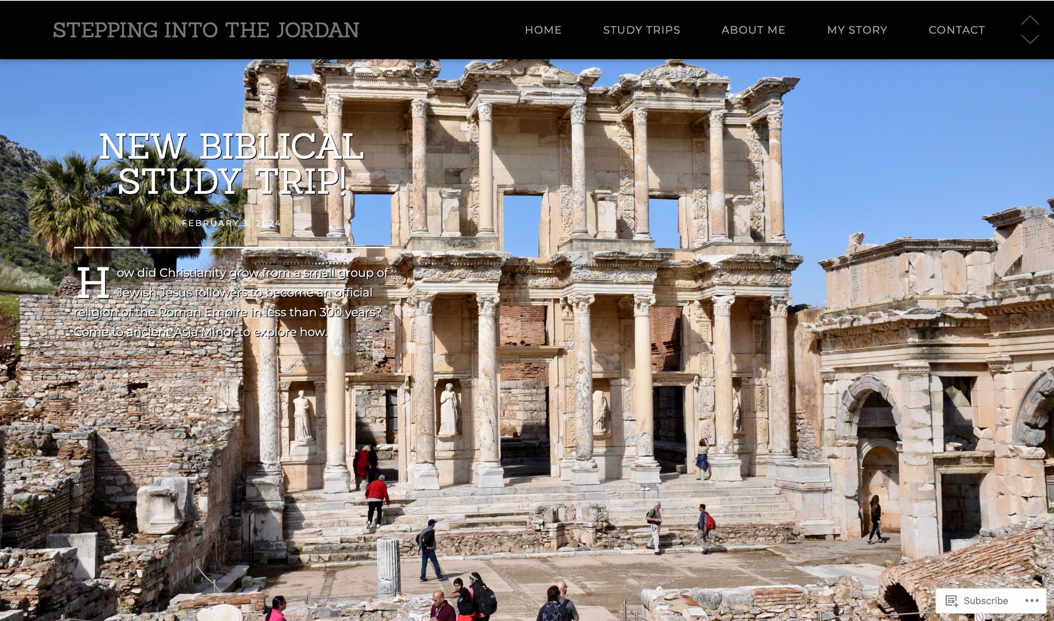
www.SteppingIntoTheJordan.com

Slide 4
Direct Link
https://steppingintothejordan.com/study-trips/

Slide 5
A Brief Review

Slide 6
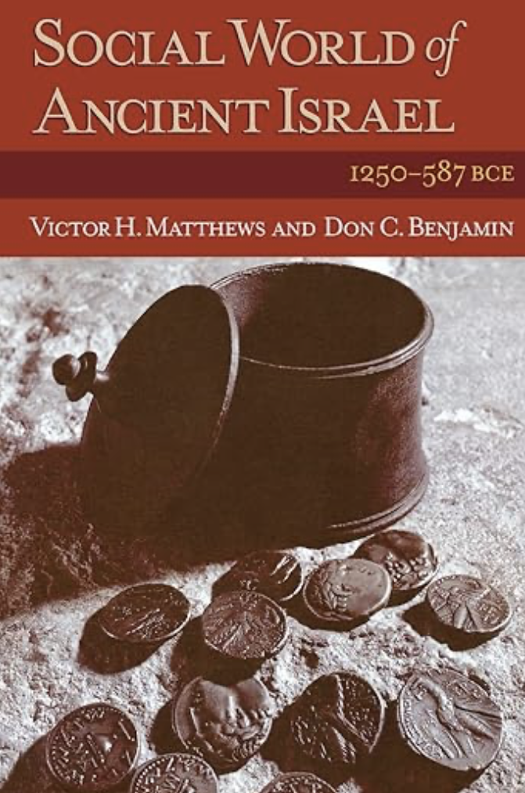
Utilizes Archaeology and Anthropology
Examines key social structures of Israel
Israel as a village society
Israel as a state

Slide 7
Families in the Biblical World
Endogamous – marry within ethnic groups
Patrilineal – descent through male lineage
Patrilocal – bride moves to husband’s family
Polygynous – husbands w/multiple wives
Patriarchal – father is head of household

Slide 8
Patriarchy
A social system
Social order, roles and structure
Patriarchy is not sexism
Sexism: women inferior to men
Historical tendency towards sexist beliefs

Slide 9
The “Beit Av”
Hebrew for “Father’s Household”
Multi-generational family units.
Extended families (3-4 generations)
The patriarch is the senior male by lineage.
Head of the household
Passed down to oldest son.
Oldest son receives a “double portion” of inheritance.

Slide 10
Individual Rights in Ancient World
The social world of the Bible is communal.
Self-identity is secondary to family identity
Identity comes from the Father’s Household (Beit Av)
Life begins at adoption, not birth.
Survival of the family on their land was everyone’s primary concern.
This was “eternal life.”

Slide 11
A Little Biblical History
God delivers Israelites from Egypt
Moses is God’s spokesperson (prophet) and leader
40 years wilderness wandering
Joshua leads Israel into Promised Land
Joshua succeeded by “Judges”
Samuel is the last Judge
Israel asks for a King
Saul, David, Solomon
Kingdom splits between Judah (South) and Israel (North)

Slide 12
A Little Biblical History
God delivers Israelites from Egypt
Moses is God’s spokesperson and leader
40 years wilderness wandering
Joshua leads Israel into Promised Land
Joshua succeeded by “Judges”
Samuel is the last Judge
Israel asks for a King
Saul, David, Solomon
Kingdom splits between Judah (South) and Israel (North)

Slide 13
Repeated Cycle in Judges
Israel begins worshipping other gods.
God raises up an enemy to subdue Israel.
Israel cries out to God.
God raises up a “Judge” to deliver them.
Israel has peace during the life of the “Judge.”
Repeat

Slide 14
Israel’s Social Structure
Agricultural/pastoral economy
Loosely affiliated clans and tribes
Household (Beit Av) is the basic unit.

Slide 15
People
Dynasty
Tribe
Village
Clan
Beit Av
Mishpaha
Kafar
Shebet
Beit XX
Am Yisrael

Slide 16
What is a Judge?
Hebrew: shaphat (שׁפט) = to judge
Book of Judges also calls them “deliverers.”
They rule the people.
Sit above the clan/tribal elders
Settle disputes between tribes/clans
Settle conflicting/complicated disputes
Call tribes to war
“Chieftain” may be a more complete term.

Slide 17
What is the difference
between a king and a judge?
Succession

Slide 18
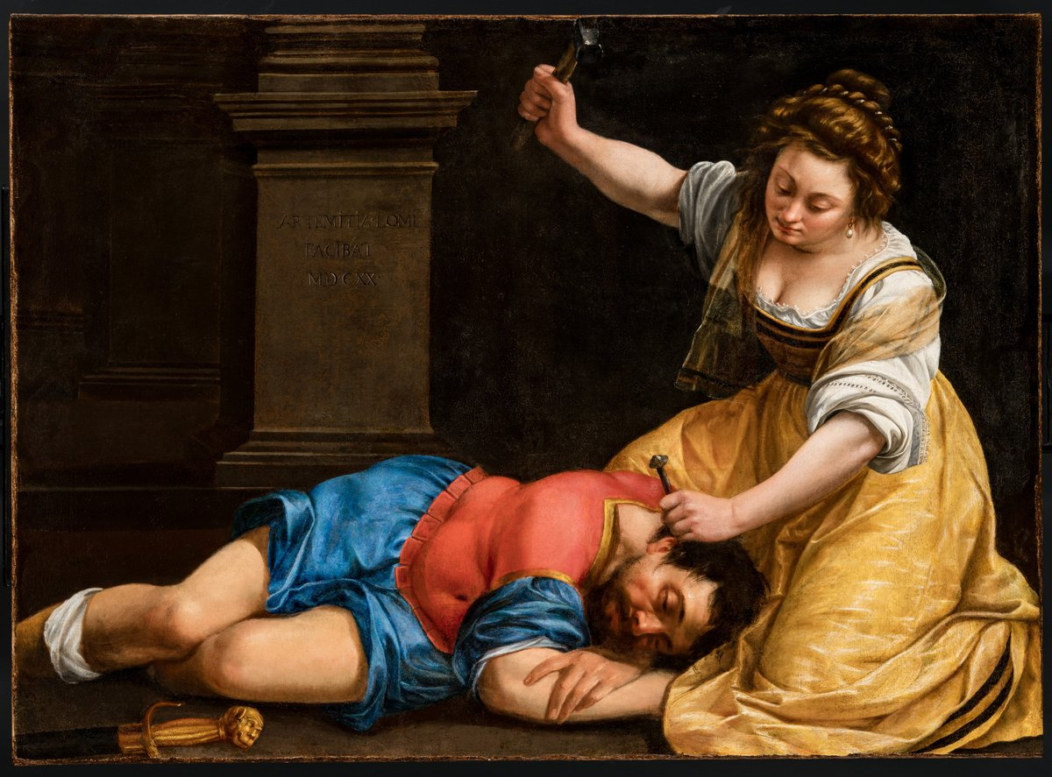
Deborah the Chieftain (and Ja’el) Judges 4–5

Slide 19
The Start of the Cycle
The Israelites again did what was evil in the sight of the LORD, after Ehud died. So the LORD sold them into the hand of King Jabin of Canaan, who reigned in Hazor; the commander of his army was Sisera, who lived in Harosheth-ha-goiim. Then the Israelites cried out to the LORD for help; for he had nine hundred chariots of iron, and had oppressed the Israelites cruelly twenty years.
Judg 4:1–3 (NRSV)

Slide 20
At that time Deborah, a prophetess, wife of Lappidoth, was judging Israel. She used to sit under the palm of Deborah between Ramah and Bethel in the hill country of Ephraim; and the Israelites came up to her for judgment. She sent and summoned Barak son of Abinoam from Kedesh in Naphtali, and said to him, “The LORD, the God of Israel, commands you, ‘Go, take position at Mount Tabor, bringing ten thousand from the tribe of Naphtali and the tribe of Zebulun.’”
Judg 4:4–6
What do we know about Deborah?

Slide 21
Do you see any critique of Deborah
in this passage?

Slide 22
“‘I will draw out Sisera, the general of Jabin’s army, to meet you by the Wadi Kishon with his chariots and his troops; and I will give him into your hand.’” Barak said to her, “If you will go with me, I will go; but if you will not go with me, I will not go.” And she said, “I will surely go with you; nevertheless, the road on which you are going will not lead to your glory, for the LORD will sell Sisera into the hand of a woman.”
Judg 4:7–9
Why does Barak ask Deborah to go?

Slide 23
Barak said to her, “If you will go with me, I will go; but if you will not go with me, I will not go.” And she said, “I will surely go with you…” Judges 4:8-9
The Lord said to Moses, “...Go up to a land flowing with milk and honey; but I will not go up among you, or I would consume you on the way, for you are a stiff-necked people.” … And Moses said to him, “If your presence will not go, do not carry us up from here. For how shall it be known that I have found favor in your sight, I and your people, unless you go with us? Exodus 33:3-16
When the troops came to the camp, the elders of Israel said, “Why has the Lord put us to rout today before the Philistines? Let us bring the ark of the covenant of the Lord here from Shiloh, so that he may come among us and save us from the power of our enemies.” 1 Samuel 4:3

Slide 24
Deborah is a sign of God’s presence.

Slide 25
Now Sisera had fled away on foot to the tent of Jael wife of Heber the Kenite; for there was peace between King Jabin of Hazor and the clan of Heber the Kenite. Jael came out to meet Sisera, and said to him, “Turn aside, my lord, turn aside to me; have no fear.” So he turned aside to her into the tent, and she covered him with a rug. Then he said to her, “Please give me a little water to drink; for I am thirsty.” So she opened a skin of milk and gave him a drink and covered him.
Judg 4:17–19

Slide 26
He said to her, “Stand at the entrance of the tent, and if anybody comes and asks you, ‘Is anyone here?’ say, ‘No.’” But Jael wife of Heber took a tent peg, and took a hammer in her hand, and went softly to him and drove the peg into his temple, until it went down into the ground—he was lying fast asleep from weariness—and he died. Then, as Barak came in pursuit of Sisera, Jael went out to meet him, and said to him, “Come, and I will show you the man whom you are seeking.” So he went into her tent; and there was Sisera lying dead, with the tent peg in his temple.
Judg 4:20–22

Slide 27
There was an alliance between
Heber the Kenite’s clan and King Jabin.
How can Ja’el justify her actions
to her husband and the clan?

Slide 28
Possible Justification
Ja’el saw that Jabin/Sisera were defeated.
The clan was at risk: guilt by association.
The Kenite clan needed a new alliance partner.
Ensuring the survival of the Beit Av and clan is also Ja’el’s responsibility.

Slide 29
And she said, “I will surely go with you; nevertheless, the road on which you are going will not lead to your glory, for the Lord will sell Sisera into the hand of a woman.”
-Judges 4:9
The Lord said, “I will be with you; and this shall be the sign for you that it is I who sent you: when you have brought the people out of Egypt, you shall worship God on this mountain.”
-Exodus 3:12
Thus Ezekiel shall be a sign to you; you shall do just as he has done. When this comes, then you shall know that I am the Lord God.
-Ezekiel 24:24

Slide 30
Ja’el is a sign of God’s faithfulness.

Slide 31
Summary
Deborah’s leadership is never critiqued.
Barak continues to rely on Deborah to relay God’s words.
Ja’el intervenes to protect her clan by ensnaring and killing Sisera. She is praised, not corrected.
“So on that day God subdued Jabin of Canaan before the Israelites…
Then Deborah and Barak son of Abinoam sang on that day….”
-Judges 4:23-5:1
God worked through Deborah, Barak, and Ja’el.
Deborah and Barak celebrated their shared work in delivering Israel, as intended by God.

Slide 32
Next Week
Huldah
Read 2 Kings 22 2 Chron 34–35 (optional)

