Slide 1
Paul’s Worldview
Paul’s misuse of the Old Testament in Romans

Slide 2
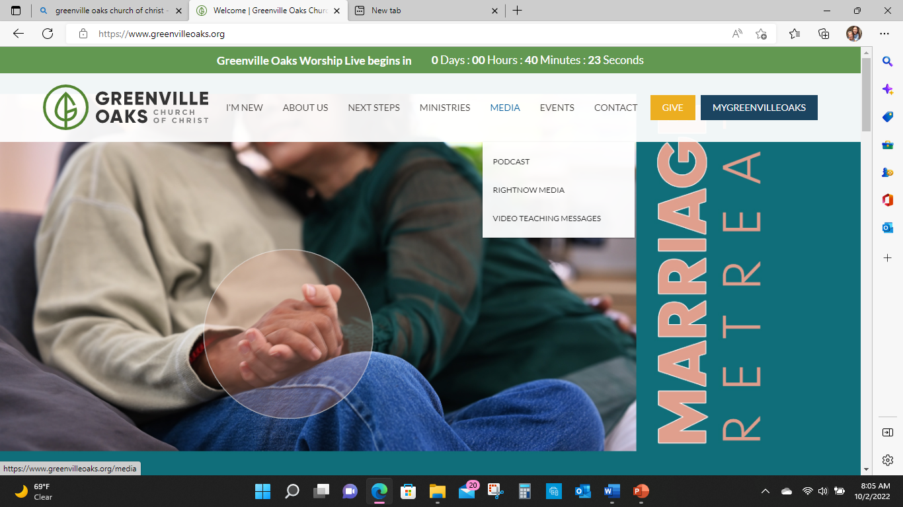

Slide 3
You had ONE job!
Malachi tells Israel that they had 1 job.
Be the rescue plan.
Malachi tells that the rescue plan is going to be shifted to “the messenger”

Slide 4
Romans
Acts 18-20 Priscilla and Aquila exit Rome because Claudius orders all the Jews to leave Rome
AD 49-53
Suetonius Roman Historian
“since the Jews were continually making disturbances at the instigations of Chrestus, Claudius expelled them from Rome”

Slide 5
Acts 18
After this, Paul left Athens and went to Corinth. ² There he met a Jew named Aquila, a native of Pontus, who had recently come from Italy with his wife Priscilla, because Claudius had ordered all Jews to leave Rome

Slide 6
Acts 18
Paul went to see them, ³ and because he was a tentmaker as they were, he stayed and worked with them. ⁴ Every Sabbath he reasoned in the synagogue, trying to persuade Jews and Greeks.

Slide 7
Acts 18
⁵ When Silas and Timothy came from Macedonia, Paul devoted himself exclusively to preaching, testifying to the Jews that Jesus was the Messiah.

Slide 8
Acts 18
⁶ But when they opposed Paul and became abusive, he shook out his clothes in protest and said to them, “Your blood be on your own heads! I am innocent of it. From now on I will go to the Gentiles.”
⁷ Then Paul left the synagogue and went next door to the house of Titius Justus, a worshiper of God.

Slide 9
Paul’s tension in Romans
Faith/faithfulness
Torah keeping (as a merit-based salvation)

Slide 10
Romans 1
Paul, a servant of Christ Jesus, called to be an apostle, set apart to share
the gospel of God, which he promised beforehand through his prophets in the holy Scriptures,
concerning his Son, who was descended from David according to the flesh

Slide 11
(Jesus) was declared to be the Son of God, in power, according (by way of) to the Spirit of holiness by his resurrection from the dead, Jesus Christ our Lord,

Slide 12
⁵ through whom we have received grace and apostleship to bring about the obedience of faith for the sake of his name among all the nations, ⁶ including you who are called to belong to Jesus Christ,

Slide 13
received grace and apostleship to bring about the obedience of faith
Obedience/Faith/Faithfullness in the Abrahamic covenant (jewish)
Grace to bring about obedience to Jesus the messiah
In order to be in covenant with Yahweh, you have to be in relationship with Jesus

Slide 14
¹⁶ For I am not ashamed of the gospel, for it is the power of God for salvation to everyone who believes, to the Jew first and also to the Greek.
¹⁷ For in it the righteousness of God is revealed from faith for faith, (beginning to end as faith)
as it is written, “The righteous shall live by faith.”
Faith is more than the mental awareness/agreement
Surface level “faith”

Slide 15
Habakkuk 2:4
Hebrew- But the righteous shall live by “his” faithfulness (human/believer)
The righteous shall live because of the believer's loyalty to Yahweh.

Slide 16
Habakkuk 2:4
Greek- But the righteous shall live by “my” faith/ faithfulness (Yahweh)
The righteous shall live because of Yahweh’s faithfulness.
Paul - “The righteous shall live by faith.”

Slide 17
Habakkuk 2:4 )
Context of Habakkuk is that Yahweh is telling Habakkuk to be patient and have faith in Yahwehs faithfulness and doing what Yahweh said he would do in punishing the Babylonians
Because Yahweh is faithful, we can trust have faith in him.

Slide 18
Paul’s Use )
Paul reconfigures the Habakkuk passage in that we are seeing Yahweh’s faithfulness in the Christ event.
Paul also shows that the believer can have faith in the Christ event because of the faithfulness of Yahweh.

Slide 19
Habakkuk )
Torah keeping is paralyzed, and we never get justice: meaning that we show our loyalty to the Yahweh covenant by keeping and practicing Torah
For Paul- faithfulness and loyalty is no longer wrapped around us keeping the Torah (circumcision, sabbath, sacrifice, food)
Faithfulness is wrapped in Jesus, a person,

Slide 20
)
Malachi says that Israel's calling, vocation, election, salvation to the nations has been transitioned to this messenger…. Paul then interprets what Malachi says and assigns the messenger as Jesus.
Paul also shows that both things are working….

Slide 21
)
Yahweh is faithful to his promise, even though Israel failed, through a particular person, seed, son of man, king, offspring, messiah.
We can be faithful because Yahweh is faithful,
Paul reads the OT through a Christ lens and messianic profile.

Slide 22
Romans 1 - Habakkuk 2:4 )
Because Yahweh is faithful, we can trust have faith in him.
Faith that Spirit is working to accomplish the plan of re-claiming all nations and that all people will be saved.

