Slide 1
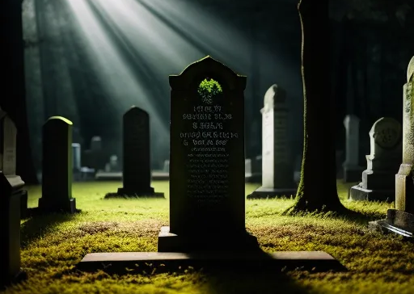
So You’re Dead, Now What?
A biblical study of death and afterlife and how they impact our lives now

Slide 2
1 + 1 = 10
GIFT

Slide 3
“Gift” (German) = “Poison” (English)
1 + 1 = 10
GIFT

Slide 4
1 + 1 = 10
1 + 1 = 10

Slide 5
1 + 1 = 10
1 + 1 = 10
1, 10, 11, 100, 101, 110, 1000

Slide 6
Reconstruction
(Reorientation)
Construction
(Orientation)
Deconstruction
(Disorientation)

Slide 7
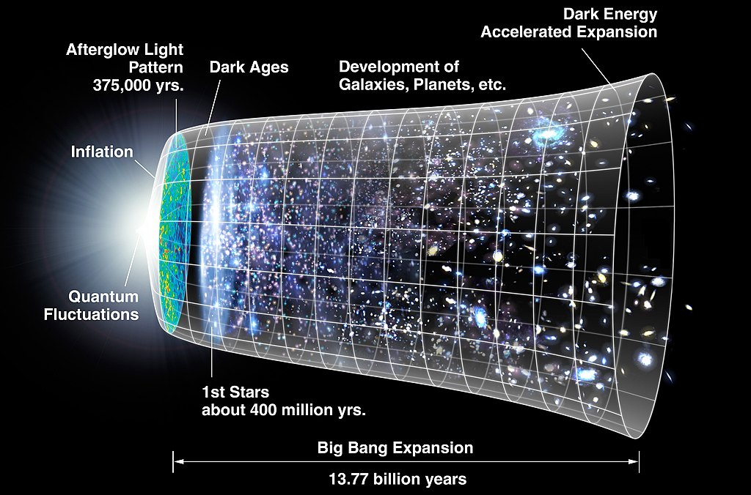
“What existed before the Big Bang?”

Slide 8
“What existed before the Big Bang?”

Slide 9
Reconstruction
(Reorientation)
Construction
(Orientation)
Deconstruction
(Disorientation)

Slide 10
Creation Stories
Genesis 1:1 - 2:3
2:4 - 25 Part 1
3:1 - 24 Part 2
A biblical study of death and afterlife and how they impact our lives now

Slide 11
1:1 In the beginning God created the heavens and the earth.
2 Now the earth was formless and empty, darkness was over the surface of the deep, and the Spirit of God was hovering over the waters.
3 And God said, “Let there be light,” and there was light. 4 God saw that the light was good, and he separated the light from the darkness. 5 God called the light “day,” and the darkness he called “night.” And there was evening, and there was morning—the first day.
A biblical study of death and afterlife and how they impact our lives now

Slide 12
6 And God said, “Let there be a vault between the waters to separate water from water.” 7 So God made the vault and separated the water under the vault from the water above it. And it was so. 8 God called the vault “sky.” And there was evening, and there was morning—the second day.
9 And God said, “Let the water under the sky be gathered to one place, and let dry ground appear.” And it was so. 10 God called the dry ground “land,” and the gathered waters he called “seas.” And God saw that it was good.
A biblical study of death and afterlife and how they impact our lives now

Slide 13
11 Then God said, “Let the land produce vegetation: seed-bearing plants and trees on the land that bear fruit with seed in it, according to their various kinds.” And it was so. 12 The land produced vegetation: plants bearing seed according to their kinds and trees bearing fruit with seed in it according to their kinds. And God saw that it was good. 13 And there was evening, and there was morning—the third day.
A biblical study of death and afterlife and how they impact our lives now

Slide 14
14 And God said, “Let there be lights in the vault of the sky to separate the day from the night, and let them serve as signs to mark sacred times, and days and years, 15 and let them be lights in the vault of the sky to give light on the earth.” And it was so. 16 God made two great lights—the greater light to govern the day and the lesser light to govern the night. He also made the stars. 17 God set them in the vault of the sky to give light on the earth, 18 to govern the day and the night, and to separate light from darkness. And God saw that it was good. 19 And there was evening, and there was morning—the fourth day.
A biblical study of death and afterlife and how they impact our lives now

Slide 15
20 And God said, “Let the water teem with living creatures, and let birds fly above the earth across the vault of the sky.” 21 So God created the great creatures of the sea and every living thing with which the water teems and that moves about in it, according to their kinds, and every winged bird according to its kind. And God saw that it was good. 22 God blessed them and said, “Be fruitful and increase in number and fill the water in the seas, and let the birds increase on the earth.” 23 And there was evening, and there was morning—the fifth day.
A biblical study of death and afterlife and how they impact our lives now

Slide 16
24 And God said, “Let the land produce living creatures according to their kinds: the livestock, the creatures that move along the ground, and the wild animals, each according to its kind.” And it was so. 25 God made the wild animals according to their kinds, the livestock according to their kinds, and all the creatures that move along the ground according to their kinds. And God saw that it was good.
A biblical study of death and afterlife and how they impact our lives now

Slide 17
26 Then God said, “Let us make mankind in our image, in our likeness, so that they may rule over the fish in the sea and the birds in the sky, over the livestock and all the wild animals, and over all the creatures that move along the ground.”
27 So God created mankind in his own image,
in the image of God he created them;
male and female he created them.
A biblical study of death and afterlife and how they impact our lives now

Slide 18
28 God blessed them and said to them, “Be fruitful and increase in number; fill the earth and subdue it. Rule over the fish in the sea and the birds in the sky and over every living creature that moves on the ground.”
29 Then God said, “I give you every seed-bearing plant on the face of the whole earth and every tree that has fruit with seed in it. They will be yours for food. 30 And to all the beasts of the earth and all the birds in the sky and all the creatures that move along the ground—everything that has the breath of life in it—I give every green plant for food.” And it was so.
A biblical study of death and afterlife and how they impact our lives now

Slide 19
31 God saw all that he had made, and it was very good. And there was evening, and there was morning—the sixth day.
2:1 Thus the heavens and the earth were completed in all their vast array.
2 By the seventh day God had finished the work he had been doing; so on the seventh day he rested from all his work. 3 Then God blessed the seventh day and made it holy, because on it he rested from all the work of creating that he had done.
A biblical study of death and afterlife and how they impact our lives now

Slide 20
2:4 This is the account of the heavens and the earth when they were created, when the Lord God made the earth and the heavens.
5 Now no shrub had yet appeared on the earth and no plant had yet sprung up, for the Lord God had not sent rain on the earth and there was no one to work the ground, 6 but streams came up from the earth and watered the whole surface of the ground. 7 Then the Lord God formed a man from the dust of the ground and breathed into his nostrils the breath of life, and the man became a living being.
A biblical study of death and afterlife and how they impact our lives now

Slide 21
8 Now the Lord God had planted a garden in the east, in Eden; and there he put the man he had formed. 9 The Lord God made all kinds of trees grow out of the ground—trees that were pleasing to the eye and good for food. In the middle of the garden were the tree of life and the tree of the knowledge of good and evil.
10 A river watering the garden flowed from Eden; from there it was separated into four headwaters. 11 The name of the first is the Pishon; it winds through the entire land of Havilah, where there is gold.
A biblical study of death and afterlife and how they impact our lives now

Slide 22
2:12 (The gold of that land is good; aromatic resin and onyx are also there.) 13 The name of the second river is the Gihon; it winds through the entire land of Cush. 14 The name of the third river is the Tigris; it runs along the east side of Ashur. And the fourth river is the Euphrates.
15 The Lord God took the man and put him in the Garden of Eden to work it and take care of it. 16 And the Lord God commanded the man, “You are free to eat from any tree in the garden; 17 but you must not eat from the tree of the knowledge of good and evil, for when you eat from it you will certainly die.”
A biblical study of death and afterlife and how they impact our lives now

Slide 23
18 The Lord God said, “It is not good for the man to be alone. I will make a helper suitable for him.”
19 Now the Lord God had formed out of the ground all the wild animals and all the birds in the sky. He brought them to the man to see what he would name them; and whatever the man called each living creature, that was its name. 20 So the man gave names to all the livestock, the birds in the sky and all the wild animals.
A biblical study of death and afterlife and how they impact our lives now

Slide 24
But for Adam no suitable helper was found. 21 So the Lord God caused the man to fall into a deep sleep; and while he was sleeping, he took one of the man’s ribs and then closed up the place with flesh. 22 Then the Lord God made a woman from the rib he had taken out of the man, and he brought her to the man.
A biblical study of death and afterlife and how they impact our lives now

Slide 25
23 The man said,
“This is now bone of my bones
and flesh of my flesh;
she shall be called ‘woman,’
for she was taken out of man.”
24 That is why a man leaves his father and mother and is united to his wife, and they become one flesh.
25 Adam and his wife were both naked, and they felt no shame.
A biblical study of death and afterlife and how they impact our lives now

Slide 26
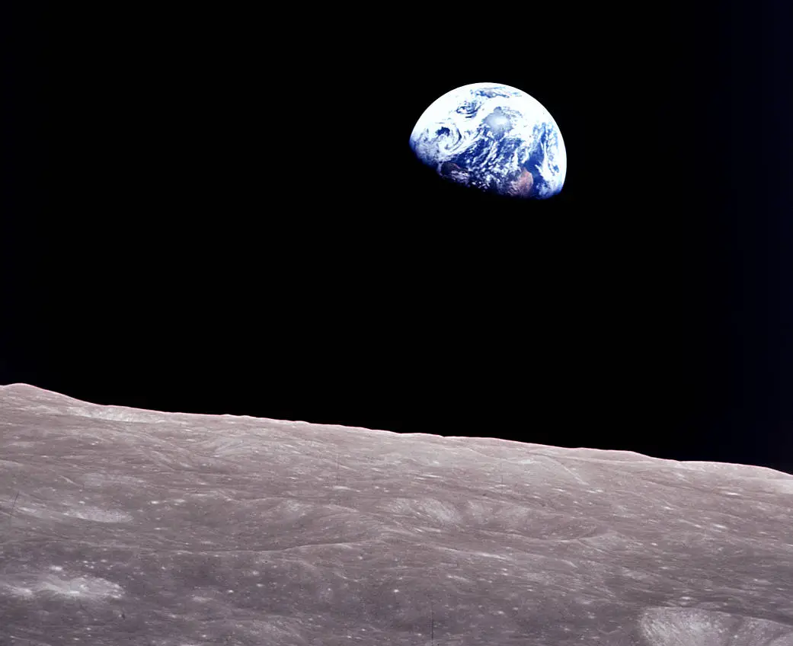

Slide 27
The Present Age
The Age to Come
Continuity
Discontinuity
Transformation

Slide 28
Genesis 1-2
“Present”
Future
Continuity

Slide 29
Key Point:
In Genesis 1-2, God’s vision for man did not involve man living on earth temporarily and then later going away to another place called “heaven.” The vision was for man to live on earth forever in relationship with God, take care of the earth, and live in harmony with others.

Slide 30
3:1 Now the serpent was more crafty than any of the wild animals the Lord God had made. He said to the woman, “Did God really say, ‘You must not eat from any tree in the garden’?”
2 The woman said to the serpent, “We may eat fruit from the trees in the garden, 3 but God did say, ‘You must not eat fruit from the tree that is in the middle of the garden, and you must not touch it, or you will die.’”
A biblical study of death and afterlife and how they impact our lives now

Slide 31
4 “You will not certainly die,” the serpent said to the woman. 5 “For God knows that when you eat from it your eyes will be opened, and you will be like God, knowing good and evil.”
6 When the woman saw that the fruit of the tree was good for food and pleasing to the eye, and also desirable for gaining wisdom, she took some and ate it. She also gave some to her husband, who was with her, and he ate it. 7 Then the eyes of both of them were opened, and they realized they were naked;
A biblical study of death and afterlife and how they impact our lives now

Slide 32
so they sewed fig leaves together and made coverings for themselves.
8 Then the man and his wife heard the sound of the Lord God as he was walking in the garden in the cool of the day, and they hid from the Lord God among the trees of the garden. 9 But the Lord God called to the man, “Where are you?”
10 He answered, “I heard you in the garden, and I was afraid because I was naked; so I hid.”
A biblical study of death and afterlife and how they impact our lives now

Slide 33
11 And he said, “Who told you that you were naked? Have you eaten from the tree that I commanded you not to eat from?”
12 The man said, “The woman you put here with me—she gave me some fruit from the tree, and I ate it.”
13 Then the Lord God said to the woman, “What is this you have done?”
The woman said, “The serpent deceived me, and I ate.”
A biblical study of death and afterlife and how they impact our lives now

Slide 34
14 So the Lord God said to the serpent, “Because you have done this,
“Cursed are you above all livestock
and all wild animals!
You will crawl on your belly
and you will eat dust
all the days of your life.
A biblical study of death and afterlife and how they impact our lives now

Slide 35
15 And I will put enmity
between you and the woman,
and between your offspring and hers;
he will crush your head,
and you will strike his heel.”
16 To the woman he said,
“I will make your pains in childbearing very severe;
with painful labor you will give birth to children.
Your desire will be for your husband,
and he will rule over you.”
A biblical study of death and afterlife and how they impact our lives now

Slide 36
17 To Adam he said, “Because you listened to your wife and ate fruit from the tree about which I commanded you, ‘You must not eat from it,’
“Cursed is the ground because of you;
through painful toil you will eat food from it
all the days of your life.
18 It will produce thorns and thistles for you,
and you will eat the plants of the field.
A biblical study of death and afterlife and how they impact our lives now

Slide 37
19 By the sweat of your brow
you will eat your food
until you return to the ground,
since from it you were taken;
for dust you are
and to dust you will return.”
20 Adam named his wife Eve, because she would become the mother of all the living.
A biblical study of death and afterlife and how they impact our lives now

Slide 38
21 The Lord God made garments of skin for Adam and his wife and clothed them. 22 And the Lord God said, “The man has now become like one of us, knowing good and evil. He must not be allowed to reach out his hand and take also from the tree of life and eat, and live forever.” 23 So the Lord God banished him from the Garden of Eden to work the ground from which he had been taken. 24 After he drove the man out, he placed on the east side of the Garden of Eden cherubim and a flaming sword flashing back and forth to guard the way to the tree of life.
A biblical study of death and afterlife and how they impact our lives now

Slide 39
x × ∞ = ∞

Slide 40
Key Point:
You only want man living forever if you first solve the sin problem. Rid them of the power of sin that leads them to do sinful behavior.

Slide 41
So You’re Dead, Now What?
A biblical study of death and afterlife and how they impact our lives now

