Slide 1
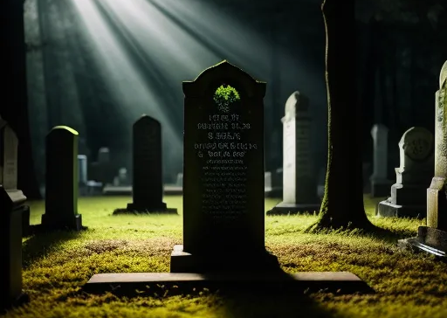
So You’re Dead, Now What?
A biblical study of death and afterlife and how they impact our lives now

Slide 2
Reconstruction
(Reorientation)
Construction
(Orientation)
Deconstruction
(Disorientation)

Slide 3
Is man mortal or immortal?
Are some parts mortal and other parts immortal?

Slide 4
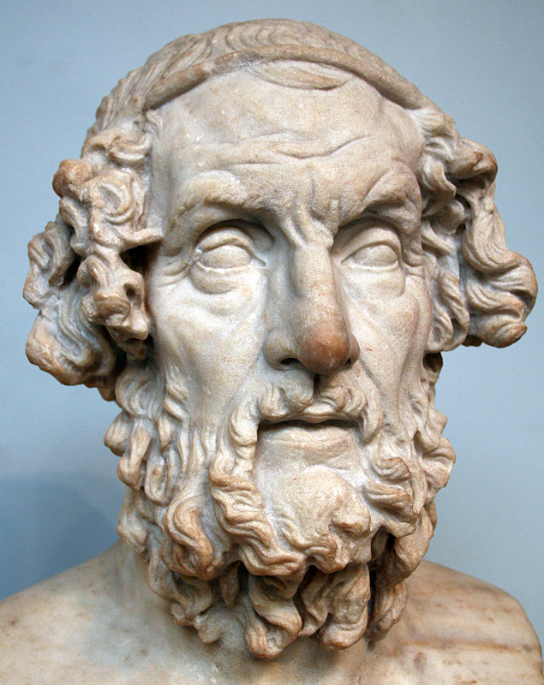
Homer
8th century B.C.

Slide 5
Homer
Life
Death
Body (part of self)
Soul (part of self)

Slide 6
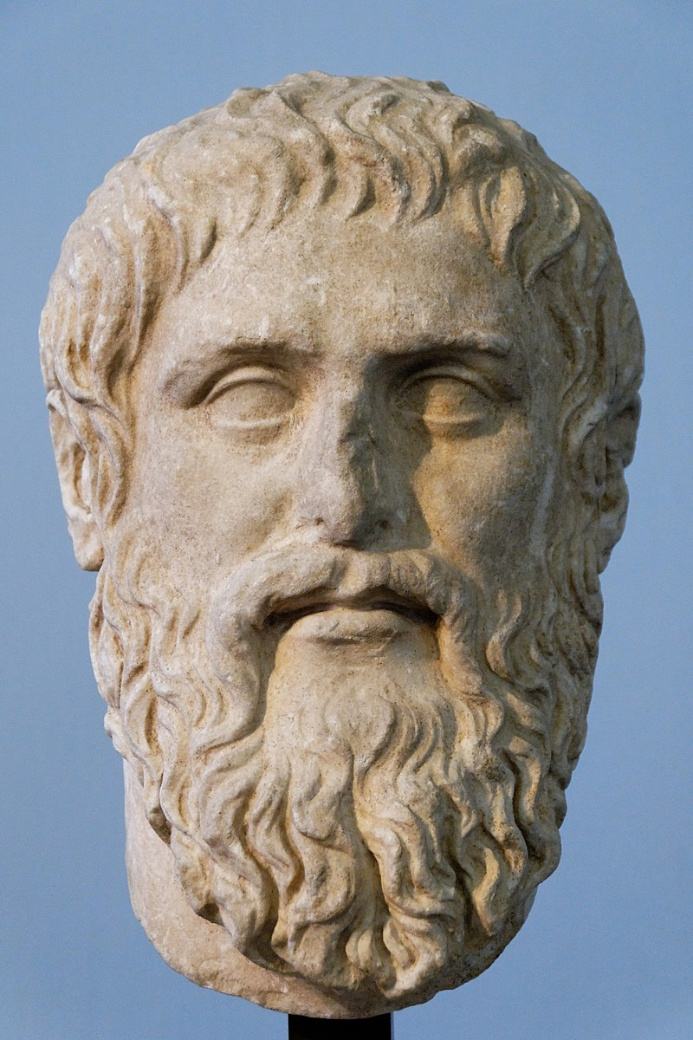
Plato
427-348 B.C.

Slide 7
“Who were the dead, for Plato? They were souls who had been released from their temporary embodiment. Where were they? In Hades, but a very different Hades, and for many a much pleasanter one, than the Homeric version. What was wrong? Nothing; this was a far better place and condition for them to be. Of course, wicked souls were being punished, but that, though unpleasant for them, was not a bad thing, since it represented the triumph of justice at last. No further ‘solution’ was necessary.” (The Resurrection of the Son of God, N.T. Wright, p. 52)

Slide 8
Plato
Life
Death
Body (shell)
Soul (real self)

Slide 9
The Lord said, “What have you done? Listen! Your brother’s blood cries out to me from the ground. Now you are under a curse and driven from the ground, which opened its mouth to receive your brother’s blood from your hand. When you work the ground, it will no longer yield its crops for you. You will be a restless wanderer on the earth.”
Genesis 4:10-12
A biblical study of death and afterlife and how they impact our lives now

Slide 10
When Adam had lived 130 years, he had a son in his own likeness, in his own image; and he named him Seth. After Seth was born, Adam lived 800 years and had other sons and daughters. Altogether, Adam lived a total of 930 years, and then he died.
Genesis 5:3-5
A biblical study of death and afterlife and how they impact our lives now

Slide 11
“You, however, will go to your ancestors in peace and be buried at a good old age.”
Genesis 15:15
A biblical study of death and afterlife and how they impact our lives now

Slide 12
Abraham lived a hundred and seventy-five years. Then Abraham breathed his last and died at a good old age, an old man and full of years; and he was gathered to his people.
Genesis 25:7-8
A biblical study of death and afterlife and how they impact our lives now

Slide 13
So Jacob tore his clothes, and put sackcloth on his loins and mourned for his son many days. Then all his sons and all his daughters arose to comfort him, but he refused to be comforted. And he said, “Surely I will go down to Sheol in mourning for my son.” So his father wept for him.
Genesis 37:34-35
A biblical study of death and afterlife and how they impact our lives now

Slide 14
Turn, O Lord, save my life;
deliver me for the sake of your steadfast love.
For in death there is no remembrance of you;
in Sheol who can give you praise?
Psalm 6:4-5
A biblical study of death and afterlife and how they impact our lives now

Slide 15
For my soul is full of troubles,
and my life draws near to Sheol.
I am counted among those who go down to the Pit;
I am like those who have no help,
like those forsaken among the dead,
like the slain that lie in the grave,
like those whom you remember no more,
for they are cut off from your hand.
Psalm 88:3-5
Do you work wonders for the dead?
Do the shades rise up to praise you? Selah
11 Is your steadfast love declared in the grave
or your faithfulness in Abaddon?
12 Are your wonders known in the darkness
or your saving help in the land of forgetfulness?
A biblical study of death and afterlife and how they impact our lives now

Slide 16
Do you work wonders for the dead?
Do the shades rise up to praise you?
Is your steadfast love declared in the grave
or your faithfulness in Abaddon?
Are your wonders known in the darkness
or your saving help in the land of forgetfulness?
Psalm 88:10-12
A biblical study of death and afterlife and how they impact our lives now

Slide 17
The highest heavens belong to the Lord,
but the earth he has given to mankind.
It is not the dead who praise the Lord,
those who go down to the place of silence;
it is we who extol the Lord,
both now and forevermore.
Psalm 115:16-18
A biblical study of death and afterlife and how they impact our lives now

Slide 18
For the grave (Sheol) cannot praise you,
death cannot sing your praise;
those who go down to the pit
cannot hope for your faithfulness.
The living, the living—they praise you,
as I am doing today;
parents tell their children
about your faithfulness.
Isaiah 38:17-20
A biblical study of death and afterlife and how they impact our lives now

Slide 19
Surely it was for my benefit
that I suffered such anguish.
In your love you kept me
from the pit of destruction;
you have put all my sins
behind your back.
Isaiah 38:17-20
A biblical study of death and afterlife and how they impact our lives now

Slide 20
And Samuel said to Saul, “Why have you disturbed me by bringing me up?”
Furthermore, the Lord will also hand Israel along with you over to the Philistines; so tomorrow you and your sons will be with me. Indeed, the Lord will hand the army of Israel over to the Philistines!”
1 Samuel 28:18-19
A biblical study of death and afterlife and how they impact our lives now

Slide 21
Go, eat your food with gladness, and drink your wine with a joyful heart, for God has already approved what you do. Always be clothed in white, and always anoint your head with oil. Enjoy life with your wife, whom you love, all the days of this meaningless life that God has given you under the sun—all your meaningless days. For this is your lot in life and in your toilsome labor under the sun. Whatever your hand finds to do, do it with all your might, for in the realm of the dead (Sheol-NRSV), where you are going, there is neither working nor planning nor knowledge nor wisdom.
Ecclesiates 9:7-10
A biblical study of death and afterlife and how they impact our lives now

Slide 22
These are the commands, decrees and laws the Lord your God directed me to teach you to observe in the land that you are crossing the Jordan to possess, 2 so that you, your children and their children after them may fear the Lord your God as long as you live by keeping all his decrees and commands that I give you, and so that you may enjoy long life. 3 Hear, Israel, and be careful to obey so that it may go well with you and that you may increase greatly in a land flowing with milk and honey, just as the Lord, the God of your ancestors, promised you.
Deut 6:1-3
A biblical study of death and afterlife and how they impact our lives now

Slide 23
26 See, I am setting before you today a blessing and a curse— 27 the blessing if you obey the commands of the Lord your God that I am giving you today; 28 the curse if you disobey the commands of the Lord your God and turn from the way that I command you today by following other gods, which you have not known.
Deut 11:26-28
A biblical study of death and afterlife and how they impact our lives now

Slide 24
Key Point: The Israelites obeyed God not for reward in the next life, there is no next life. They obeyed God so their lives would be good in this life, the only life.

Slide 25
13 I saw that wisdom is better than folly,
just as light is better than darkness.
14 The wise have eyes in their heads,
while the fool walks in the darkness;
but I came to realize
that the same fate overtakes them both.
Ecclesiastes 2:13-14
A biblical study of death and afterlife and how they impact our lives now

Slide 26
18 I also said to myself, “As for humans, God tests them so that they may see that they are like the animals. 19 Surely the fate of human beings is like that of the animals; the same fate awaits them both: As one dies, so dies the other. All have the same breath^{[spirit]}; humans have no advantage over animals. Everything is meaningless. 20 All go to the same place; all come from dust, and to dust all return. 21 Who knows if the human spirit rises upward and if the spirit of the animal goes down into the earth?”
Ecclesiastes 3:18-21
A biblical study of death and afterlife and how they impact our lives now

Slide 27
3 A man may have a hundred children and live many years; yet no matter how long he lives, if he cannot enjoy his prosperity and does not receive proper burial, I say that a stillborn child is better off than he. 4 It comes without meaning, it departs in darkness, and in darkness its name is shrouded. 5 Though it never saw the sun or knew anything, it has more rest than does that man— 6 even if he lives a thousand years twice over but fails to enjoy his prosperity. Do not all go to the same place?
Ecclesiastes 6:3-6
A biblical study of death and afterlife and how they impact our lives now

Slide 28
Homer / Ancient Israelites
Life
Death
Body (part of self)
“Soul” (part of self)

Slide 29
Reconstruction
(Reorientation)
Construction
(Orientation)
Deconstruction
(Disorientation)

Slide 30
So You’re Dead, Now What?
A biblical study of death and afterlife and how they impact our lives now

