Slide 1
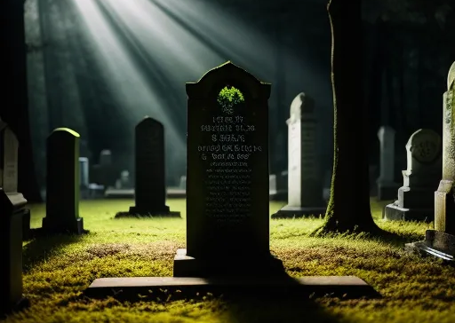
So You’re Dead, Now What?
A biblical study of death and afterlife and how they impact our lives now

Slide 2
Reconstruction
(Reorientation)
Construction
(Orientation)
Deconstruction
(Disorientation)

Slide 3
Position A
Position B

Slide 4
19 “Do not store up for yourselves treasures on earth, where moths and vermin destroy, and where thieves break in and steal. 20 But store up for yourselves treasures in heaven, where moths and vermin do not destroy, and where thieves do not break in and steal. 21 For where your treasure is, there your heart will be also.
22 “The eye is the lamp of the body. If your eyes are healthy,[c] your whole body will be full of light. 23 But if your eyes are unhealthy,[d] your whole body will be full of darkness. If then the light within you is darkness, how great is that darkness!
Matthew 6
A biblical study of death and afterlife and how they impact our lives now

Slide 5
24 “No one can serve two masters. Either you will hate the one and love the other, or you will be devoted to the one and despise the other. You cannot serve both God and money.
Matthew 6
A biblical study of death and afterlife and how they impact our lives now

Slide 6
10 By the grace God has given me, I laid a foundation as a wise builder, and someone else is building on it. But each one should build with care. 11 For no one can lay any foundation other than the one already laid, which is Jesus Christ. 12 If anyone builds on this foundation using gold, silver, costly stones, wood, hay or straw, 13 their work will be shown for what it is, because the Day will bring it to light. It will be revealed with fire, and the fire will test the quality of each person’s work. 14 If what has been built survives, the builder will receive a reward. 15 If it is burned up, the builder will suffer loss but yet will be saved—even though only as one escaping through the flames.
1 Corinthians 3
A biblical study of death and afterlife and how they impact our lives now

Slide 7
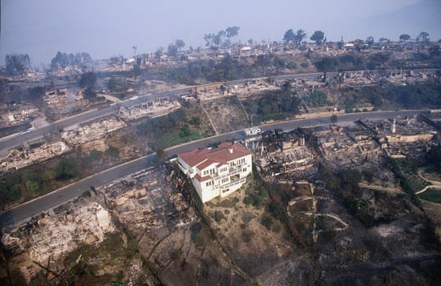
A biblical study of death and afterlife and how they impact our lives now

Slide 8
God Redeems His Creation
Genesis 1-2
Eden
Genesis 3-Revelation 20
Present Age
Revelation 21-22
Age to Come
Good
Good
Perfect
Sin & Death

Slide 9
Reconstruction
(Reorientation)
Construction
(Orientation)
Deconstruction
(Disorientation)

Slide 10
So You’re Dead, Now What?
A biblical study of death and afterlife and how they impact our lives now

