Slide 1
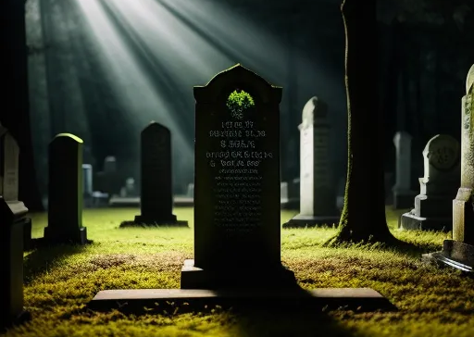
So You’re Dead, Now What?
A biblical study of death and afterlife and how they impact our lives now

Slide 3
So You’re Dead, Now What?
A biblical study of death and afterlife and how they impact our lives now

Slide 5
The Present Age
The Age to Come
Continuity
Transformation
Discontinuity

Slide 6
Calculus
Trigonometry
Geometry
Algebra
Arithmetic
Numerals

Slide 7
Reconstruction
(Reorientation)
Construction
(Orientation)
Deconstruction
(Disorientation)

Slide 8
So You’re Dead, Now What?
A biblical study of death and afterlife and how they impact our lives now

